Slide 2
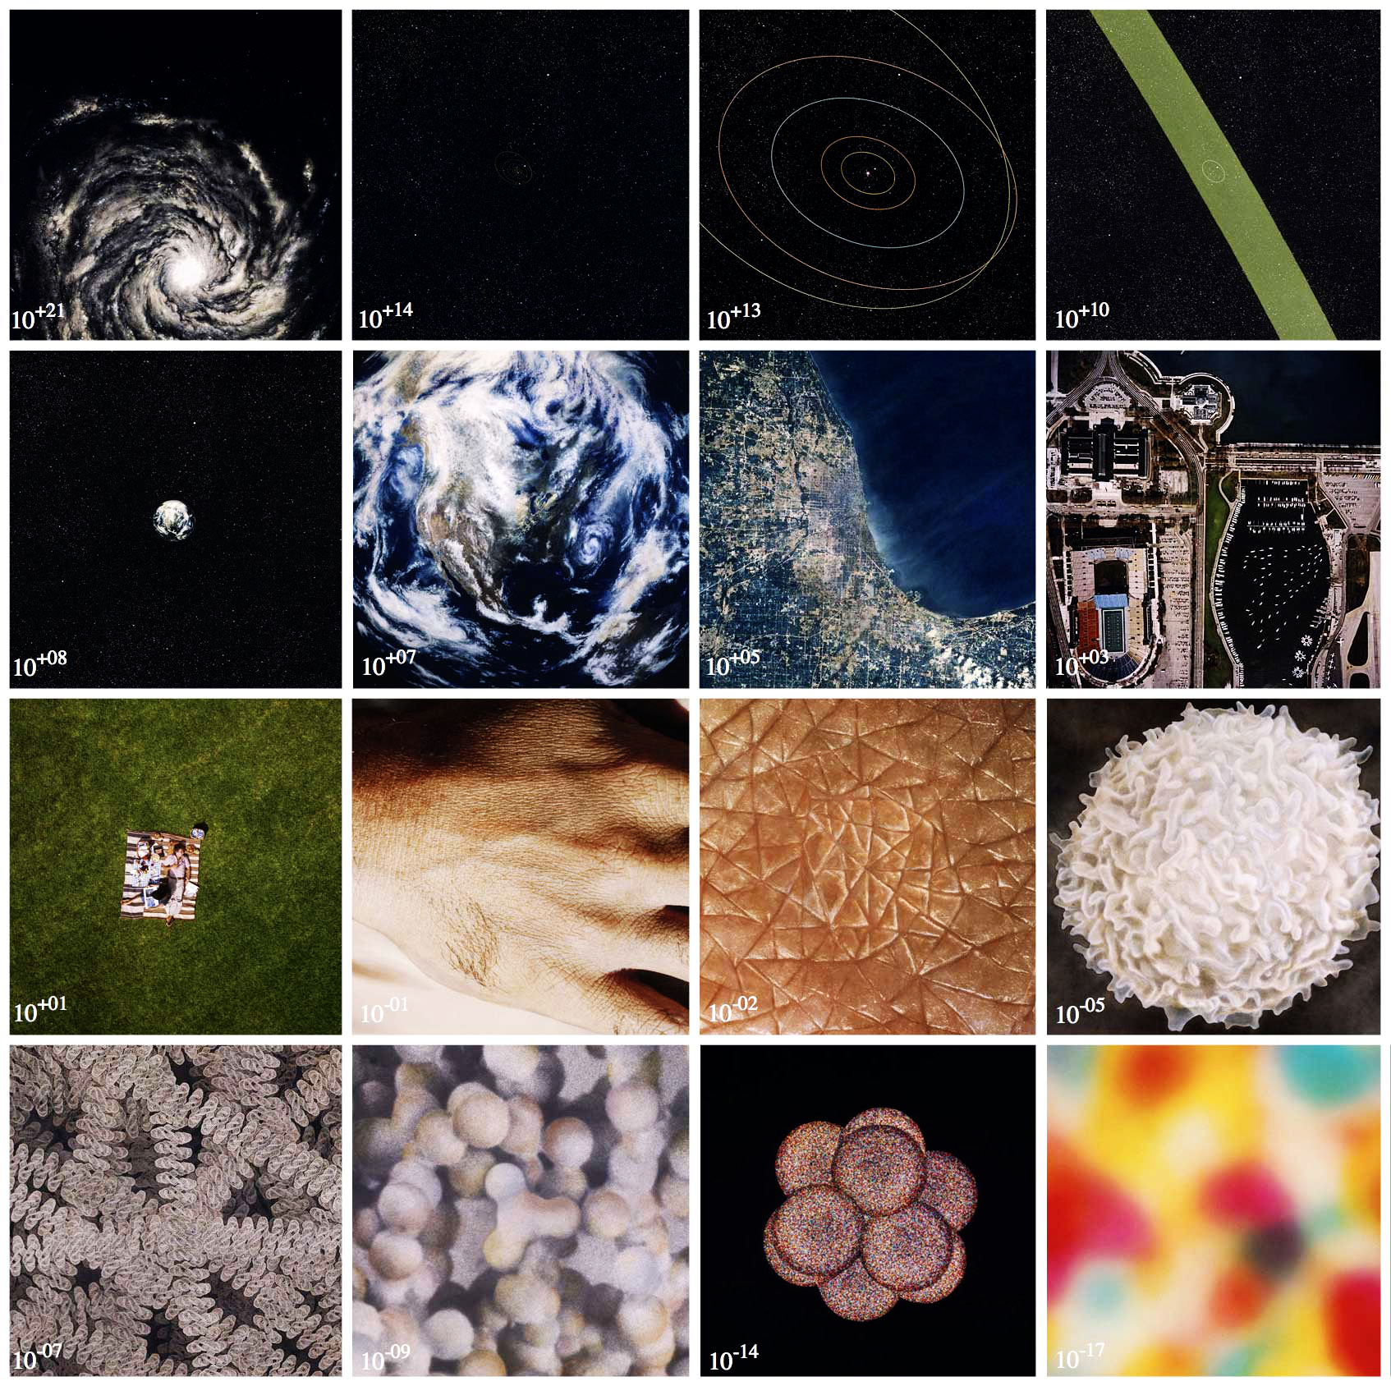

Slide 3
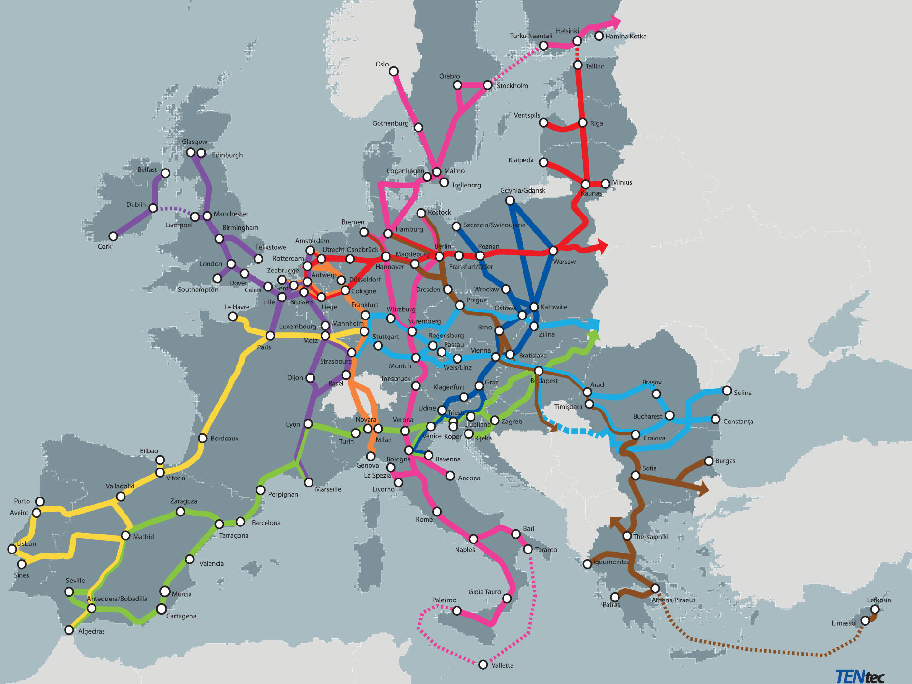

Slide 4
Agenda
11:00 – 11:10 Welcome and introduction – Ivo Cré, POLIS Network
Session I: Shaping the TEN-T together
11:10 – 11:20 TEN-T and cycling - Aleksander Buczynksi, ECF
11:20 – 11:30 TEN-T for sustainable mobility - Emmanuel Dommergues, UITP
11:30 – 11:40 Urban nodes (s) and governance - Sebastian Schöneck, FrankfurtRheinMain Region
11:40 – 11:50 Tiina Ruohonen, City of Oslo - MOVE 21
Session II: The TEN-T regulation revision: panel discussion and Q&A
11:50 – 12:20 Panel discussion
12:20 – 12:30 Q&A session

Slide 5
Urban Nodes in the new Urban Mobility Framework
‘As main connection points, cities are key components of the trans-European transport network (TEN-T), the backbone of the Single European Transport Area and essential for a well-functioning single market.’ (Item 1.1!)

Slide 6
New definition
New approach: urban nodes requirements
New priorities
Improved governance

Slide 7
Article 3 - definitions
(f) 'urban node' means an urban area where elements of the transport infrastructure of the trans-European transport network, such as ports including passenger terminals, airports, railway stations, bus terminals, logistic platforms and facilities and freight terminals, located in and around the urban area, are connected with other elements of that infrastructure and with the infrastructure for regional and local traffic;

Slide 8
Article 56: Updating of the network
(c) include urban nodes in the trans-European transport network, if it is demonstrated that the number of inhabitants exceeds 100,000;

Slide 9
Article 40 – Urban nodes requirements
When developing the trans-European transport network in urban nodes, in order to ensure the effective functioning of the entire network without bottlenecks, Member States shall ensure:
(a) availability of alternative fuels recharging and refuelling infrastructure, including in logistics platforms and for public transport in full compliance with the requirements of Regulation (EU) […] [on the deployment of alternative fuels infrastructure];
(b) by 31 December 2025:
(i) adoption of a sustainable urban mobility plan (SUMP) in line with Annex V that includes notably measures to integrate the different modes of transport, to promote efficient zero-emission mobility including sustainable and zero-emission urban logistics, to reduce air and noise pollution and that takes long-distance trans-European transport flows into consideration;
(ii) collection and submission to the Commission of urban mobility data per urban node covering at minimum greenhouse gas emissions, congestion, accidents and injuries, modal share and access to mobility service, as well as data on air and noise pollution. Thereafter these data shall be submitted every year;
(c) by 31 December 2030:
(i) for passenger transport: sustainable, seamless and safe interconnection between rail, road, air, the active modes of transport and, as appropriate, inland waterway and maritime infrastructure;
(ii) for passenger transport: ability for passengers to access information, book, pay their journeys and retrieve their tickets through multimodal digital mobility services;
(iii) for freight transport: sustainable, seamless and safe interconnection between rail, road, and, as appropriate, inland waterway, air and maritime infrastructure as well as appropriate connections with logistics platforms and facilities;
(iv) the development of multimodal passenger hubs to facilitate first and last mile connections which are equipped with at least one recharging station as defined in Article 2, point (43), of Regulation (EU) […] [on the deployment of alternative fuels infrastructure] dedicated to serve heavy-duty vehicles;
(d) by 31 December 2040: the development of at least one multimodal freight terminal allowing for sufficient transhipment capacity within or in the vicinity of the urban node.
The Commission shall adopt, no later than one year after the entry into force of this Regulation an implementing act establishing a methodology for the data to be collected by the Member States referred to under point (ii) of paragraph (b). That implementing act shall be adopted in accordance with the examination procedure referred to in Article 59(3).

Slide 10
Article 41 – Additional priorities for urban nodes
In the promotion of projects of common interest related to urban nodes, and in addition to the general priorities set out in Articles 12 and 13, attention shall be given to the following:
(a) seamless interconnection between the infrastructure of the trans-European transport network and the infrastructure for regional and local transport;
(b) mitigation of the exposure of urban areas to negative effects of transiting rail and road transport, which may include bypasses;
(c) promotion of efficient and low-noise zero emission transport and mobility, including greening urban fleets;
(d) increase of the modal share of public transport and of active modes;
(e) digital exchange of transport and traffic information between urban and non-urban traffic management centres and with entities providing information services, in line with ISO/CEN standards.

Slide 11
Chapter V: implementation
Article 52: governance of European Transport Corridors and horizontal priorities: 3 (c) urban nodes WG may be set up by coordinator; 6 The European Coordinator may consult regional and local authorities, … in relation to the work plan and its implementation.
Article 53: The work plan of the ETC shall provide a detailed analysis of the state of implementation, which includes in particular:
(h) an identification of measures in urban nodes which are relevant for the effective functioning of the corridor and achievement of the objectives of the trans-European transport network;

Slide 12
Agenda
11:00 – 11:10 Welcome and introduction – Ivo Cré, POLIS Network
Session I: Shaping the TEN-T together
11:10 – 11:20 TEN-T and cycling - Aleksander Buczynksi, ECF
11:20 – 11:30 TEN-T for sustainable mobility - Emmanuel Dommergues, UITP
11:30 – 11:40 Urban nodes (s) and governance - Sebastian Schöneck, FrankfurtRheinMain Region
11:40 – 11:50 Tiina Ruohonen, City of Oslo - MOVE 21
Session II: The TEN-T regulation revision: panel discussion and Q&A
11:50 – 12:20 Panel discussion
12:20 – 12:30 Q&A session

Slide 13
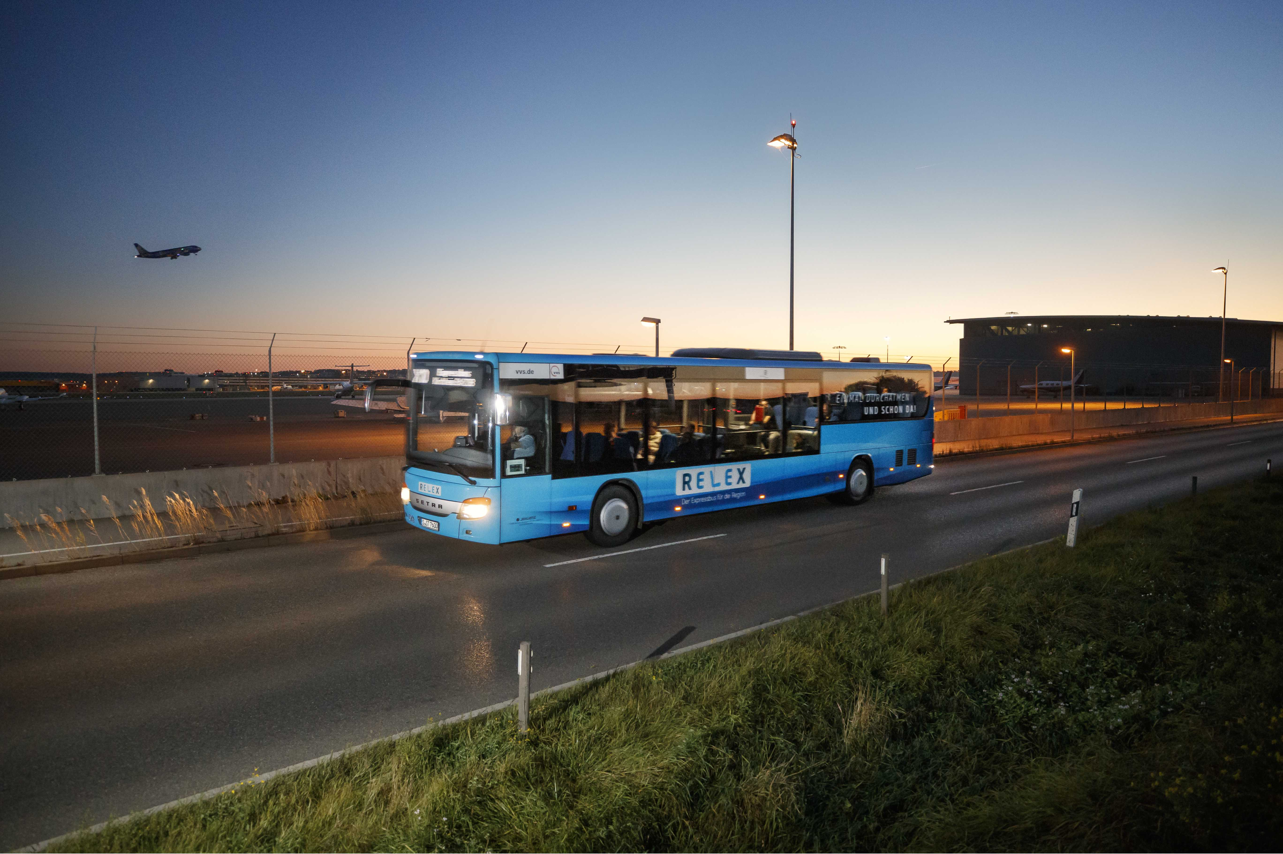
www.errin.eu
www.polisnetwork.eu
Pictures ERRIN, Polis, Gelderland, IdF, Frankfurt, NUVIT

