Slide 2
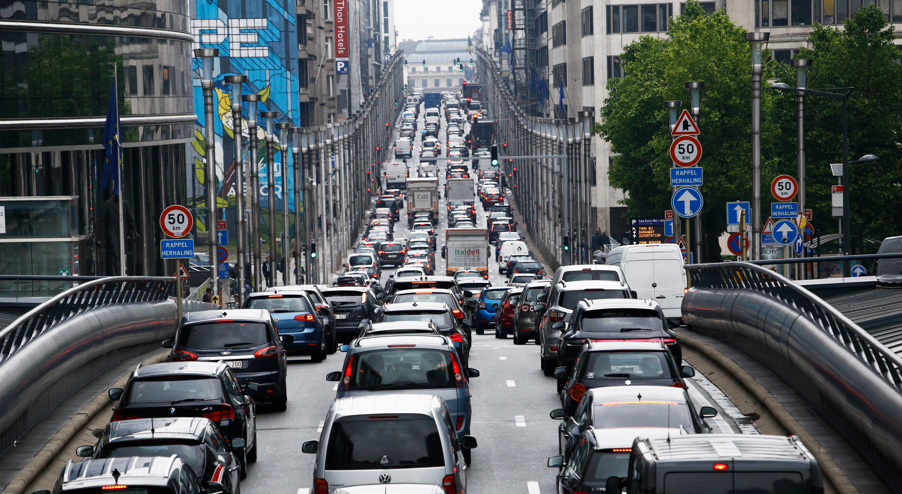
Road space is an extremely scarce – and therefore valuable – resource for cities
Photo credits: alexandros michailidis, gabriel12 / Shutterstock.com
gabriel12 / shutterstock.com

Slide 3
Horizon 2020 project
September 2018-February 2022
Developed comprehensive and sophisticated processes and tools to better address needs for urban street space, including enhanced stakeholder engagement
Explored options to use the limited space more flexibly during the day
Contributed to enhanced operation of the Trans-European Transport Network, by addressing challenges within the urban nodes, where most long-distance trips begin and end

Slide 4
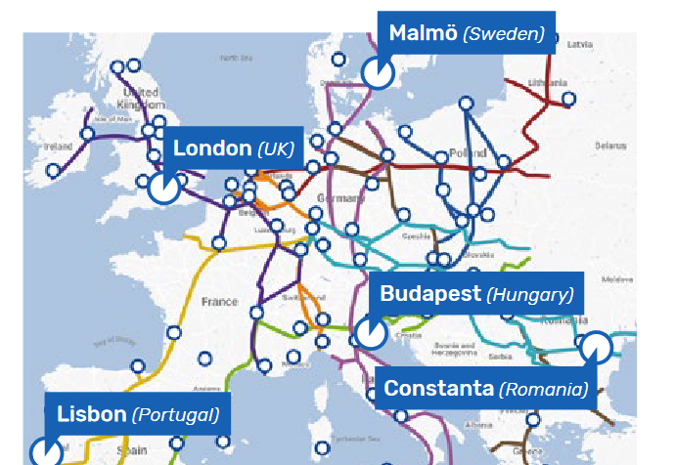
5 European cities
Case studies: busy roads linking to the European Transeuropean Transport Network
Universities
University College London
Technical University Dresdes
Sciences Po
Road user groups
International Federation of Pedestrians
European Cyclists Federation
International Association of Public Transport
Alliance for Logistics Innovation
POLIS
Private sector
PTV
Dynniq
Buchanan Computing
VECTOS
EIP

Slide 5
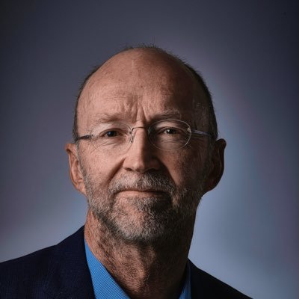
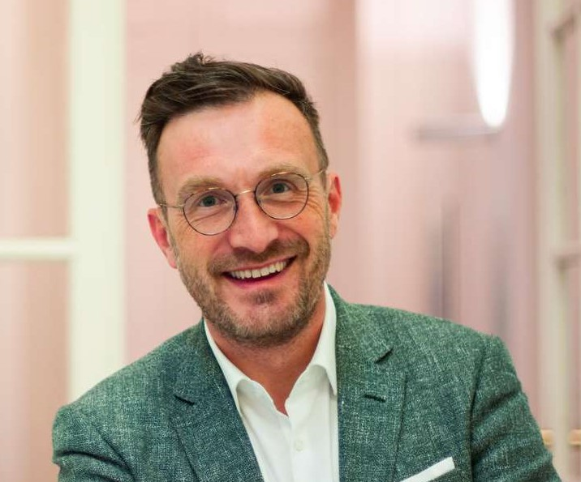
Opening session: Street design: concepts, context and challenges
Opening statement
Matthew Baldwin, Deputy Director General DG MOVE, Chair of EU Mission for 100 Climate-Neutral and Smart Cities
Keynote speech
Pascal Smet, Secretary of State of the Brussels-Capital Region, responsible for Urbanism

Slide 6
Presentations
How MORE addresses the challenges facing city streets (Paulo Anciaes, UCL)
Street carbon: current sources and future potentials (Ellen Hill, Vectos)
Concepts and street design principles (Peter Jones, UCL)
Policy and regulatory frameworks (Charlotte Halpern, Sciences Po)
Current user groups and patterns of street use (Regine Gericke, TU Dresden)
Future street patterns and potential role for new technologies (Meng Lu, DYNNIQ)
Q&A

Slide 8
Housekeeping & safety measures
Please remember to keep your facemask on at all times
During the breaks, please take your coffee and food and take a seat (we cannot stand and eat or drink until tomorrow ☹ )

Slide 10
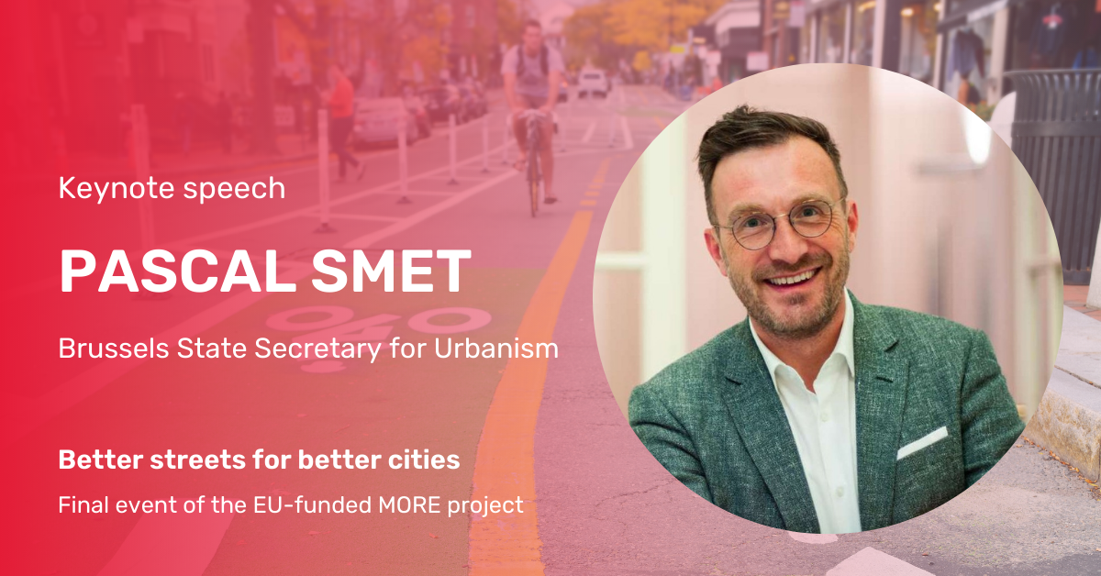

Slide 11
14:00: Street design: processes, outcomes, and recommendations
This session will provide an overview of the street redesign process developed by MORE.
Representatives from Budapest, Lisbon, London, Malmö and Constanta will share their experiences and tips for success
16:00: Wrap up and final recommendations

