Slide 1
Better streets for better cities MORE Final Event 17th September 2022
Brussels
This project has received funding from the European Union’s Horizon 2020 research and innovation programme under grant agreement No 769276.
This document reflects only the author's view and that the Agency is not responsible for any use that may be made of the information it contains.

Slide 2
1400 – 1600 Street design: processes, outcomes, and recommendations
Paul Curtis
This project has received funding from the European Union’s Horizon 2020 research and innovation programme under grant agreement No 769276.
This document reflects only the author's view and that the Agency is not responsible for any use that may be made of the information it contains.
Notes:
WP5 leader

Slide 3
Introduction to the MORE approach and tools
Notes:
Intro to the tools and step by step process
Then we will see how cities have followed this process and adapted it to local needs + outcomes

Slide 4
Experience from the five MORE cities
Notes:
Now we will see how the MORE Cities applied this approach and tools to co-create their street designs

Slide 5
Step by step street design process & MORE design tools
Paul Curtis
This project has received funding from the European Union’s Horizon 2020 research and innovation programme under grant agreement No 769276.
This document reflects only the author's view and that the Agency is not responsible for any use that may be made of the information it contains.
Notes:
WP5 leader

Slide 6
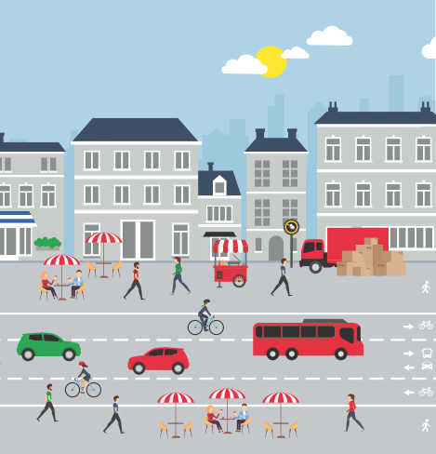
Rationale for new street design process
Gaps in current street design consultation process & space allocation
Options generated and consulted on often exclude key stakeholders and the public
Modelling does not capture value of all street functions
Assessment scope can be narrow due to lack of appraisal tools
Such gaps are emphasised with advent of new mobility services and technologies
Notes:
All street functions : e.g. kerbside activities

Slide 7
MORE co-creation process
MORE addresses these gaps offering a full co-creation consultation process for street design and space allocation
To better consider needs of multiple users
Optimise the efficiency of the street system
Based on 5 technical web or computer-based tools:
Notes:
MORE embraces the co-creation approach to street redesign
Internal stakeholders
External stakeholders
Public

Slide 8
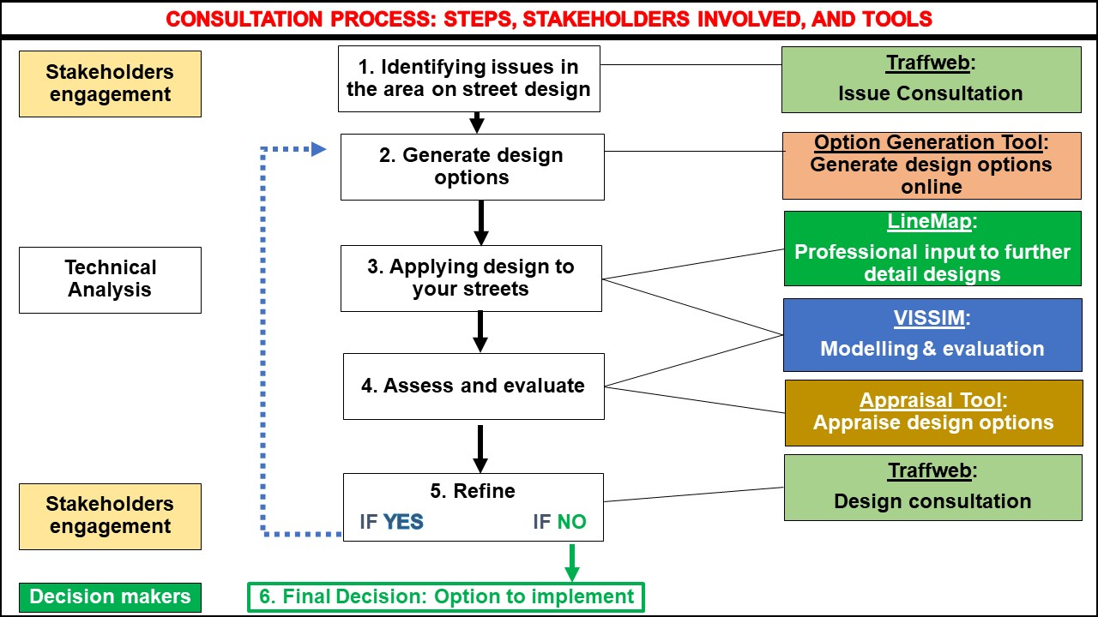
MORE process and tools
Notes:
We have designed and validated this process for street design
- collecting issues identified from consulting the public / local stakeholders online tool Traffweb
generate road design options using the Road Design Option Generation Tool (Tool 1). Also online. Dozens of layout ideas for allocating space. High level
apply (draw) designs provisionally onto (plans) specific street sections using Linemap professional input from municipality TPs
Assess/ simulate using enhanced VISSIM
Evaluate using Appraisal tool
Go back and consult with public and stakeholders to consult Traffweb
Refine Y or N
Select option to implement w decision makers

Slide 9
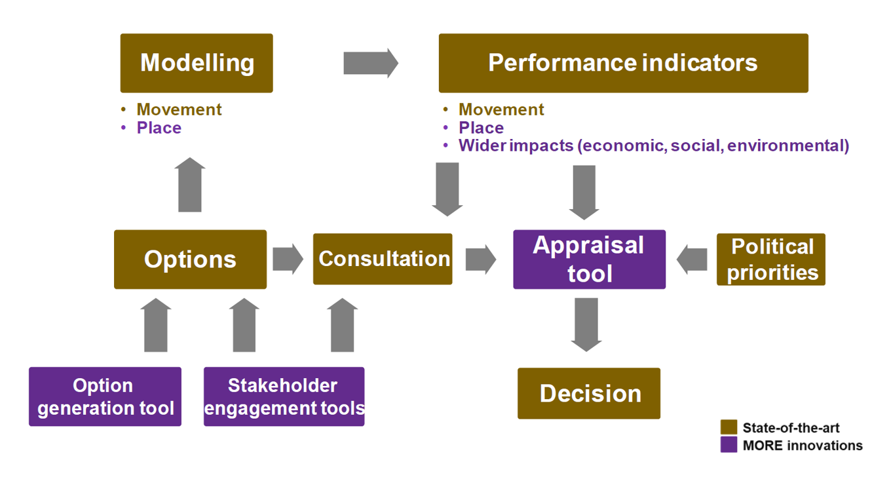
Notes:
We have designed and validated this process for street design
- collecting issues identified from consulting the public / local stakeholders online tool Traffweb
generate road design options using the Road Design Option Generation Tool (Tool 1). Also online. Dozens of layout ideas for allocating space. High level
apply (draw) designs provisionally onto (plans) specific street sections using Linemap professional input from municipality TPs
Assess/ simulate using enhanced VISSIM
Evaluate using Appraisal tool
Go back and consult with public and stakeholders to consult Traffweb
Refine Y or N
Select option to implement w decision makers

Slide 10
MORE Option Generation Tools
Paulo Anciaes
University College London
This project has received funding from the European Union’s Horizon 2020 research and innovation programme under grant agreement No 769276.
This document reflects only the author's view and that the Agency is not responsible for any use that may be made of the information it contains.
Notes:
WP5 leader

Slide 11
TraffWeb & LineMap Engaging stakeholders in the design process
Robin Morrison
Buchanan Computing
This project has received funding from the European Union’s Horizon 2020 research and innovation programme under grant agreement No 769276.
This document reflects only the author's view and that the Agency is not responsible for any use that may be made of the information it contains.
Notes:
WP5 leader

Slide 12
PTV Vissim Simulation Tool
Inga Luchmann
Peter Sukennik
PTV Group
This project has received funding from the European Union’s Horizon 2020 research and innovation programme under grant agreement No 769276.
This document reflects only the author's view and that the Agency is not responsible for any use that may be made of the information it contains.
Notes:
WP5 leader

Slide 13
MORE Option Appraisal Tool
Paulo Anciaes
University College London
This project has received funding from the European Union’s Horizon 2020 research and innovation programme under grant agreement No 769276.
This document reflects only the author's view and that the Agency is not responsible for any use that may be made of the information it contains.
Notes:
WP5 leader

Slide 14
Experience from the five MORE cities
Notes:
Now we will see how the MORE Cities applied this approach and tools to co-create their street designs

Slide 15
Budapest

Slide 16
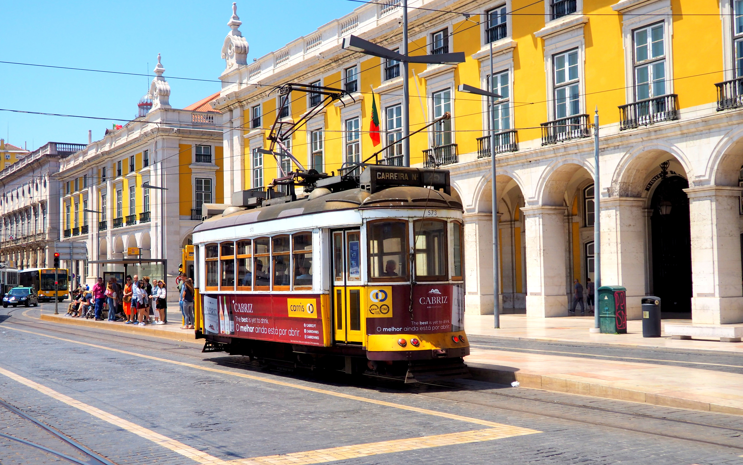
Lisbon

Slide 17
London

Slide 18
Constanta

Slide 19
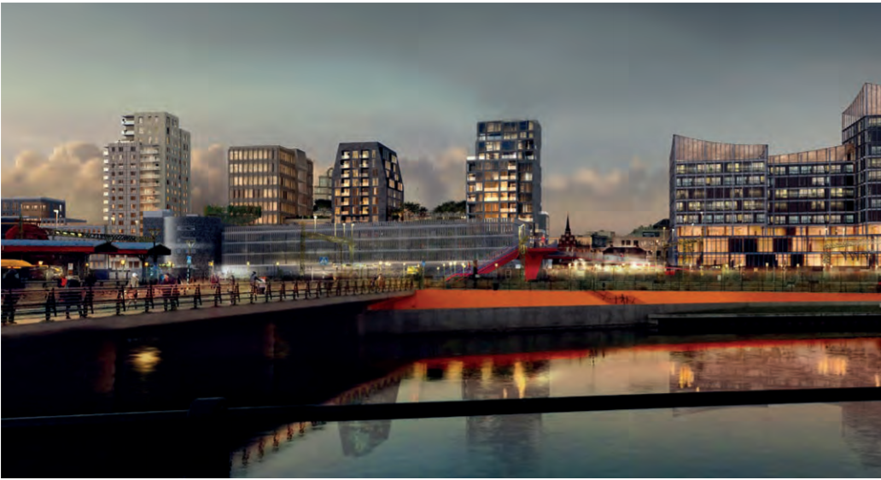
Malmo

Slide 20
Any questions?
Notes:
LIS:
Stakeholder and public engagement approach
Many elements of this were new to you. Did you find the tools easily transferable / challenges to overcome (E.g. virtual design days tricky)
LONDON
The conclusion is that allocating road space to priority modes alone does not always provide the sought after outcomes desired, as needs to be delivered alongside wider policy interventions that reduces the volume of traffic.
Main finding is that current methodologies completely disregard/ don’t know how to monetise benefits for pedestrian/place improvements

Slide 21
Thank you !
Paul Curtis
paul.curtis@vectos.eu
This project has received funding from the European Union’s Horizon 2020 research and innovation programme under grant agreement No 769276.
This document reflects only the author's view and that the Agency is not responsible for any use that may be made of the information it contains.

