Slide 1
MORE Final conference February 17th, 2022
Maria Brodde Makri
City of Malmö
This project has received funding from the European Union’s Horizon 2020 research and innovation programme under grant agreement No 769276.
This document reflects only the author's view and that the Agency is not responsible for any use that may be made of the information it contains.

Slide 2
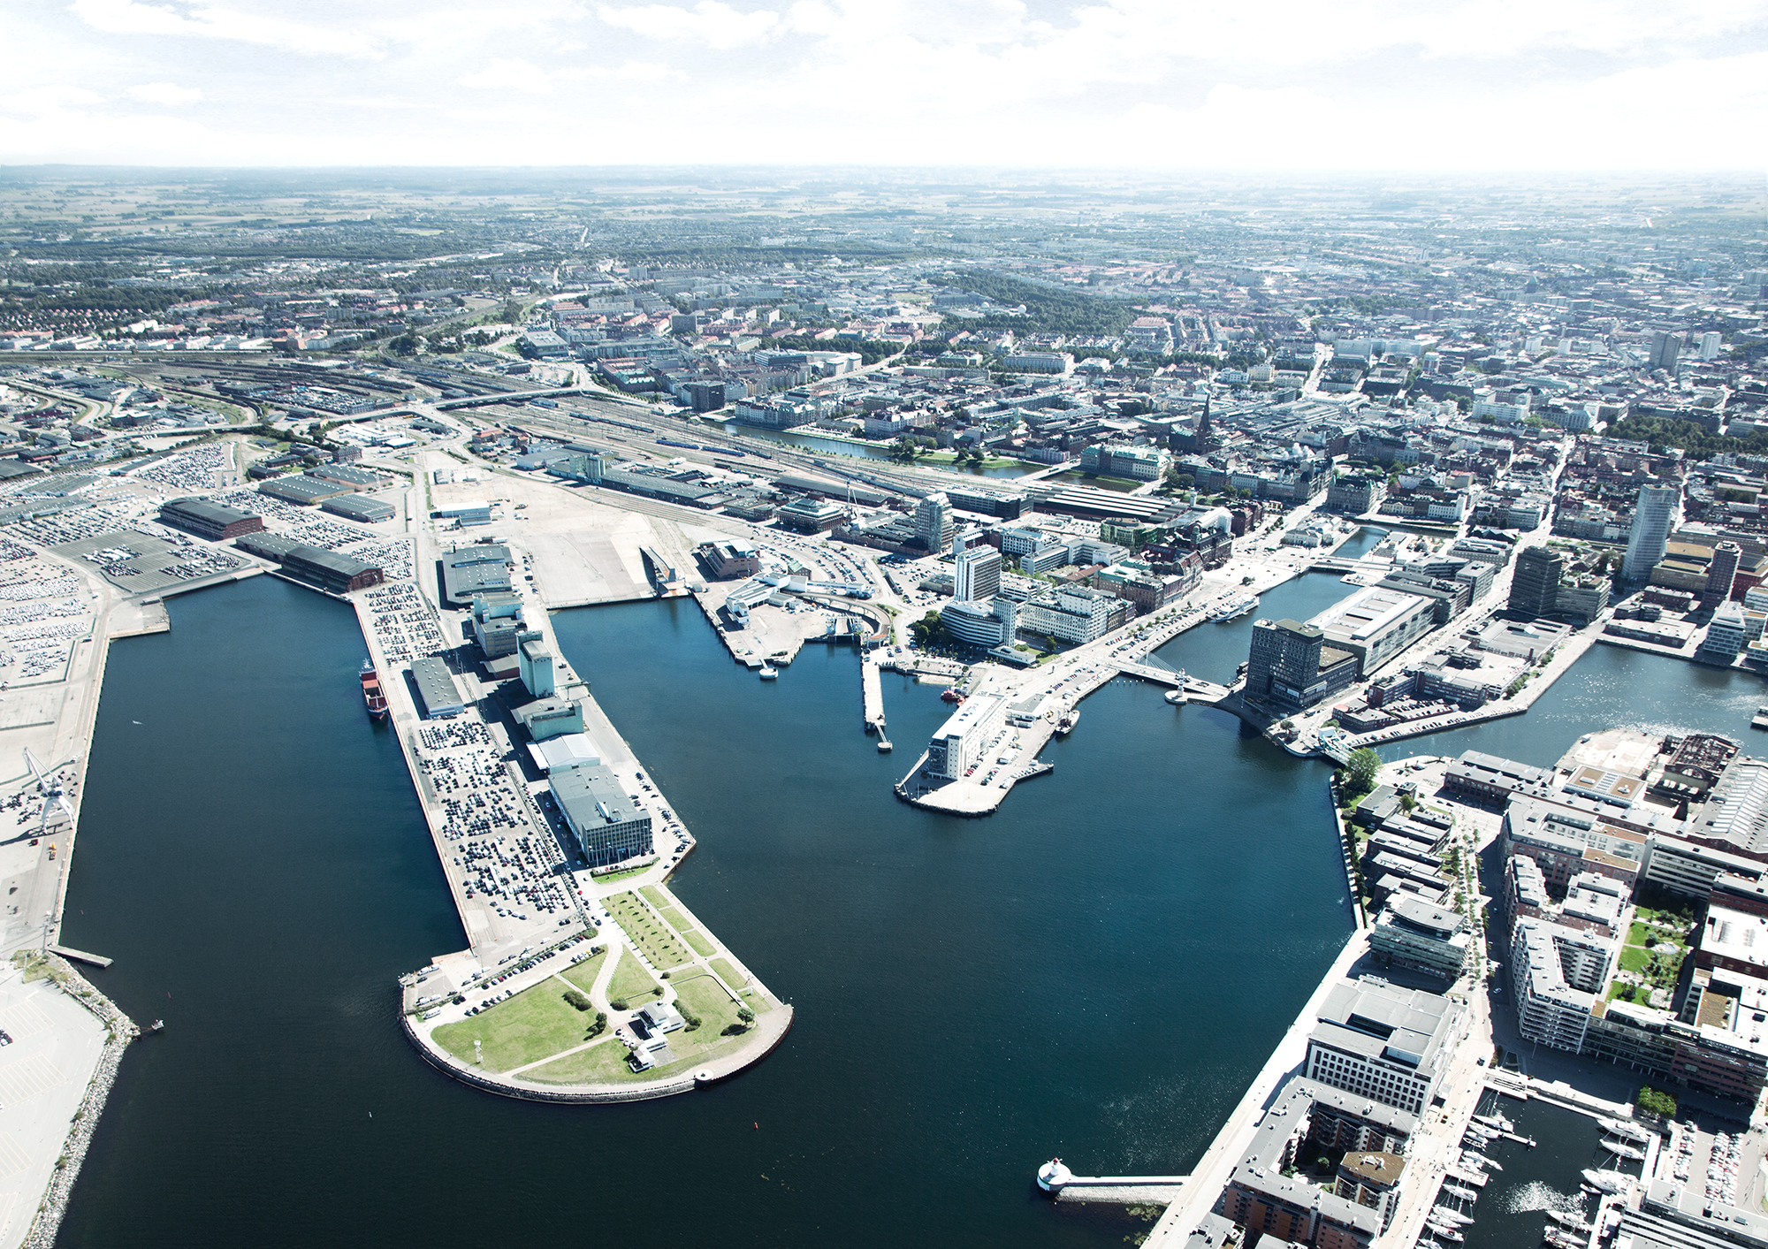
NYHAMNEN- OUR STUDY AREA
Notes:
Study Corridor - TEN-T to the heart of the city
Feeder Route
All Modes of transport as well as the Harbour and a major Logistic centre are represented.
Feeder Route - major road for commuting.
Focus area - Industrial and Commercial area - undeveloped

Slide 3
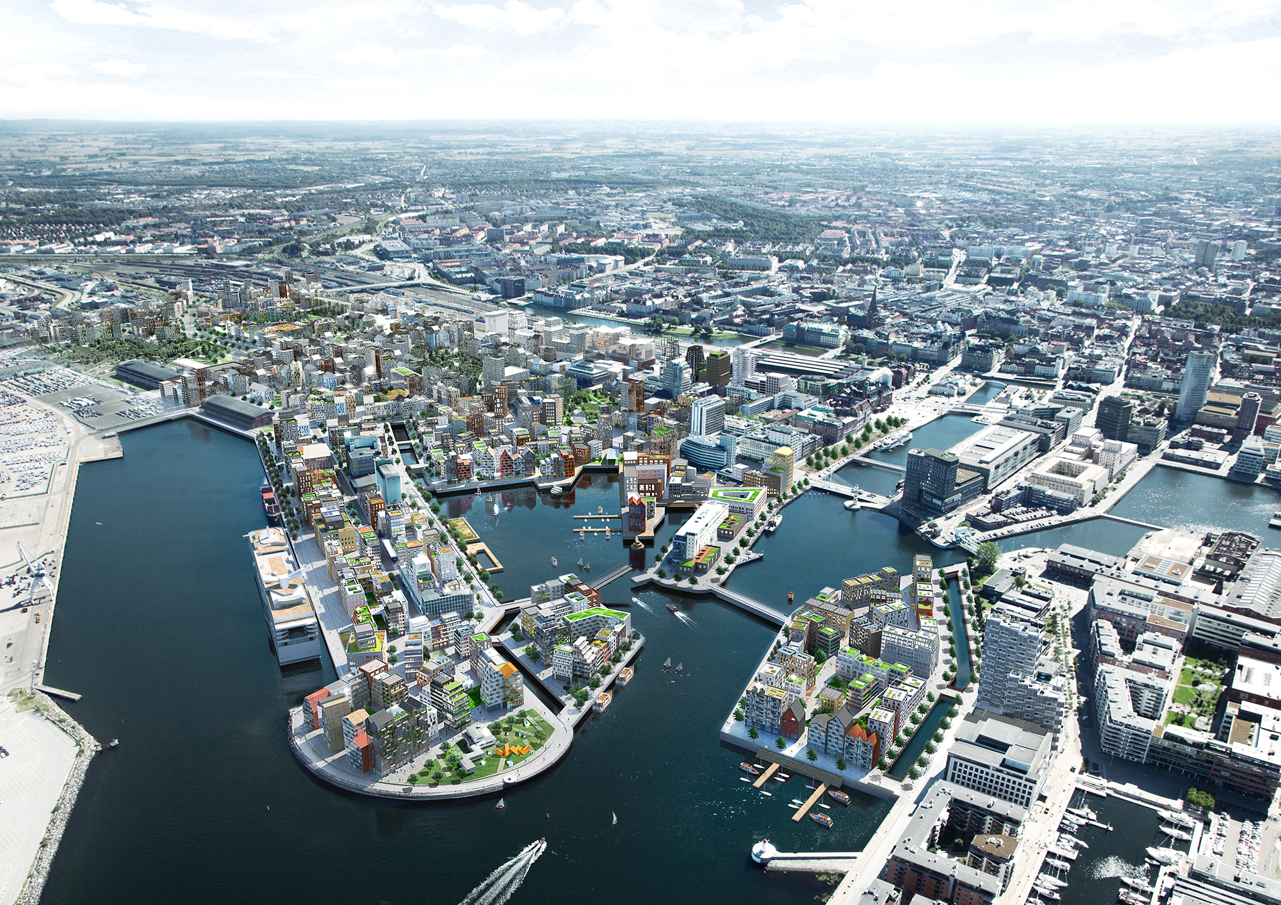
NYHAMNEN 2050
Notes:
Focus area will be transformed to
the Most Densed part of the city and part of the City Centre

Slide 4
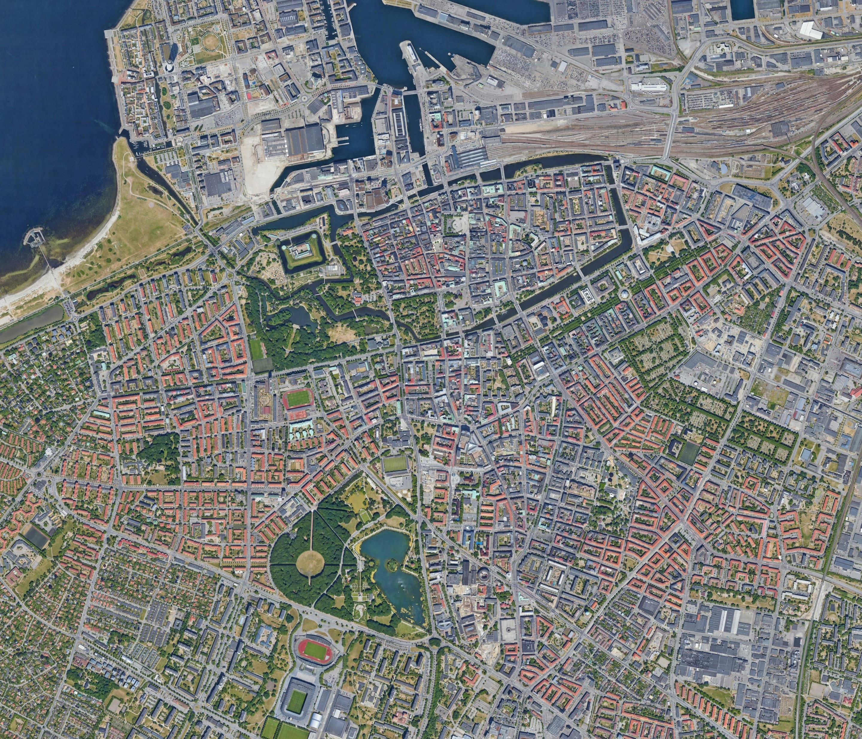
Reference streets to gather data for Nyhamnen
Sustainability
Stora Varvsgatan
Mobility
Sallerupsvägen
Assigned scenarios based on street characteristics
Used for
Indicators
Citizen participation activities
Results are applied on case study area
Liveability
Regementsgatan
Liveability
Erik Dahlbergsgatan
Mobility Mariedalsvägen
400 m
Sustainability
Södra Förstadsgatan
N
Notes:
Since our main street and study area are not urbanised yet
We needed to find areas similar to what is planned in Nyhamnen- that’s why we have chosen to work with Reference streets.
The areas are chosen to match the street design of Nyhamnen and
represent 3 Scenarios – M S L
We have done citizen participation activities and observation studies.

Slide 5
The MORE process according to the Malmö team
Notes:
Lot of discussions ongoing during these years
This is how we the MORE team would like to see Planning of Urban Space
From Deciding – Planning – Building
To …
The cost ofr these additional measures is minor in time and money
Considering that we can achieve
Streets people need and want
Save money from adjusting misstakes and rebuildning
Learn

Slide 6
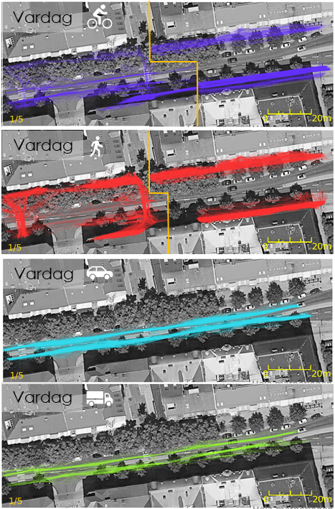
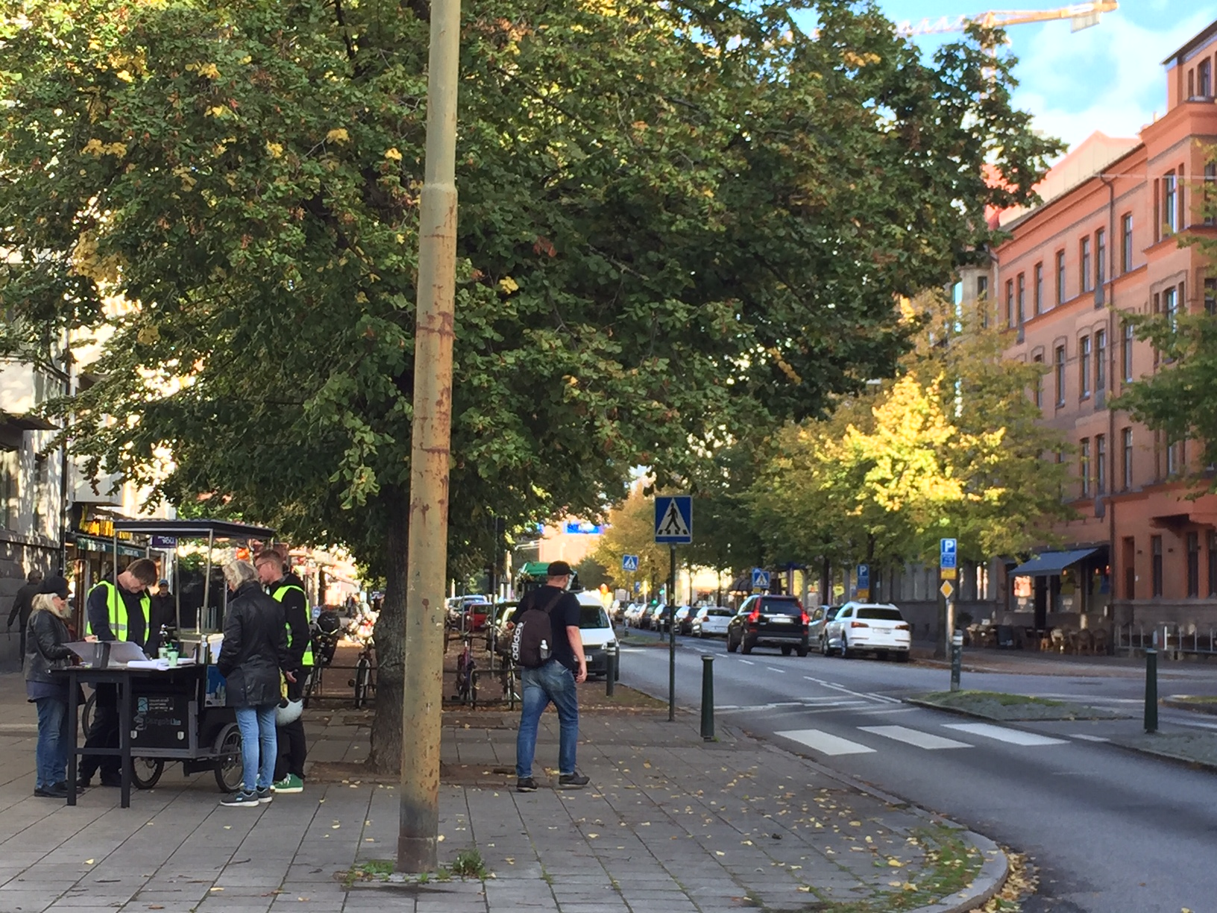
BEST PRACTICE MALMÖ
Combination of results
From Citizen participation
and Observations studies
Zebra crossings
Outside zebra crossings
Notes:
We have done citizen participation activities using Trafweb tool and observation studies.
Left – results from observations from L street
High degree of Compliance among P & C
Results significantly different from M street

Slide 7
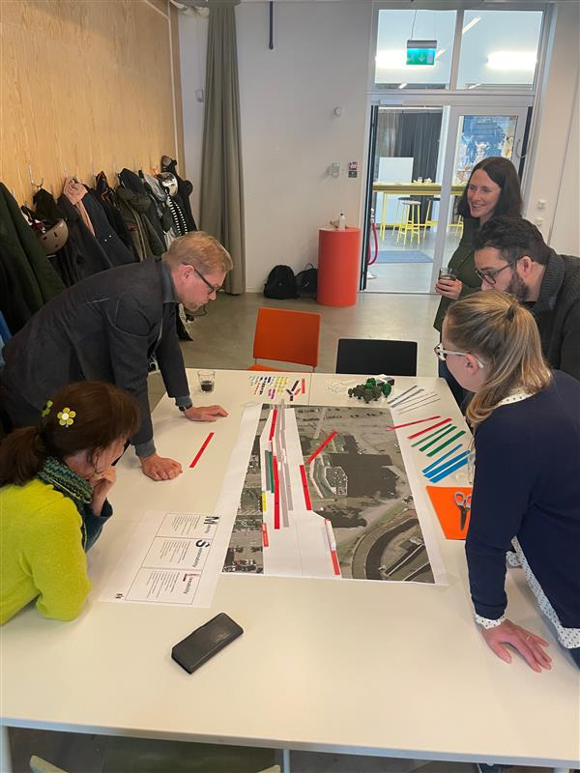
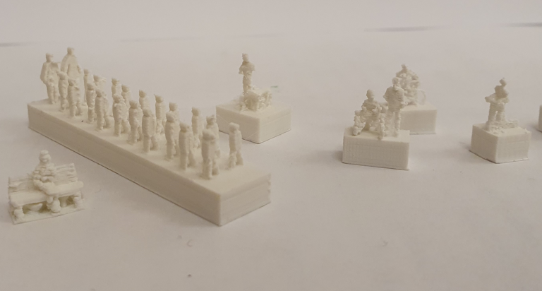
BEST PRACTICE MALMÖ
Develop Linemap with 3D prints of people, benches, vehicles and trees
Elements that help us see what we can make space for
Notes:
For Co-Creation activities - with LineMap tool
We adjusted and developed it with 3D-prints

Slide 8
Continue the MORE saga in Malmö
3 different projects are trying the MORE-process in Malmö during 2022
A Malmö-adapted handbook for urban planners is under development
PICTURE
Notes:
Good results we had
Has created Demand among PL
Asked to participate and support
Apply our learnings in the Traffic Planning Process
HANDBOOK

Slide 9
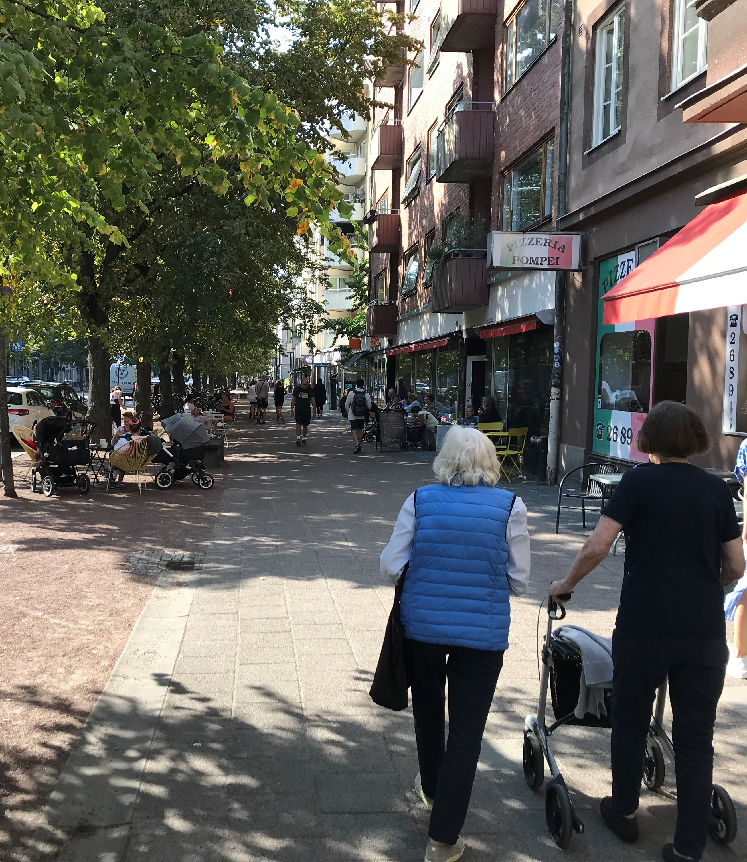
MORE 2.0- Streets as ecosystems
New ways and methods to explore new technologies and their effects
Further development of urban planning methodology
Inclusive planning
Use of scenarios
Equalize street users, include pedestrians and place qualities

Slide 10
Thank you!
Maria Brodde Makri
City of Malmö
maria.brodde@malmo.se
This project has received funding from the European Union’s Horizon 2020 research and innovation programme under grant agreement No 769276.
This document reflects only the author's view and that the Agency is not responsible for any use that may be made of the information it contains.

