Slide 1
MORE Option Generation Tools
Paulo Anciaes
UCL (University College London)
Better streets for better cities
Brussels, 17-02-2022

Slide 2
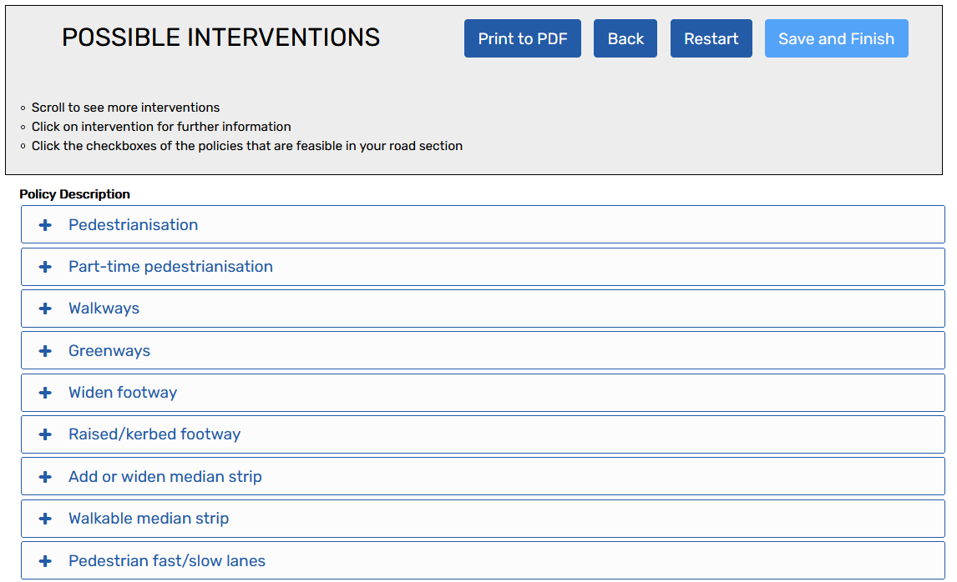
Tool 1: Policy interventions
Tool inputs
Tool outputs
Road uses that should be made better off
Road uses that should not be made worse off
Policy objectives to meet
Selected from a database of 210 interventions

Slide 3
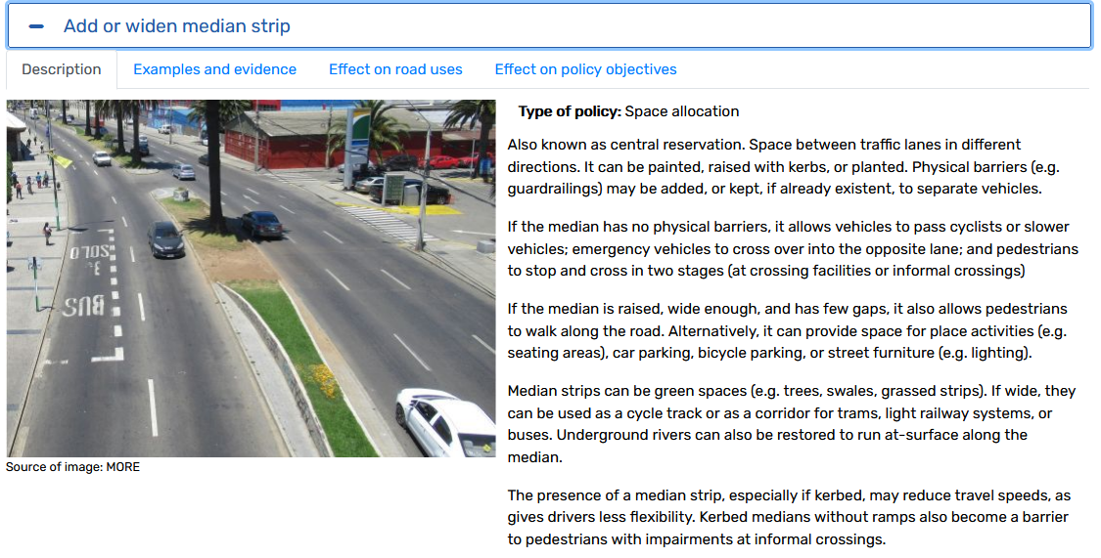
Tool 1: Policy interventions
Output: Description page

Slide 4
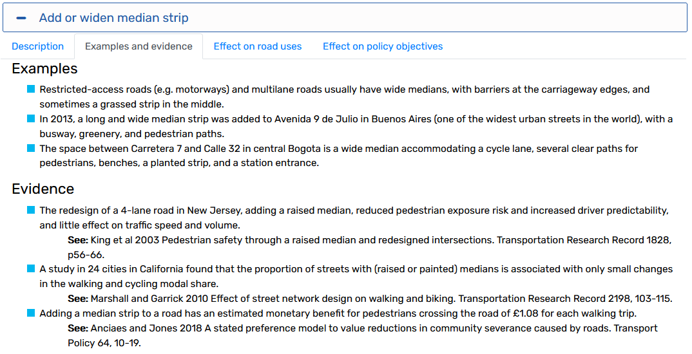
Tool 1: Policy interventions
Output: Evidence page

Slide 5
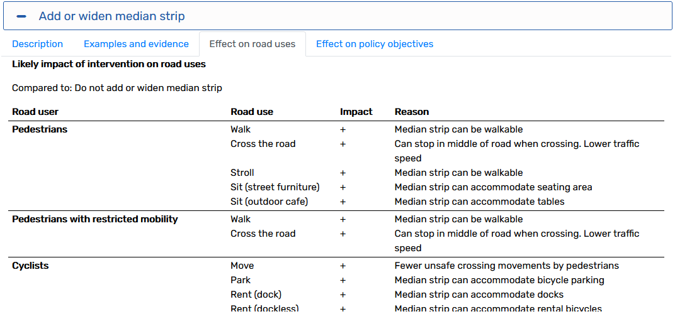
Tool 1: Policy interventions
Output: Effects page
(…)

Slide 6
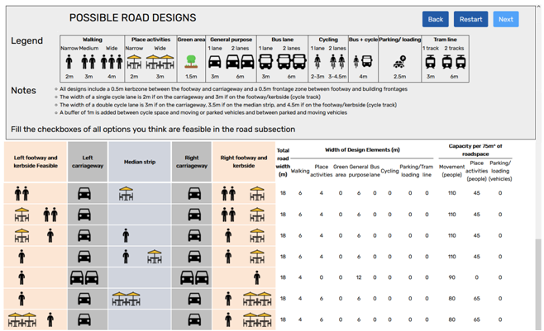
Tool 2: Road designs
Tool inputs
Tool outputs
Current space alocation
Level of priority to each design element in the redesigned street
(…)

Slide 7
Thank you for your attention!
p.anciaes@ucl.ac.uk
This project has received funding from the European Union’s Horizon 2020 research and innovation programme under grant agreement No 769276.
This document reflects only the author's view and that the Agency is not responsible for any use that may be made of the information it contains.

