Slide 1
TEN-T and cycling
Aleksander Buczyński
European Cyclists’ Federation
a.buczynski@ecf.com

Slide 2
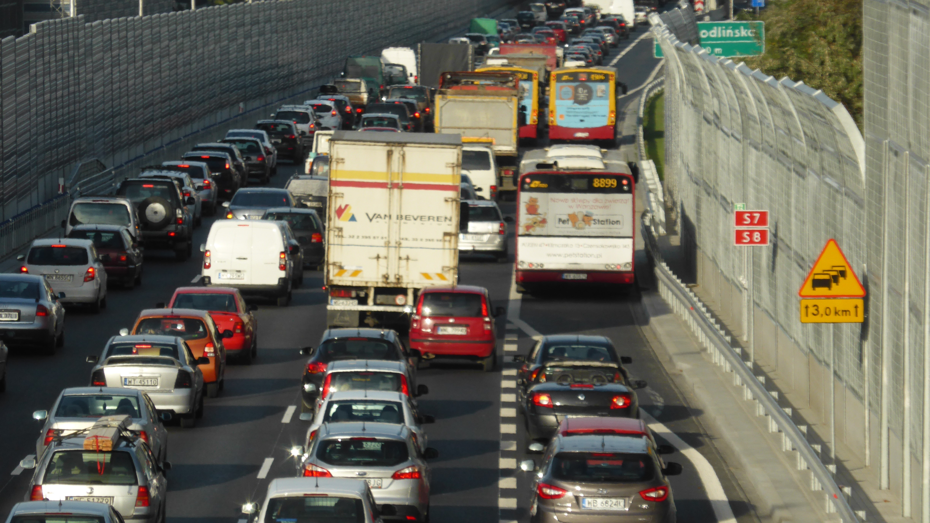
Trans-European Transport Network
The EU transport policy
Roads, rails, inland waterways, ports, airports…
Most of traffic on TEN-T is local
TEN-T is also about tourism

Slide 3
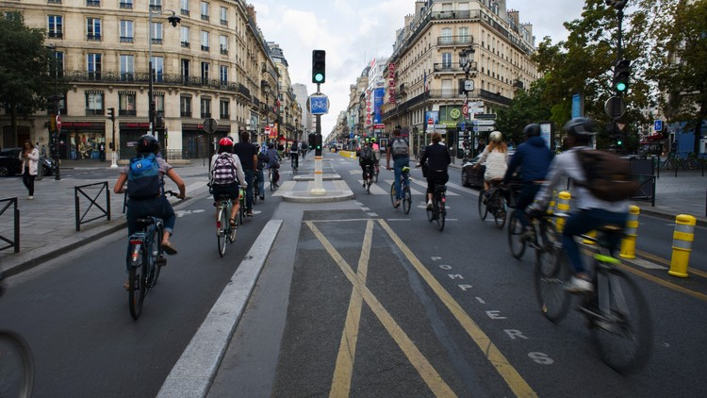
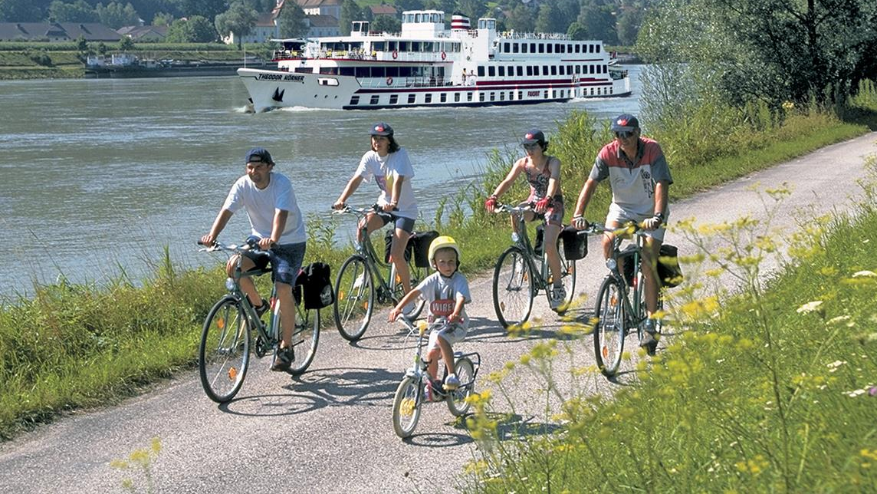
Cycling in the EU
Every year:
250 million people cycle 150 billion km
CO2 savings: 16 million tonnes
2.3 billion cycle tourism trips generate €44 billion
Total benefits: €150 billion

Slide 4
Regulation (EU) No 1315/2013
Recital 9:
[...] Where possible, synergies with other policies should be exploited, for instance with tourism aspects by including on civil engineering structures such as bridges or tunnels bicycle infrastructure for long-distance cycling paths like the EuroVelo routes.
Notes:
Cycling already mentioned in the current regulation
A nice recital suggests that synergies with other policies should be exploited, for instance, by including bicycle infrastructure on structures like bridges.
The EuroVelo European cycle route network also mentioned.
But only a recital and it’s not followed up by specific articles in the guidelines themselves.

Slide 5
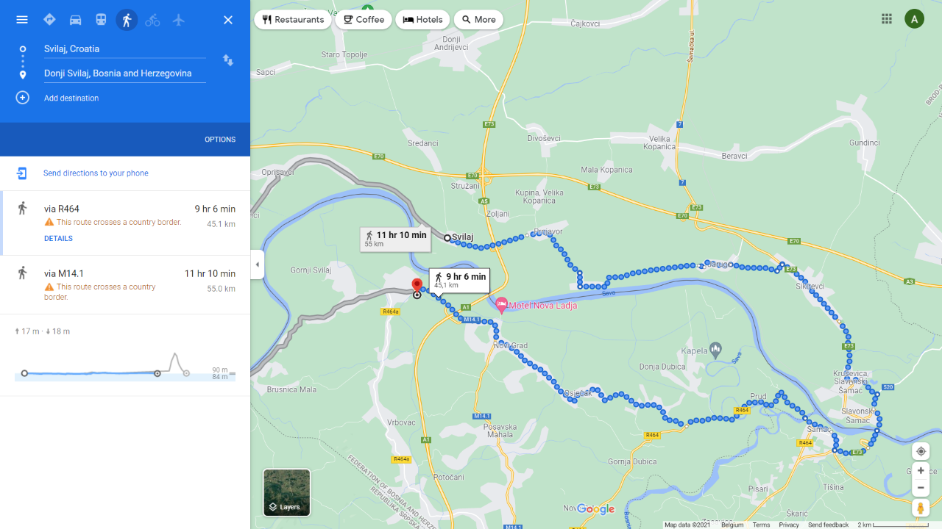
Synergies still not exploited
Notes:
new EU-funded bridge across the Sava river on the border of Croatia with Bosnia and Herzegovina,
part of the TEN-T Rhine-Danube Corridor,
no infrastructure for walking or cycling
as a consequence, cross-border trips can be done in 5 or 10 km by car, but cyclists must make a 40 km detour.

Slide 6
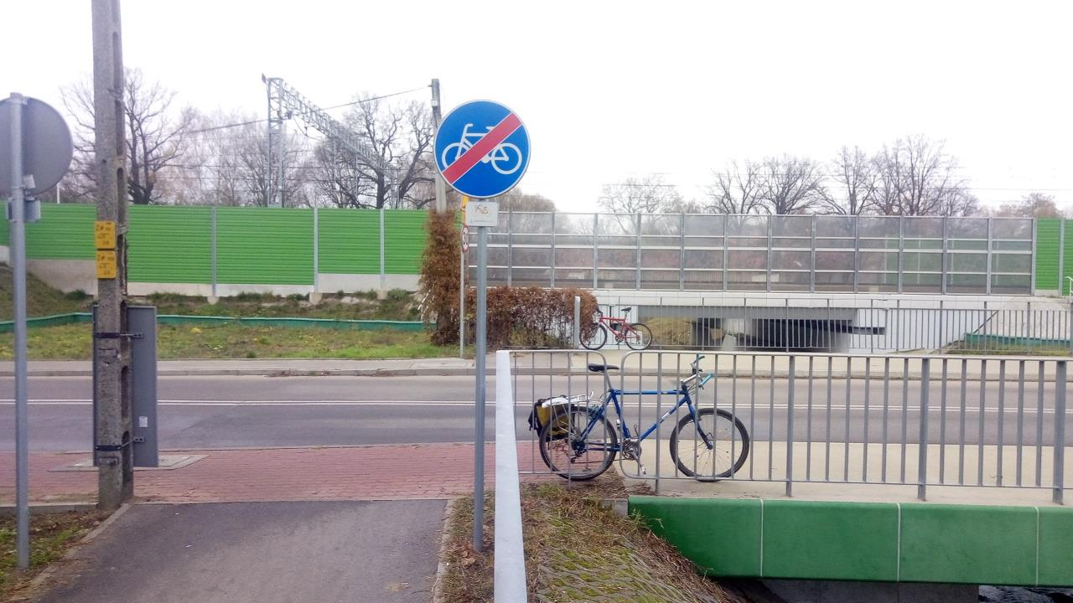
TEN-T infrastructure creates barriers for cycling
Notes:
The closest cycle crossings 5 km

Slide 7
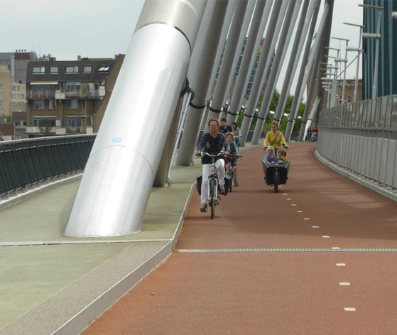
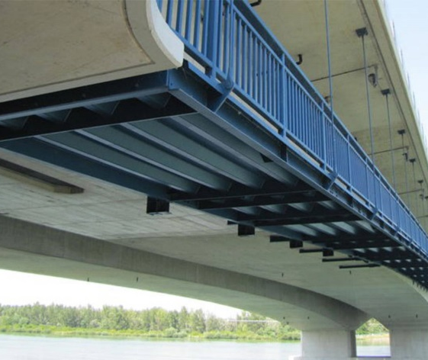
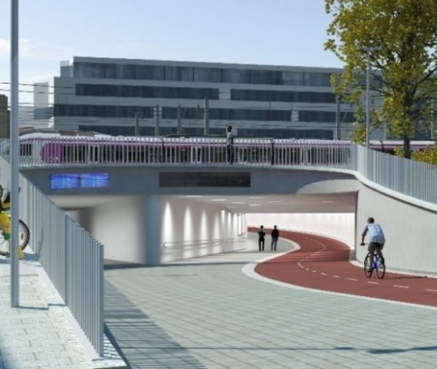
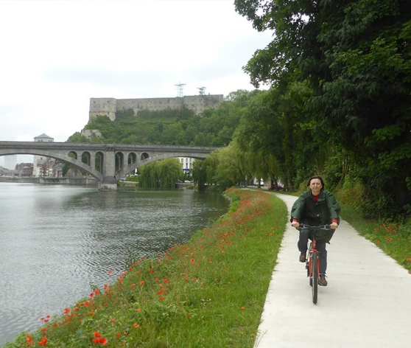
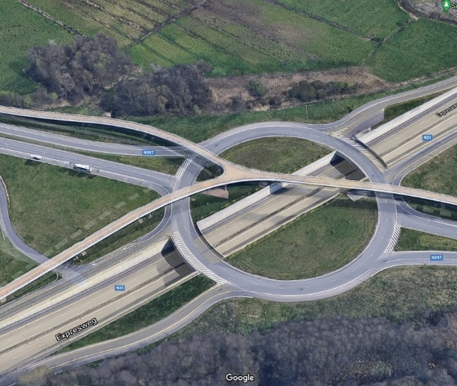
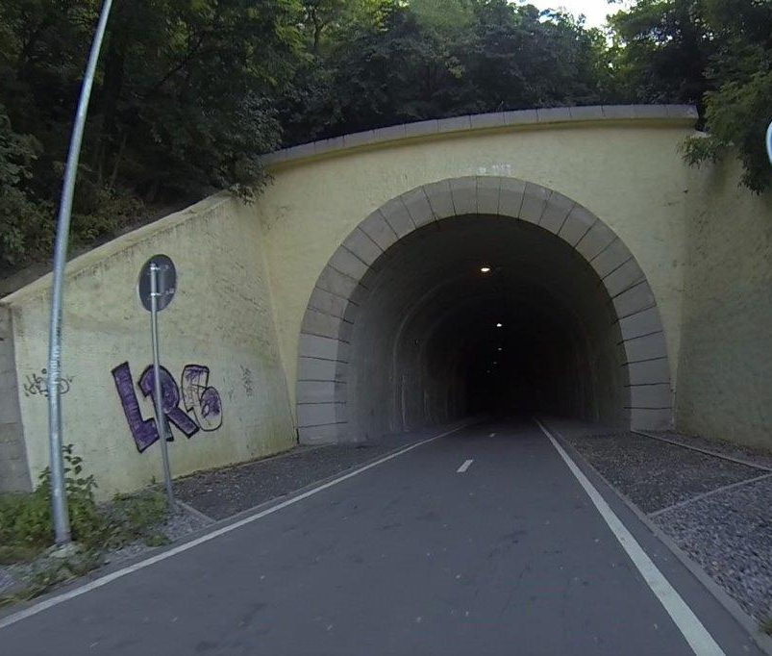

Slide 8
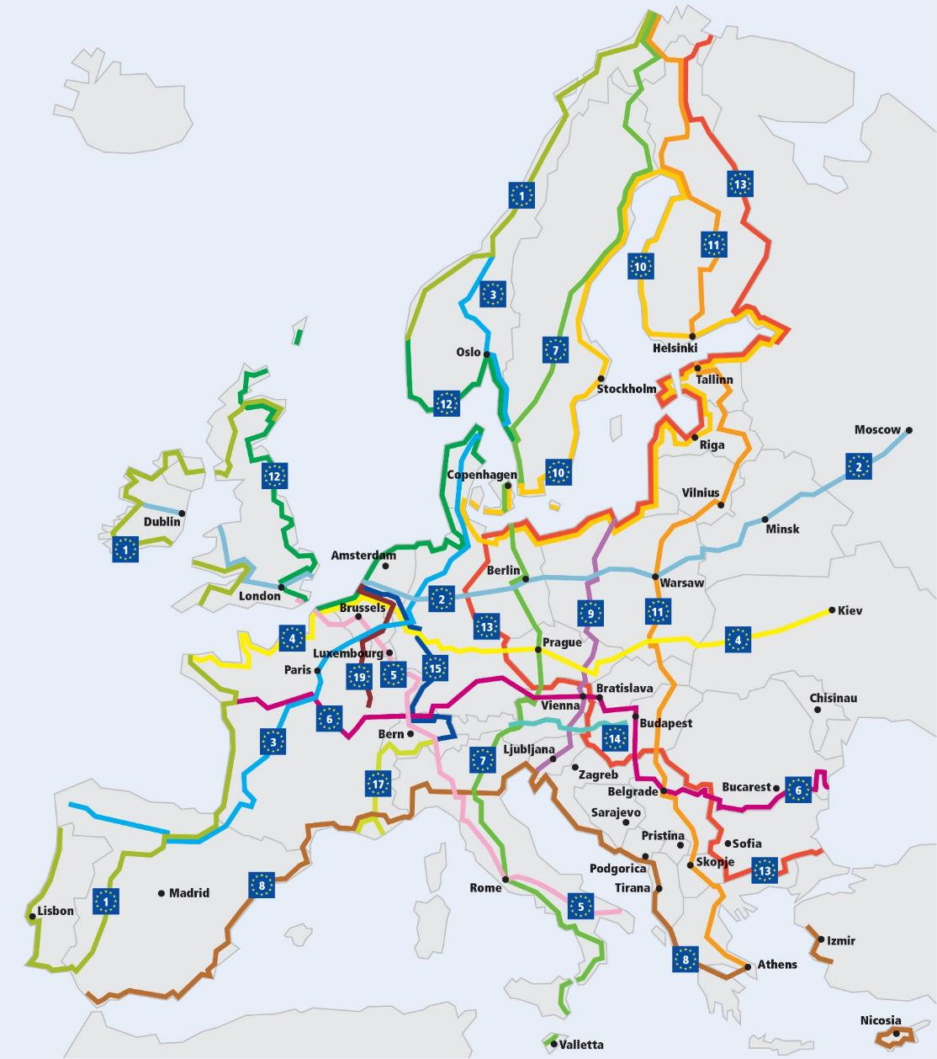
How to improve the TEN-T?
Include EuroVelo, the European cycle route network
Integrate elements of walking and cycling infrastructure in other TEN-T networks
Notes:
Two main areas for improvement

Slide 9
TEN-T legislative proposal by the Commission
Aleksander Buczyński
European Cyclists’ Federation
a.buczynski@ecf.com

Slide 10
Pro/opportunities
Definition of “active modes”
Obligatory SUMPs & some data collection for urban nodes
Including modal split – important!
Ensuring continuity and accessibility of cycle paths as “additional priority” in rail/road projects
But: can be interpreted as “pre-existing dedicated cycle paths” only
Road safety taking into account the needs of vulnerable users as “additional priority” in road projects

Slide 11
Con/threats
No integration of EuroVelo, the European cycle route network
No systematic exploitation of opportunities for new cycling connections in big infrastructure investments
No connections with active modes outside urban nodes
Medium-size towns – perfect for riding a bike to the train station!
42% of cycling fatalities outside built-up areas
Requirement to upgrade TEN-T roads to ~motorway standard
Increased barrier effect of TEN-T roads
Stronger than “continuity of cycle paths” or “safety of VRUs”

Slide 12
Article 18/30. Additional priorities for railway/road infrastructure development
In the promotion of projects of common interest related to railway/road infrastructure, and in addition to the general priorities set out in Articles 12 and 13, attention shall be given to the following: […]
when building or upgrading railway/road infrastructure, ensure the continuity and accessibility of pedestrian and cycling paths in order to promote the active modes of transport;
Might be interpreted as “existing cycle tracks only”, no analysis of plans, potential or needs
In “additional priorities”, not “infrastructure requirements”
Paths only (tracks?), not routes/connections

Slide 13
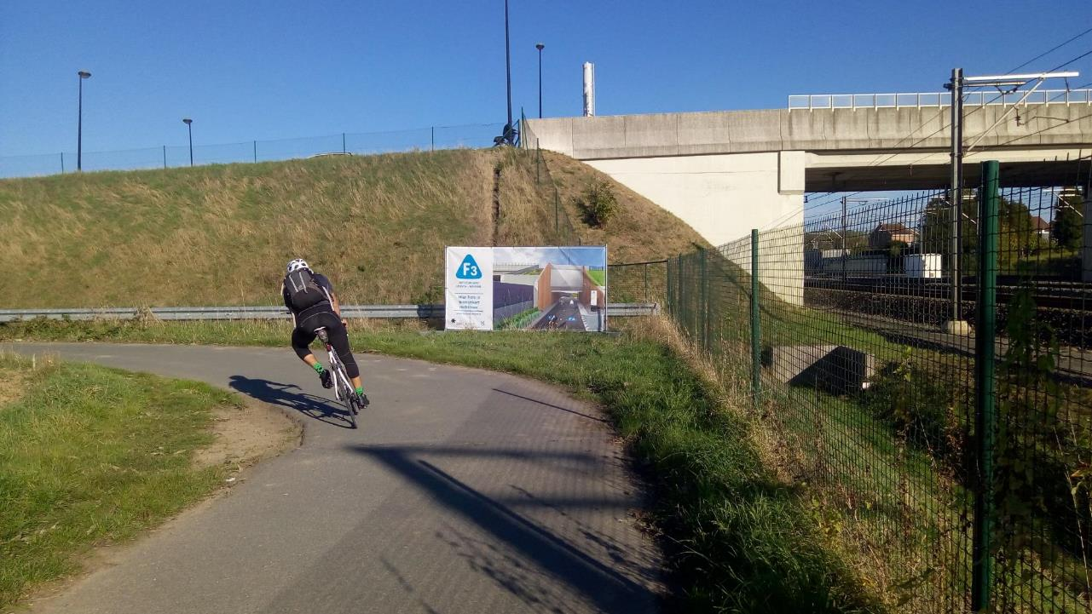
F3 cycle highway Brussels – Leuven: not covered

Slide 14
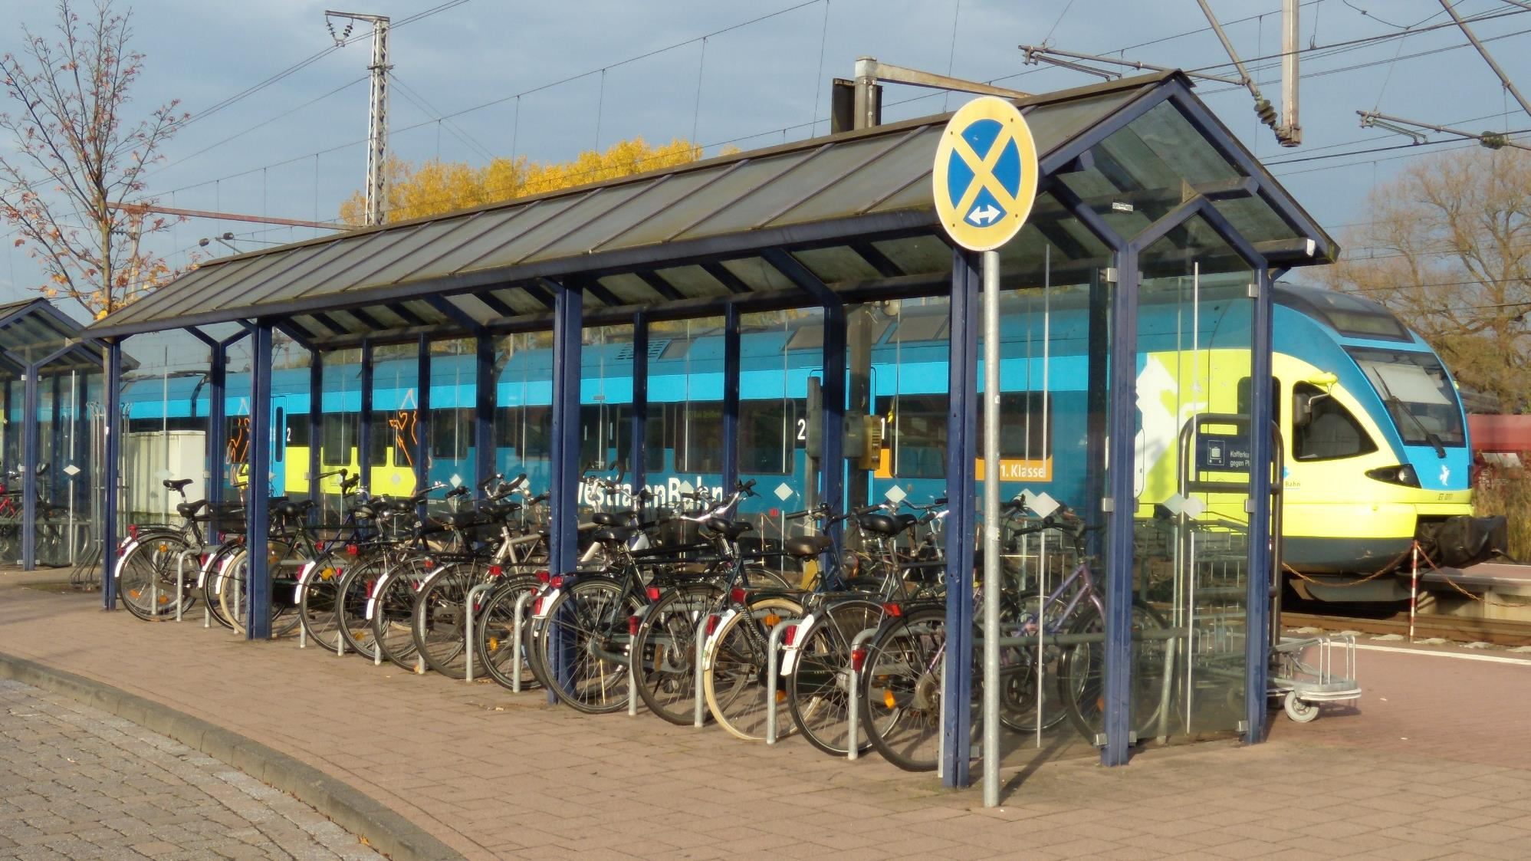
Trips to urban nodes often start in smaller cities

Slide 15
How to improve the Commission’s proposal?
Integrate EuroVelo, the European cycle route network
Address the barrier effect of TEN-T
Create new cycling connections within TEN-T projects
Flesh out the section on urban nodes
https://ecf.com/what-we-do/policy-areas/ten-t-eurovelo-and-cycling

