Slide 1
Challenges facing city streets
..and how MORE addresses them
Paulo Anciaes
UCL (University College London)
Better streets for better cities
Brussels, 17-02-2022

Slide 2
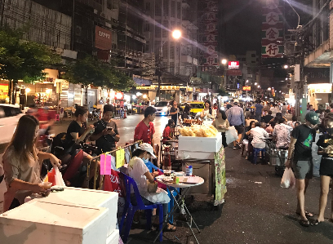
City streets have a variety of uses
Movement
Place
Movement of people (walking, cycling, or by car, bus, taxi, motorcycle, tram)
Movement of goods (by vans, trucks, or cargo cycles)
Parking, loading, pick-up/drop-off
Waiting for buses or taxis
Outdoor activities (window shopping, strolling, socializing, sitting)

Slide 3
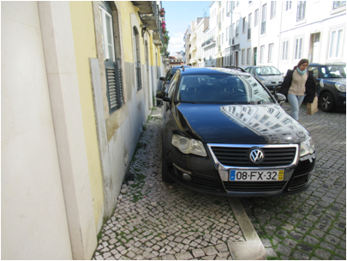
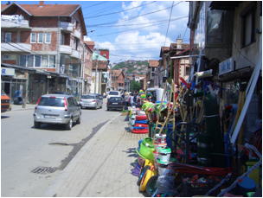
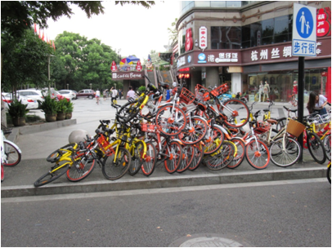
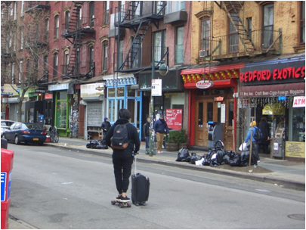
Demands on scarce space generates conflicts
‘old’ conflicts
new conflicts

Slide 4
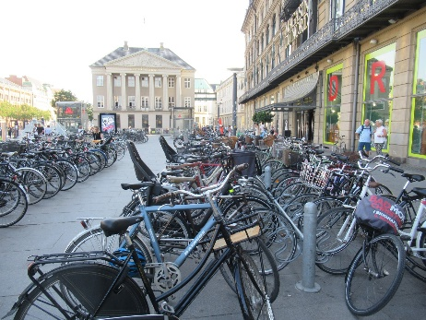
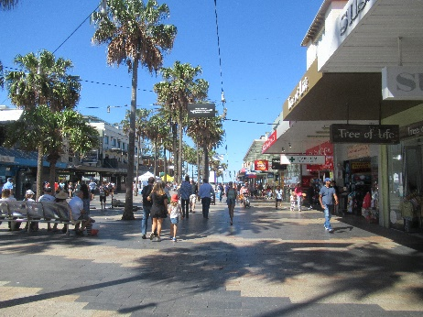
Addressing economic aspects
Increasing accessibility of customers and freight vehicles to stores and providing good pedestrian infrastructure and places to rest..
..promotes the local economy and can counter the tendency for the decline of physical stores in commercial streets.

Slide 5
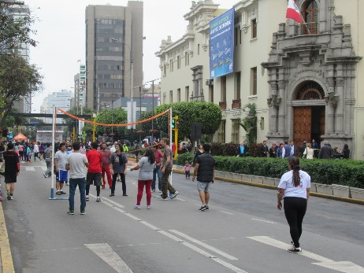
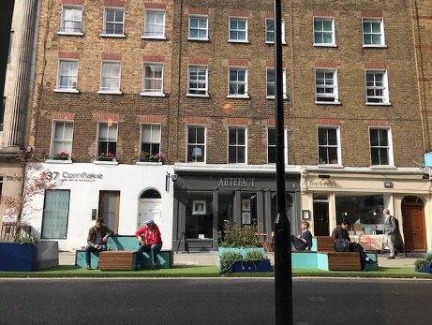
Addressing social aspects
Achieving a more sustainable modal split (fewer cars, more active modes) and providing good-quality places improves:
Social interaction and social cohesion
Personal security
Community severance
Physical activity
Stress
Traffic safety

Slide 6
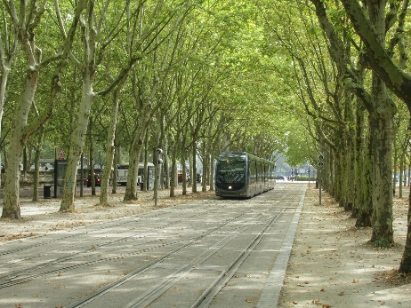
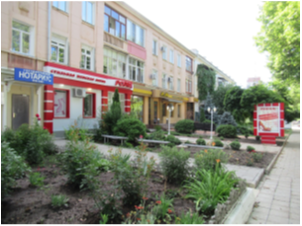
Addressing environmental aspects
Achieving a more sustainable modal split (fewer cars, more active modes) and providing green areas improves:
Noise and air pollution
Visual environment
Soil and water
Local climate
Energy consumption and CO₂ emissions

Slide 7
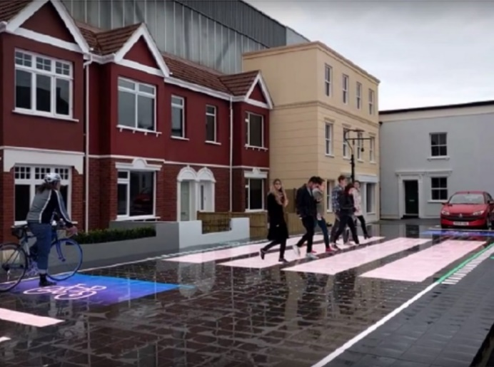
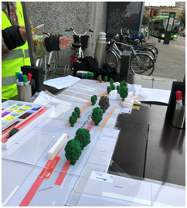
Dealing with contested space
A technical issue
A political issue
Solutions have been designed to optimize movement (e.g. adaptive traffic signals, self-healing materials, dynamic allocation of space)
Solving conflicts requires dialoguing with a wide range of stakeholders
Responsibility for solving conflicts is fragmented across planning and delivery agencies
Many technical solutions rely on gathering information about street use, possibly infringing on the individuals’ privacy.

Slide 8
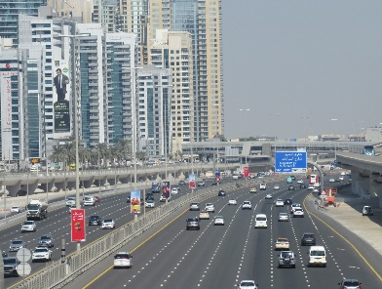
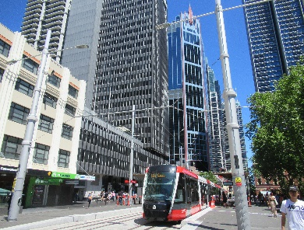
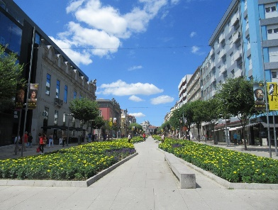
Changing political priorities
 | Stage 1 (car-oriented city)
 | Car use: increasing Political priority: car mobility. Interventions: new roads and car parking, segregation of modes
 | Stage 2 (sustainable mobility city)
 | Car use: levelling out Political priority: public transport and non-motorised modes. Interventions: improving public transport and walking and cycling infrastructure
 | Stage 3 (city of places)
 | Car use: declining Political priority: place-making Interventions: improving the quality of streets and public spaces

Slide 9
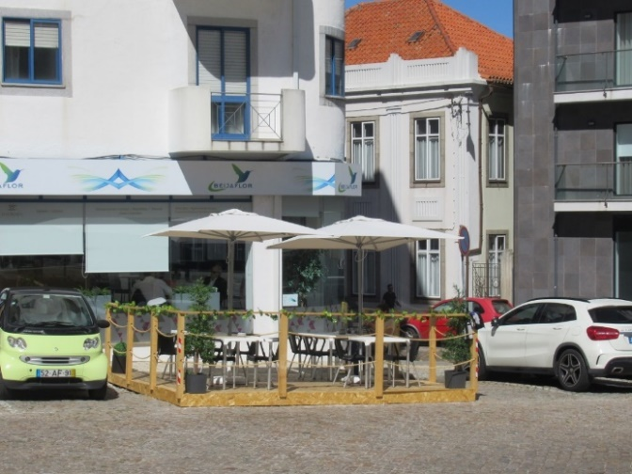
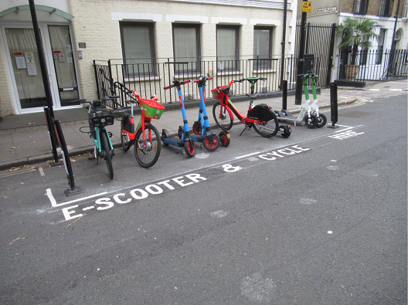
COVID-19 and roadspace
The COVID-19 crisis accelerated trends:
Shift of activities from the physical to the online world
Use of active modes and green areas, as health-promoting activities
Political priorities to active modes and place activities
The success of measures applied during this period demonstrates their benefits for society and paves the way for further similar measures in the future

Slide 10
Considers all street uses (movement and place)
Improves modelling of conflicts between street uses
Considers (and where possible, measures) wider aspects of street space allocation
Explores new technical solutions
Integrates stakeholder engagement in the street space allocation process
Makes political priorities explicit in the option generation/appraisal stages

Slide 11
Thank you for your attention!
p.anciaes@ucl.ac.uk
This project has received funding from the European Union’s Horizon 2020 research and innovation programme under grant agreement No 769276.
This document reflects only the author's view and that the Agency is not responsible for any use that may be made of the information it contains.

