Slide 1
MORE Stakeholder Engagement Tools
ROBIN MORRISON
Buchanan Computing
Better streets for better cities
Brussels, 17-02-2022
This project has received funding from the European Union’s Horizon 2020 research and innovation programme under grant agreement No 769276.
This document reflects only the author's view and that the Agency is not responsible for any use that may be made of the information it contains.

Slide 2
Introduction
Traffweb: Map based Web application for Public Consultation
Street Layout Toolkit: Physical design tool for collaborative design creation in workshops using a system of blocks, acetates and scale plans
LineMap: Road markings application for the digital representation and refinement of designs

Slide 3
Stakeholder Engagement
Issue Consultation: Collect issues, suggestions and comments regarding the current situation within the area of interest: Traffweb
Design Option Creation: Collaborative design creation using Street Layout Toolkit and LineMap
Design Consultation: Feedback on design(s) for the improvement of the area of interest: LineMap and Traffweb

Slide 4
Traffweb
Stakeholders can use Traffweb to:
Record issues within the area of interest
Provide feedback on Designs
Designers can log into a secure area for dashboard reporting and downloadable results
Notes:
Traffweb and Linemap work together- LineMap for Designers Traffweb for Public Stakeholders

Slide 5
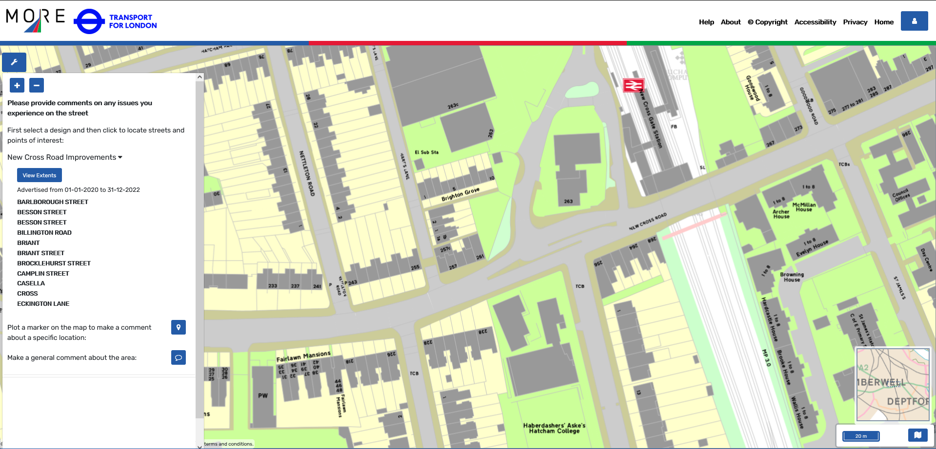
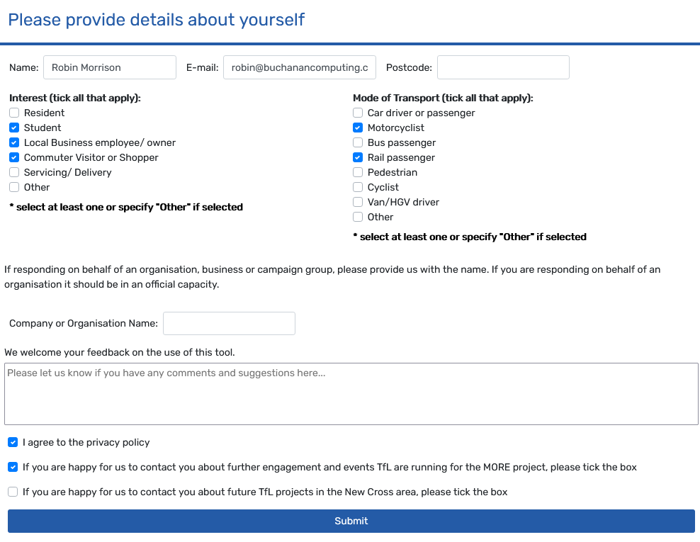
Traffweb: Issue Consultation
Notes:
Collect issues from stakeholders in the area of interest using a base map: Map tools for navigation and legend

Slide 6
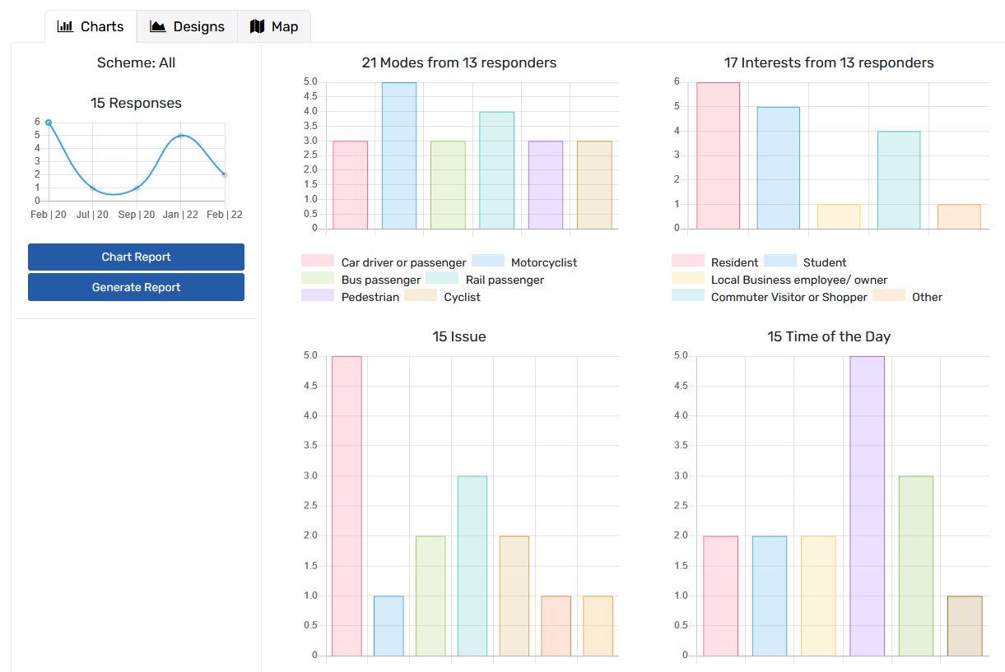
Traffweb: Reporting
Dashboard of results
Map of issues by category
Survey and Issue data report download
Notes:
Secure area provides designers with a dashboard of results and downloadable reports

Slide 7
Street Layout Toolkit
A Physical Design Toolkit enables local stakeholders such as residents and business owners to collaborate in the design process at workshops
Stakeholders can try out different combinations of street design elements on scale plans using coloured physical blocks and acetates

Slide 8
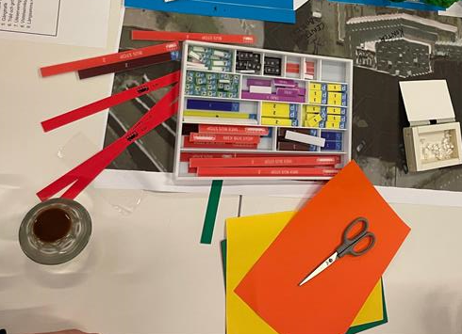
Street Layout Toolkit
A street plan at a scale of 1:200 showing the road layout and the existing buildings
Blocks representing different fixed length road use items such as loading or parking bays
Acetates representing longer or non-linear items such as bus and cycle lanes
A set of pens to mark points of detail
Stickers to fix the design created by the blocks

Slide 9
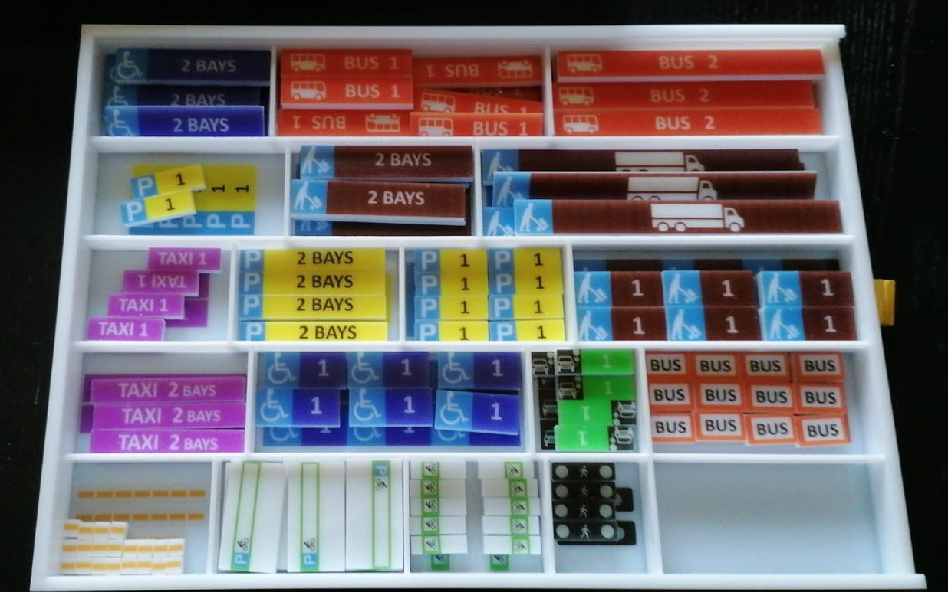
Notes:
Process: stakeholders invited to design workshop: Briefing on current conditions – traffic regs + issues,
Groups - depending on size of group and area of interest could divided into smaller groups looking at specific sections,

Slide 10
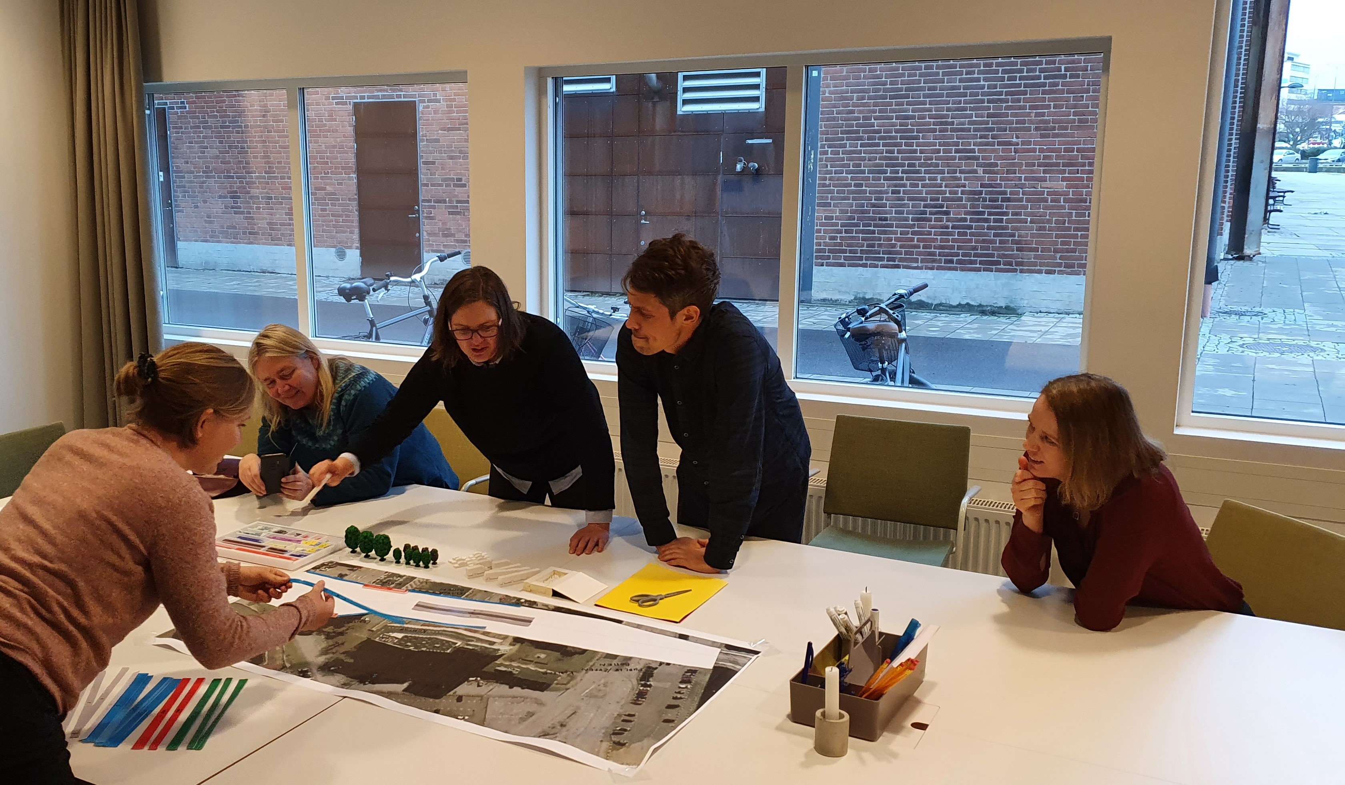
Notes:
Workshop in action:
Fixed conditions and space taken into consideration – building lines, or prohibited areas for parking
Stakeholder then produce Designs for remaining space using blocks and acetates,

Slide 11
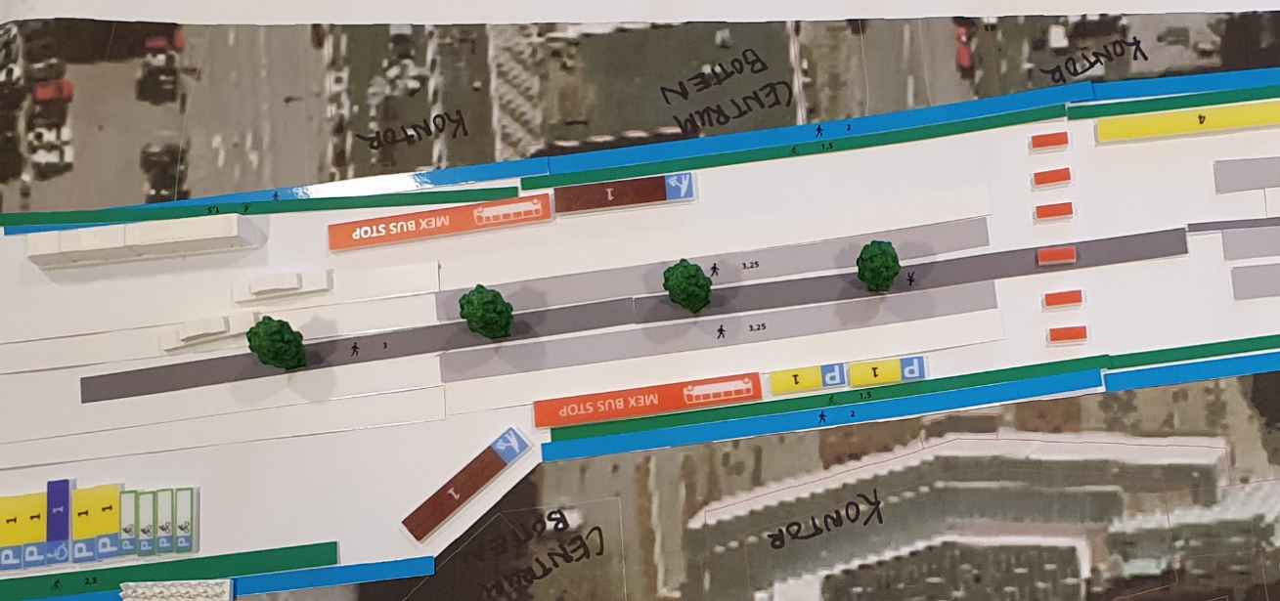
Street Layout Toolkit
Notes:
Once agreement has been reached the design is fixed using stickers and annotations.
Then use LineMap to produce digital rep of design

Slide 12
LineMap: Digital Design Creation
Map based Road Marking Design Tool in the cloud
Designers can produce digital representations of the designs created using the Street Layout Toolkit
Designs can be displayed as blocks or accurate road markings
Publish to Traffweb for Consultation
Export to VISSIM as an overlay for modelling

Slide 13
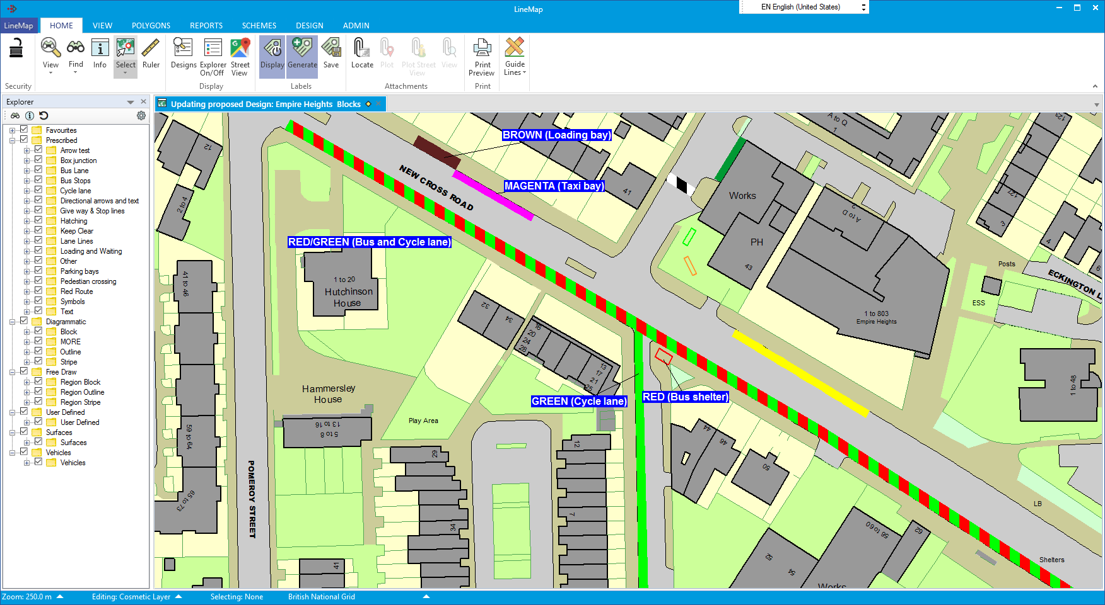
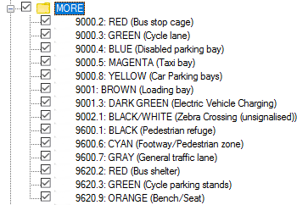
Notes:
Explorer – library of Road Markings and Interactive map. Designs can be created as blocks matching the Street Layout Toolkit…

Slide 14
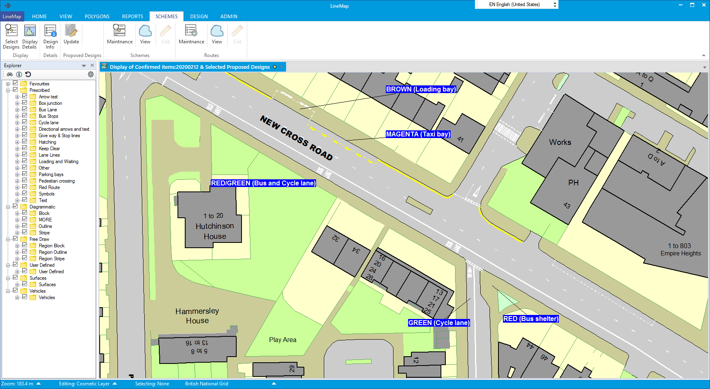
Notes:
…then converted into accurate road markings where further detail can be added such as direction arrows and text.
Block and markings designs can be published to Traffweb for design feedback

Slide 15
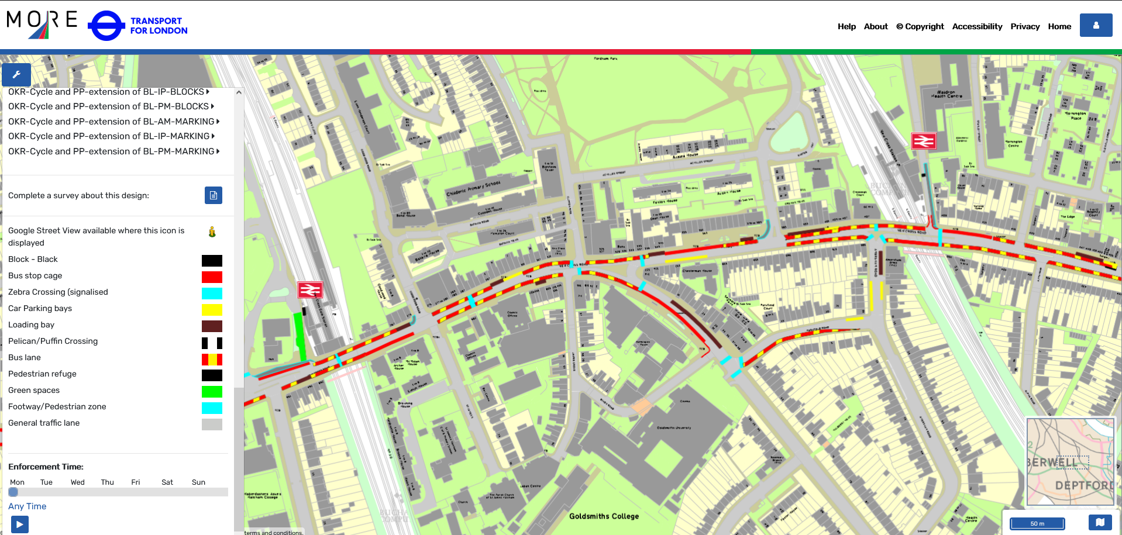
Traffweb: Design Consultation
Notes:
Blocks provide an excellent overview of road use at high levels..

Slide 16
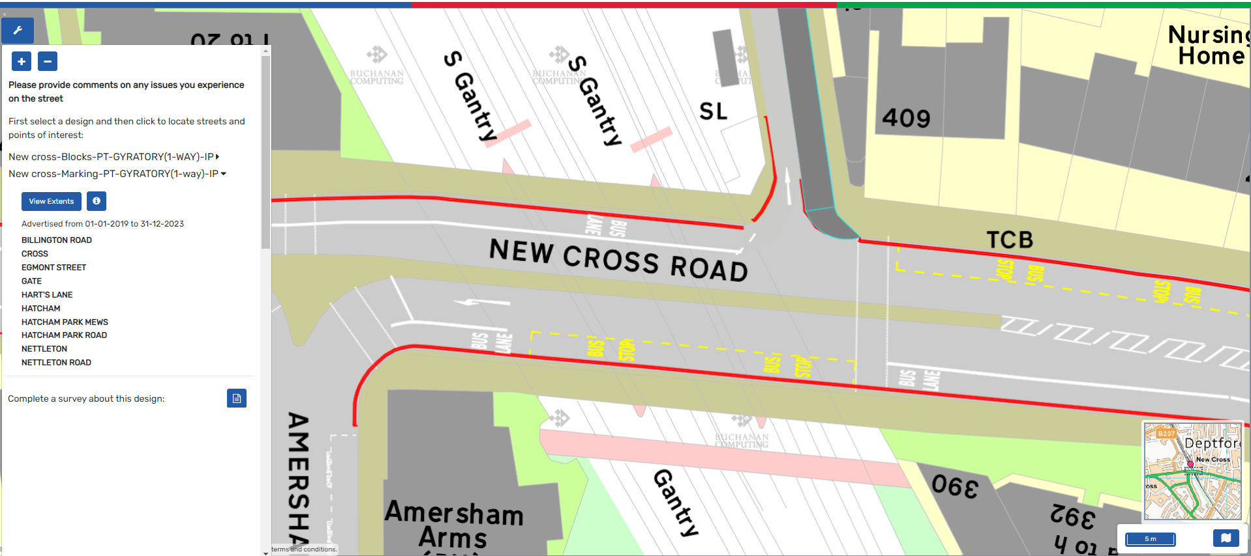
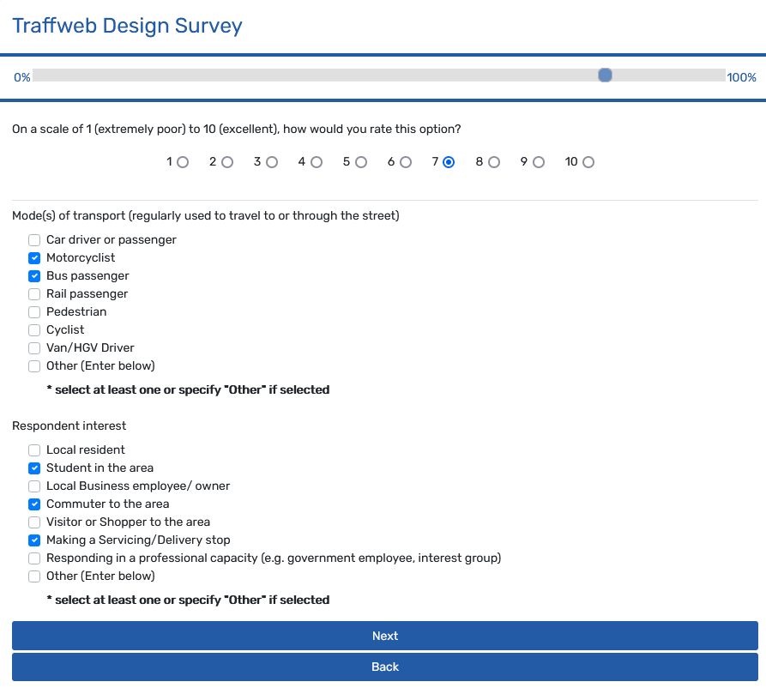
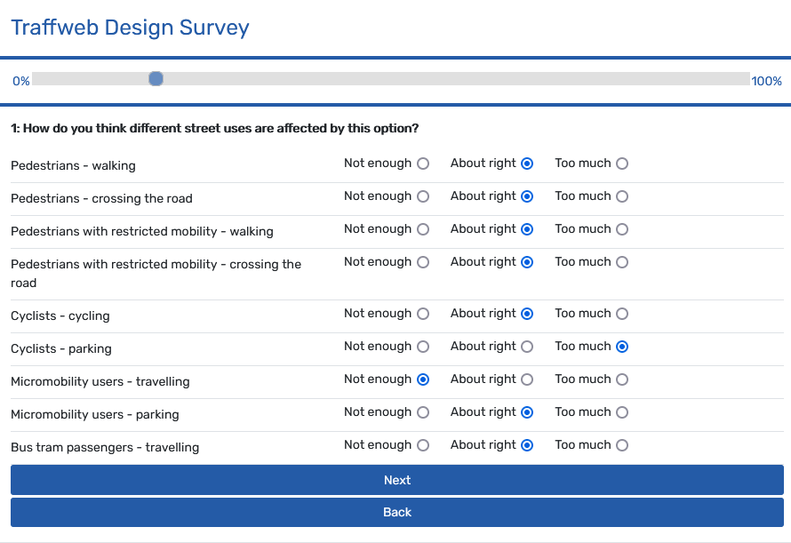
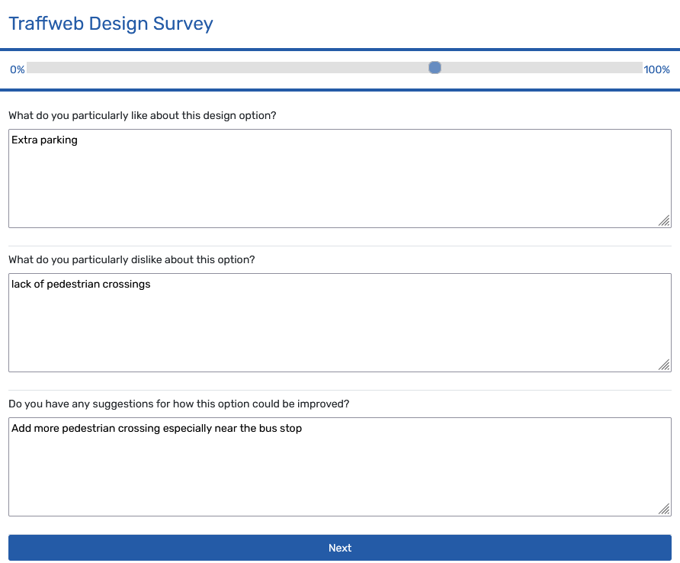
Traffweb: Design Consultation
Notes:
Lower level showing marking details: click to complete survey on design:
Feedback can be used to further refine the designs in Linemap and republish or aid in deciding whether to go forward with the design

Slide 17
Thank you !
ROBIN MORRISON
Robin.Morrison@buchanancomputing.co.uk
This project has received funding from the European Union’s Horizon 2020 research and innovation programme under grant agreement No 769276.
This document reflects only the author's view and that the Agency is not responsible for any use that may be made of the information it contains.
Notes:
Tuesdsay 22 February, 11:00 – 13:00 CET: An introduction to the MORE tools for road space reallocation

