Slide 1
What’s next for TEN-T policy in the EU? 24 February 2022
Tiina Ruohonen, City of Oslo

Slide 2
MOVE21 will help European cities to transform into climate neutral, connected multimodal urban nodes for smart and clean mobility and logistics
This project has received funding from the European Union’s Horizon 2020 research and innovation programme under grant agreement No 953939

Slide 3
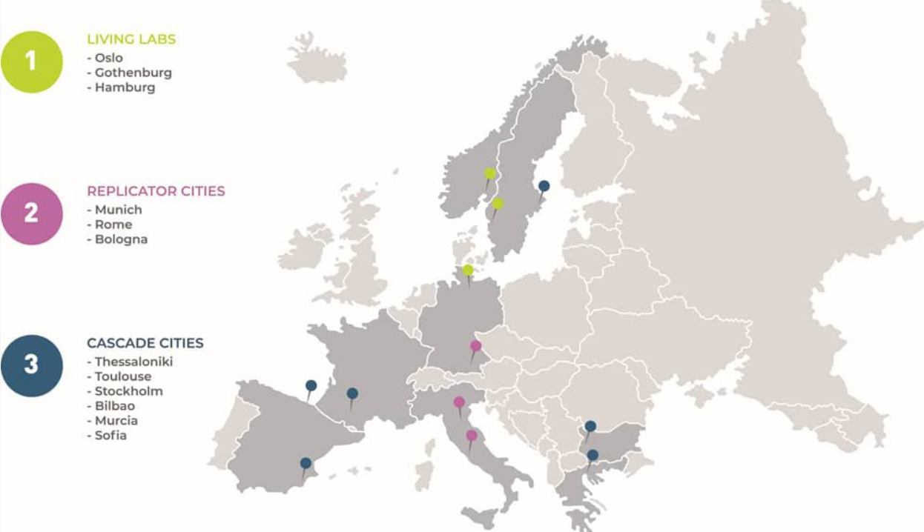

Slide 4
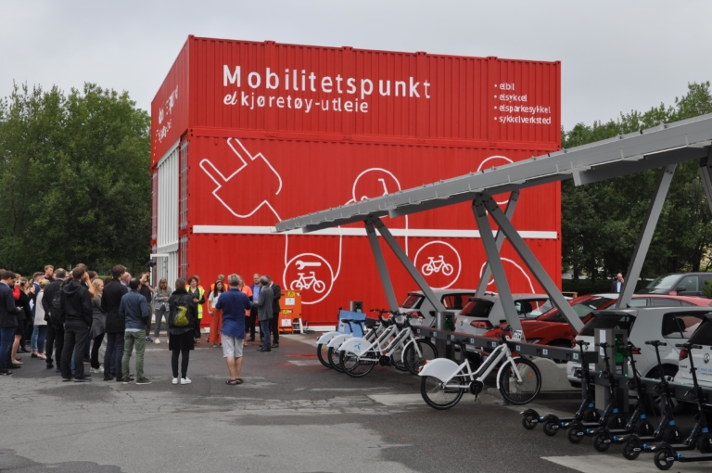
Integrated approach to
domains, sectors and levels
Test, deploy, replicate and upscale zero emission solutions through co-creation in urban nodes and functional urban areas on the TEN-T Scan-Med corridor
Combine technological and non-technological innovations to facilitate effective implementation
Increase liveability in European cities by focusing on social cohesion, and transport and health equity
Establish a platform for coordination, collaboration and data sharing for clean and efficient urban multimodal mobility on TEN-T corridor level
Maximise uptake of solutions through ambitious replication, uptake and dissemination activities

Slide 5
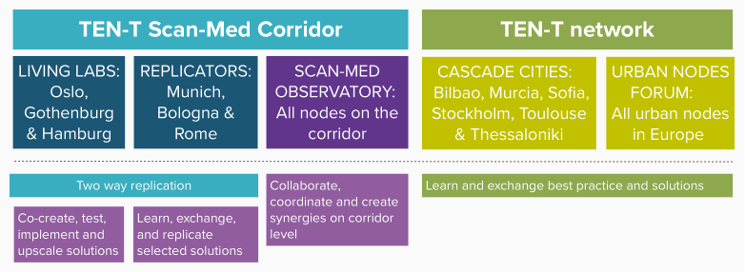

Slide 6
TEN-T corridor approach in MOVE21
Boost system level perspective
Promote efficient (multi-)governance
Increase TEN-T related cross-border collaboration
Build on existing financial and institutional cooperation (STRING megaregion)
Evaluate implemented solutions in urban nodes from the point of TEN-T accessibility and network performance

Slide 7
Scan-Med Observatory
Address real needs
Ensure that local and regional perspectives are part of the decision-making process – balance national level representation in TEN-T policy discussions
Foster an ecosystem for governance coordination, data and knowledge sharing on the corridor
Encourage common funding mechanisms and joint systems components
Outlive the project!

Slide 8
From 19 to 76 urban nodes on the Scan-Med

Slide 9
Getting ready
Observatory framework in place by October this year
Launch in October during European week of regions and cities
Have your say – what should the observatory focus on during its first year?

Slide 10
Thanks!
Stay in touch:
tiina.ruohonen@byr.oslo.kommune.no

