Slide 1

MORE Final Conference, Brussels
17th February 2022
Concepts and Street Design Principles
Peter Jones, UCL
This project has received funding from the European Union’s Horizon 2020 research and innovation programme under grant agreement No 769276.
This document reflects only the author's view and that the Agency is not responsible for any use that may be made of the information it contains.

Slide 2
Concepts & street design principles
‘Roads’ vs ‘streets’
Policy priorities and street design
‘Movement’ and ‘Place’ street functions
Streets as ‘eco-systems’
Categories of policy measures
Street design zones and elements
Design ‘principles’
Flexibility in space allocation

Slide 3
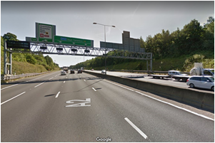
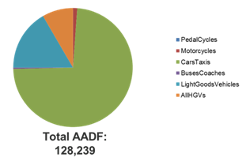
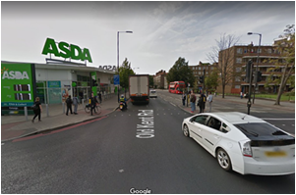
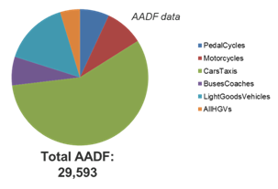
1. ‘Roads’ vs ‘Streets’
ROADS
STREETS

Slide 4
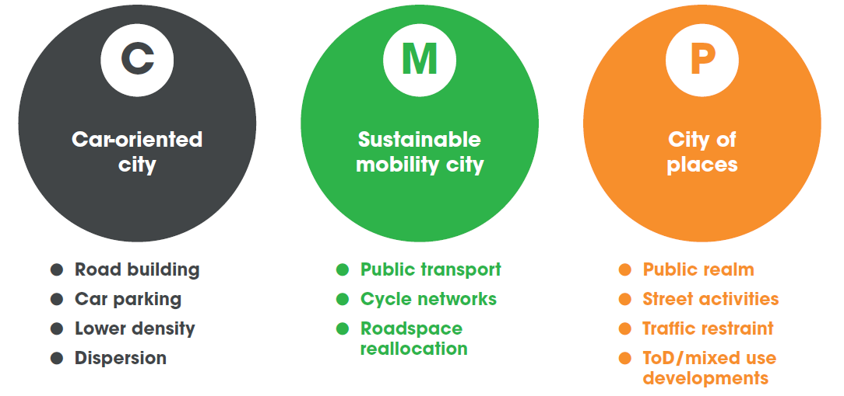
2. Policy priorities and street design elements
Source: EU ‘CREATE’ Project

Slide 5
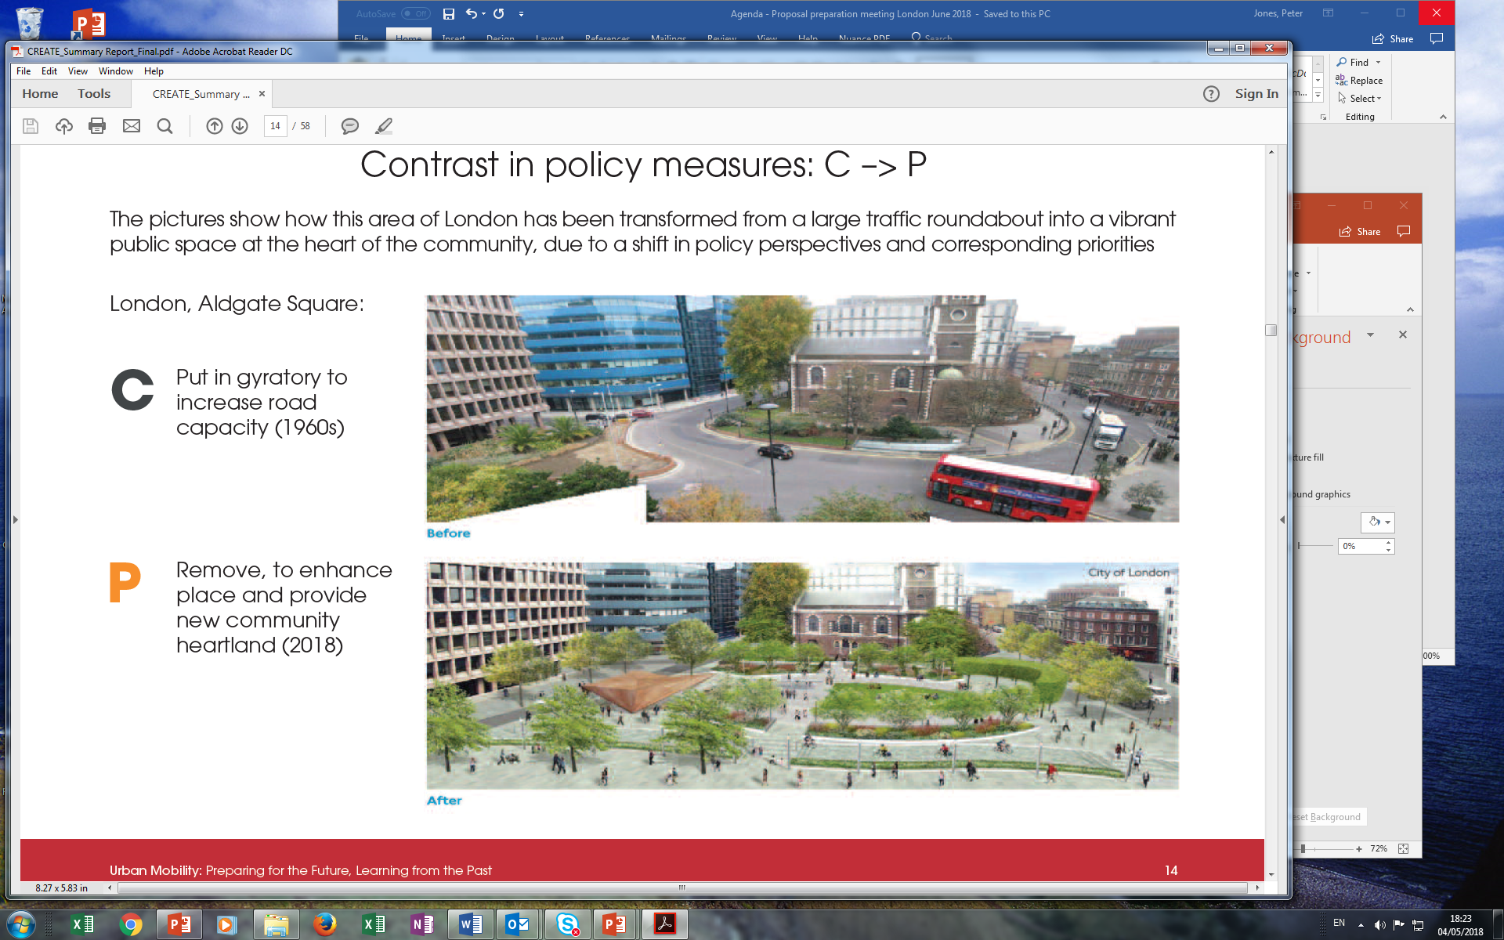
Contrast in space use: C -> P

Slide 6
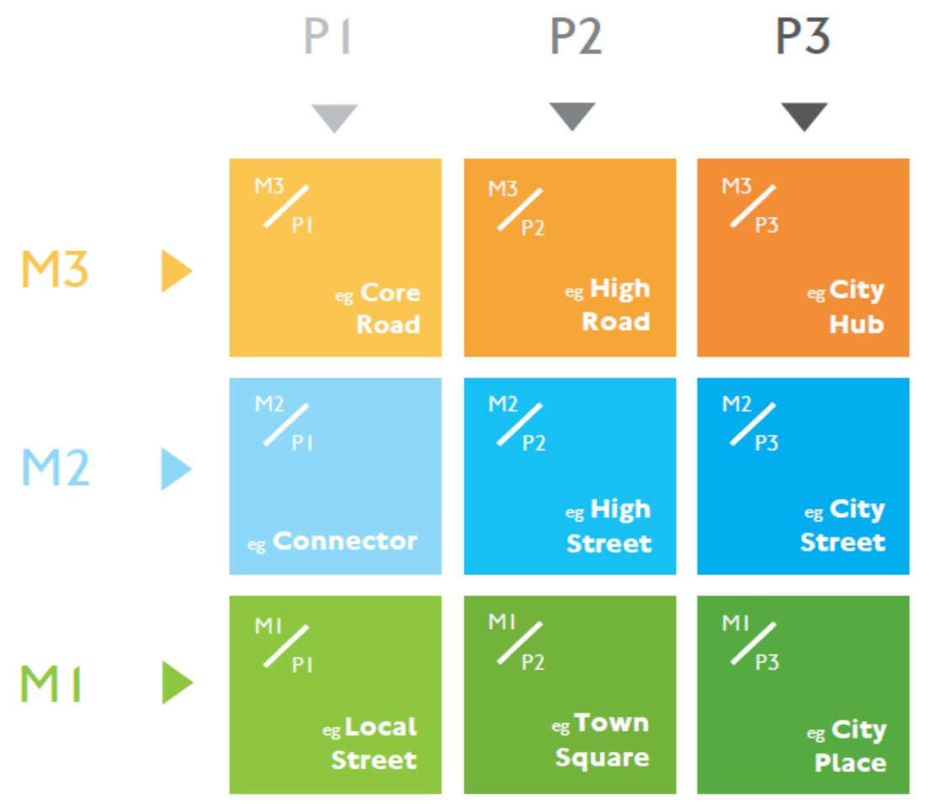
3. ‘Movement’ and ‘Place’ street functions
Street classification applied by TfL as recommended by the Roads Task Force.
With three levels of ‘Movement’ (of people) and three levels of ‘Place’.

Slide 8
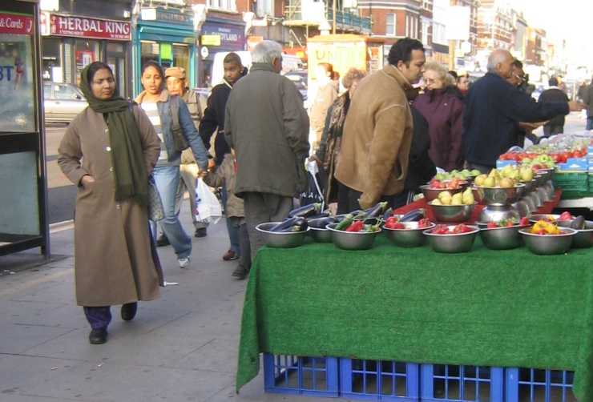
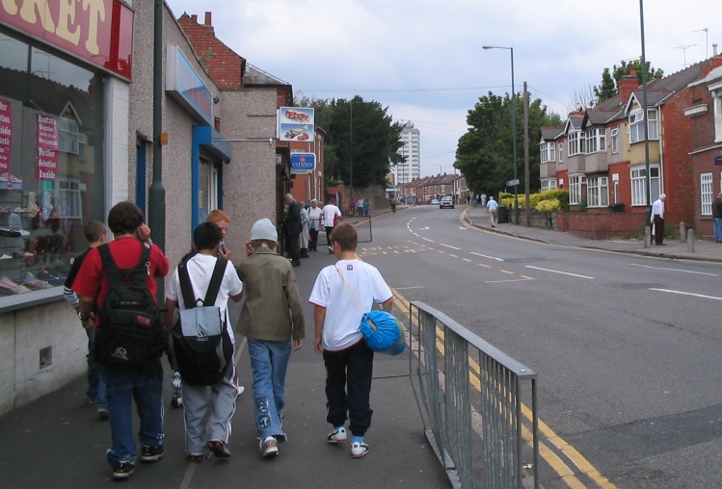
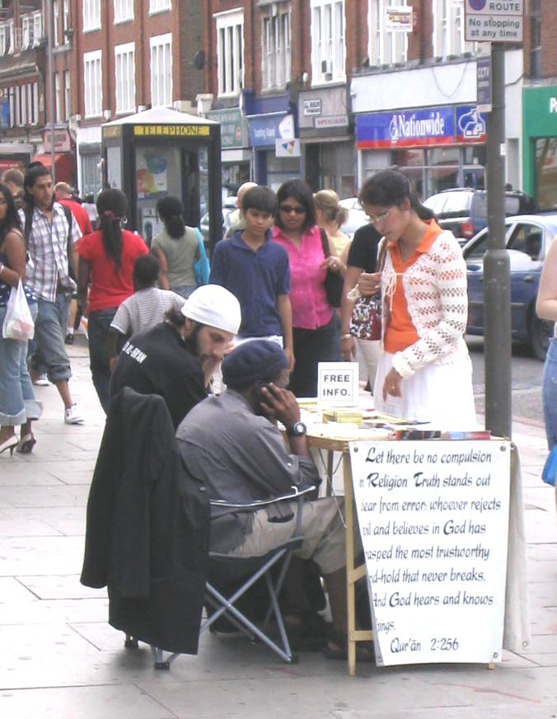
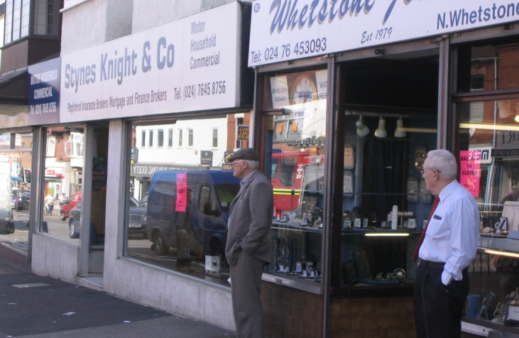
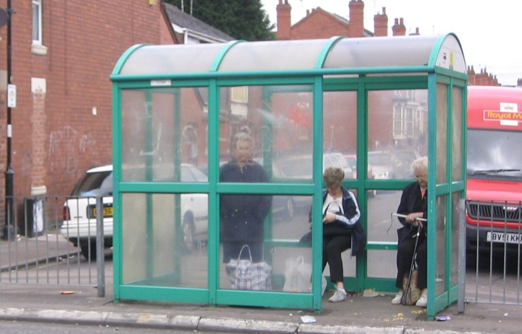
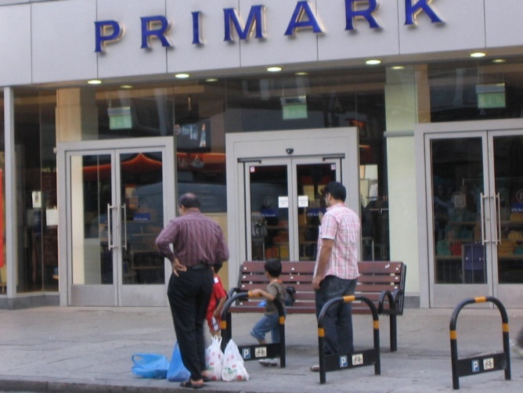
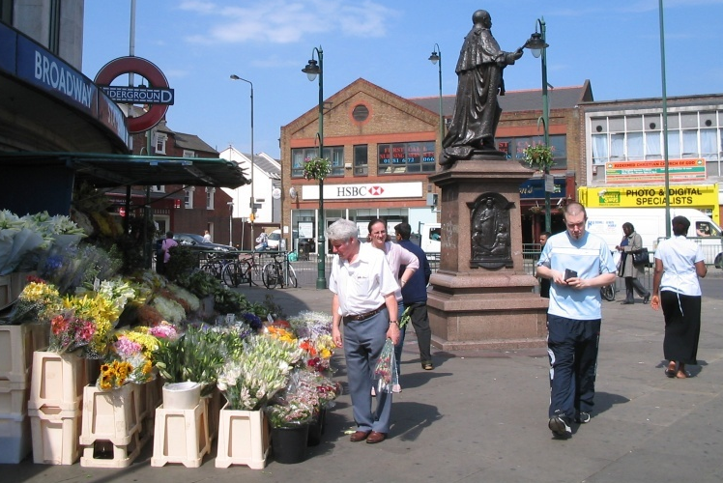
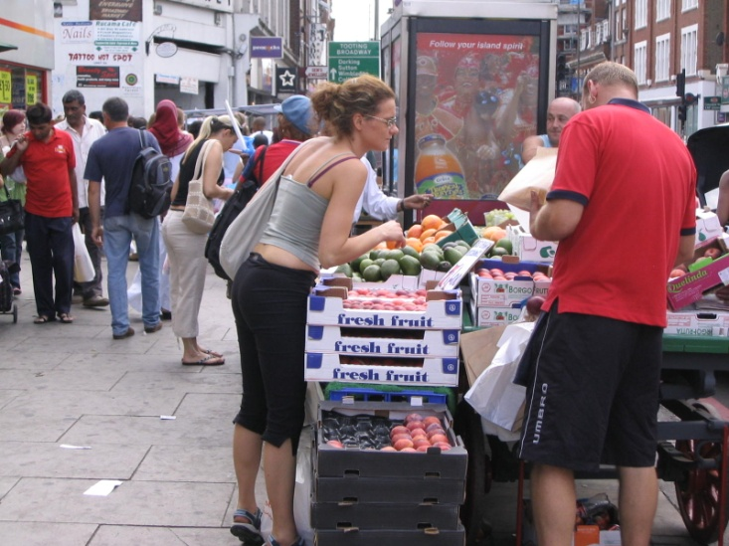
Street
Activities

Slide 9
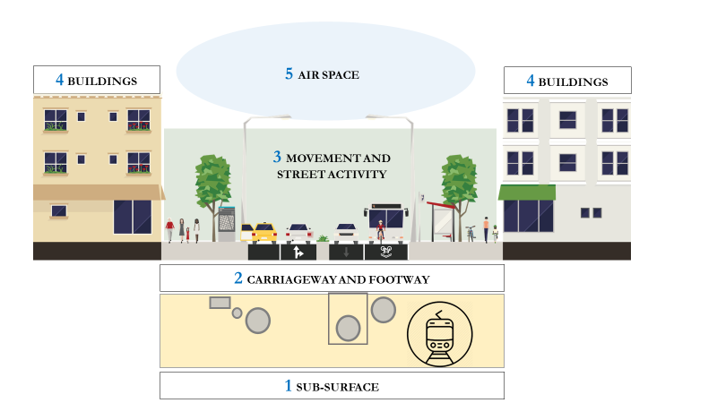
4. Streets as ‘Eco-Systems’: Key components

Slide 10
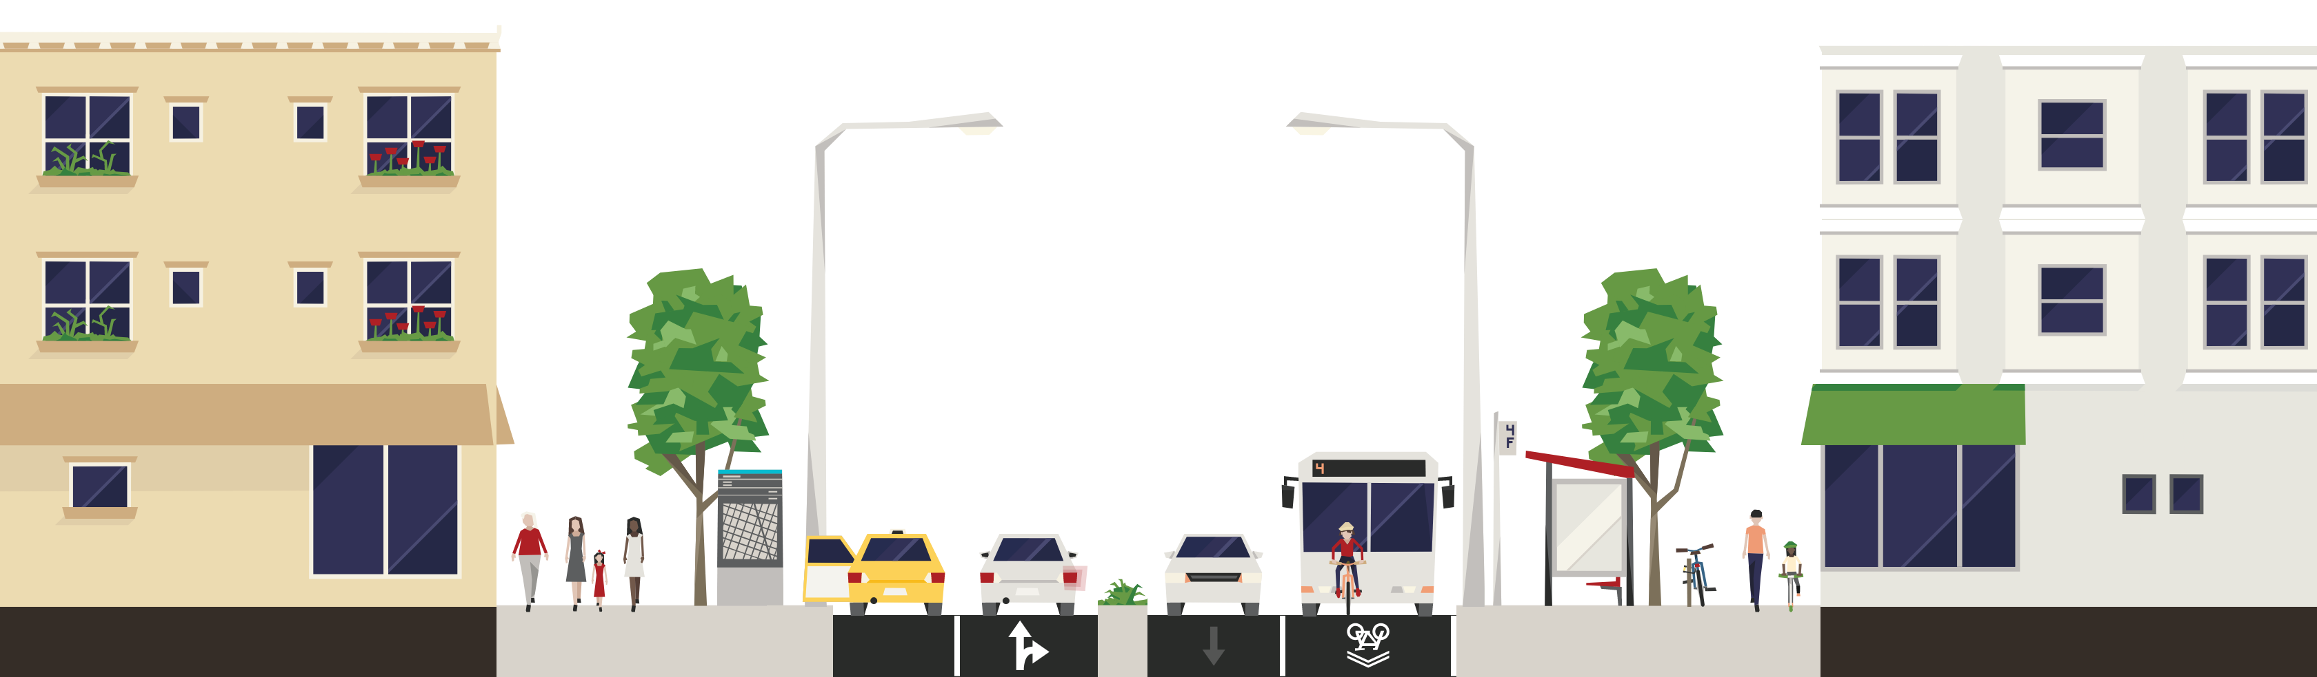

Interactions within components
Traffic monitoring & management
Navigation
Surveillance
Information and data transfer
Arrivals/departures:
Customers, Employees, vendors, service provider etc.
Social Interaction
Delivery of goods
Trade and commerce
Provision of services
Utility Failure – disruption of street activity
Dead load and live load on sub-surface

Slide 11
5. Categories of policy measures
Physical measures: determine amount of provision for a particular street use, if any.
Regulatory measures: control access, by determining when, where and what activities can take place in a given location, at what times and for how long. Access may be granted by regulating:
  The type of person that can use a parking bay (e.g. resident, disabled person)
  What activity is permitted (e.g. ‘no access, except for loading’)
  What type of vehicle is permitted (e.g. buses only)
Pricing measures: used to regulate levels of demand (e.g. traffic) or encourage compliance (e.g. ULEZ)
These may be used in combination (e.g. parking)

Slide 12
6. Street design zones and elements

Slide 13
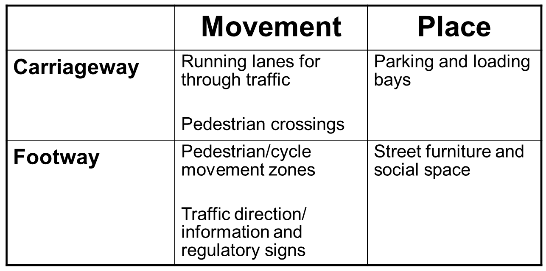
Elements by function

Slide 14
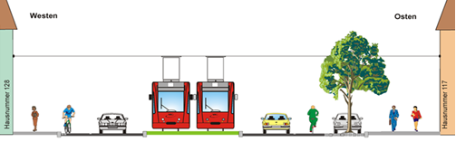
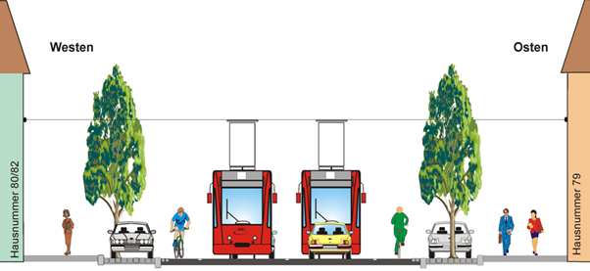
7. Design ‘Principles’: context sensitive
RESIDENTIAL
RETAIL

Slide 15
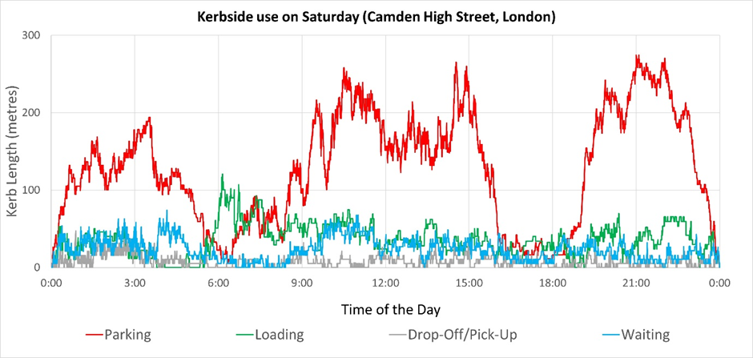
8. Flexibility in space allocation

Slide 16
Thank you
Peter Jones
peter.jones@ucl.ac.uk
This project has received funding from the European Union’s Horizon 2020 research and innovation programme under grant agreement No 769276.
This document reflects only the author's view and that the Agency is not responsible for any use that may be made of the information it contains.

