Slide 1
Better streets for better cities MORE Final Event
Brussels, 17 February 2022
Current user groups and patterns of street use
Regine Gerike, Caroline Koszowski, Bettina Schröter, Rico Wittwer TU Dresden
With Valuable Contributions from Partners
This project has received funding from the European Union’s Horizon 2020 research and innovation programme under grant agreement No 769276.
This document reflects only the author's view and that the Agency is not responsible for any use that may be made of the information it contains.

Slide 2
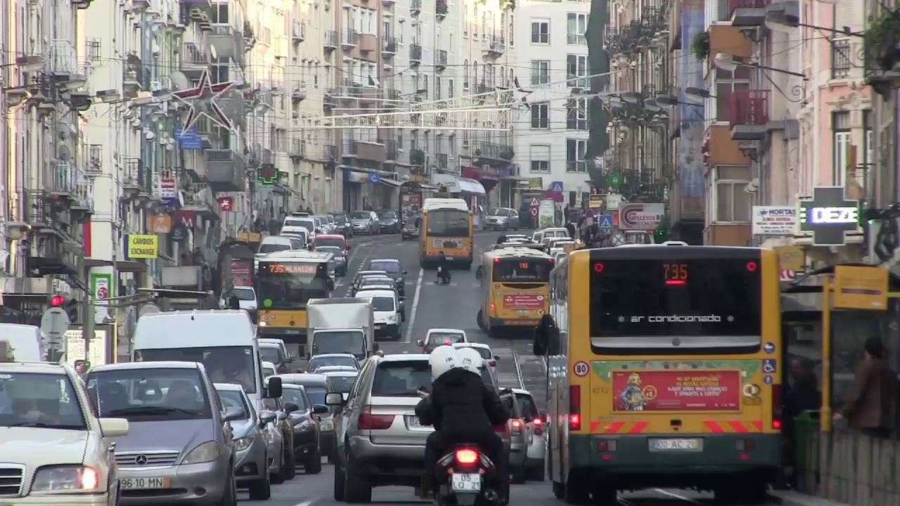
Current Street User Groups
Movement
Pedestrians
Cyclists
Micro Vehicles
PT: Busses, Trams
Taxis, Hired Vehicles
Motorcycles
Cars
Light Vans, HGV
Place
Activities: Waiting, Eating, Watching, Relaxing, Chatting, Working
Access
Parking, Stopping
Services
Picture by City of Lisbon

Slide 3
Indicators for Measuring Street Performance
Movement Function
Movement Function
Wider Impacts
Indicators on quality of movement:
Travel time, delay
Reliability
Waiting times at junctions
Number of vehicles per kilometer at street sections
Volumes, number of movement users:
Motorized vehicles (cars, LGV, HGV, motorcycles, bicycles, micro vehicles such as scooters), buses, trams
Pedestrians walking along the footway
Pedestrian crossing volumes
Public transport passengers
Volumes, number of place users:
Distinguished e.g. by location, person group, activity type
Duration of stationary activities:
Distinguished e.g. by location, person group, activity type
Number and duration of kerbside activities
User perception
Traffic accidents
Noise
Air quality
Carbon emissions
On-street crime (Security)
Public health

Slide 4
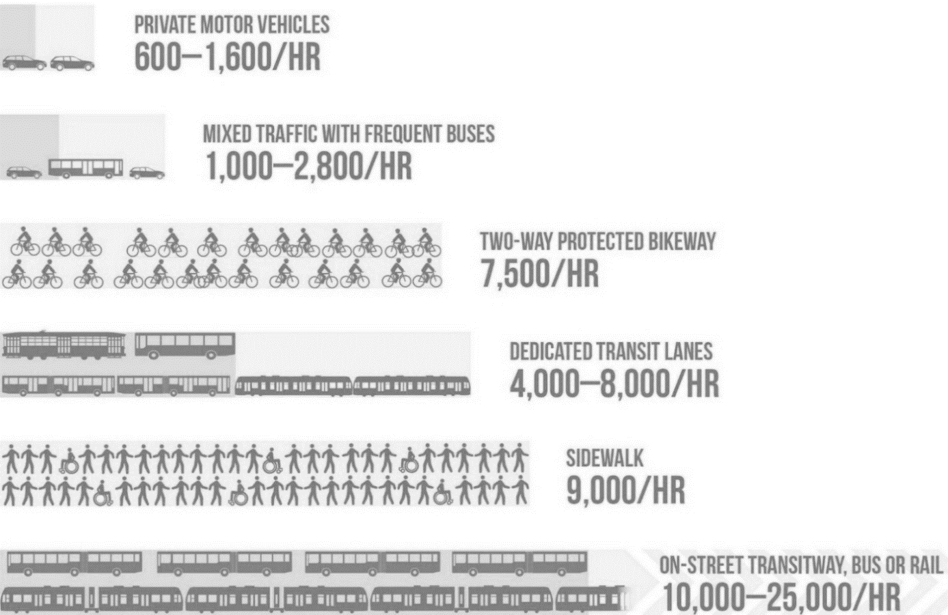
Space Efficiency of Street User Groups
The capacity of a single 10-foot lane (appr. 3m) by mode at peak conditions with normal operations.
NACTO (2016) Transit Street Design Guide. https://nacto.org/publication/transit-street-design-guide/introduction/why/designing-move-people/

Slide 5
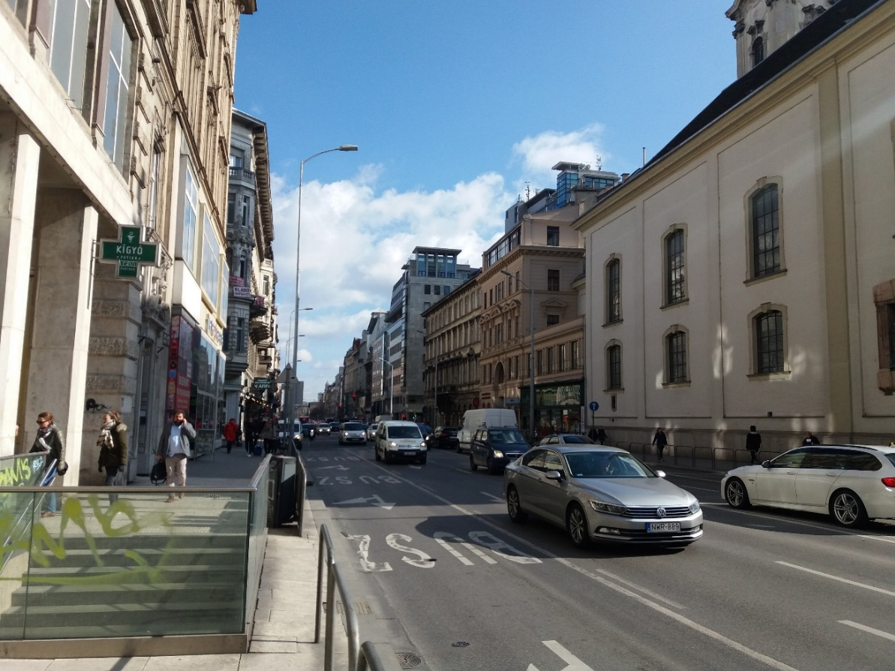
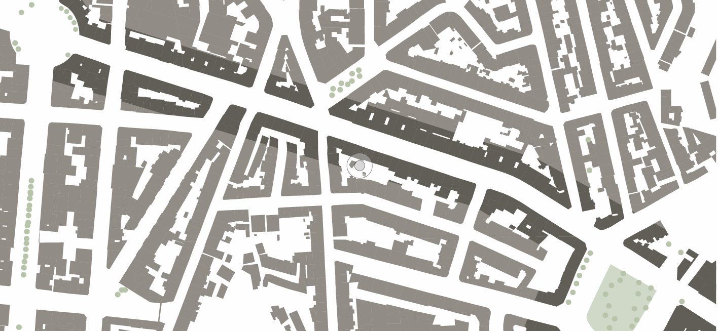
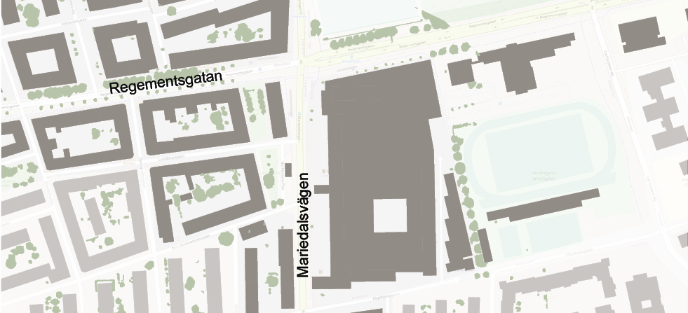
MORE-Cities: Stress Sections
Budapest
Constanta
Lisbon
London
Malmö
Maps created on the basis of © OpenStreetMap Contributors (2021); Own picture; MORE-Meeting in Budapest (28.02.2020)

Slide 6
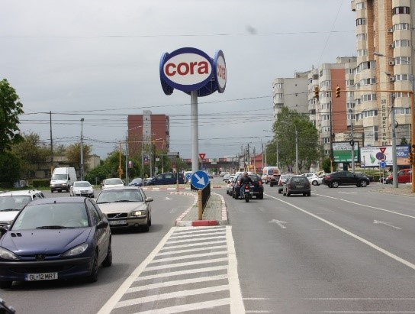
MORE-Cities: Stress Sections
Budapest
Constanta
Lisbon
London
Malmö
Maps created on the basis of © OpenStreetMap Contributors (2021); Picture by City of Constanta

Slide 7
MORE-Cities: Stress Sections
Budapest
Constanta
Lisbon
London
Malmö
Maps created on the basis of © OpenStreetMap Contributors (2021); Picture by City of Lisbon

Slide 8
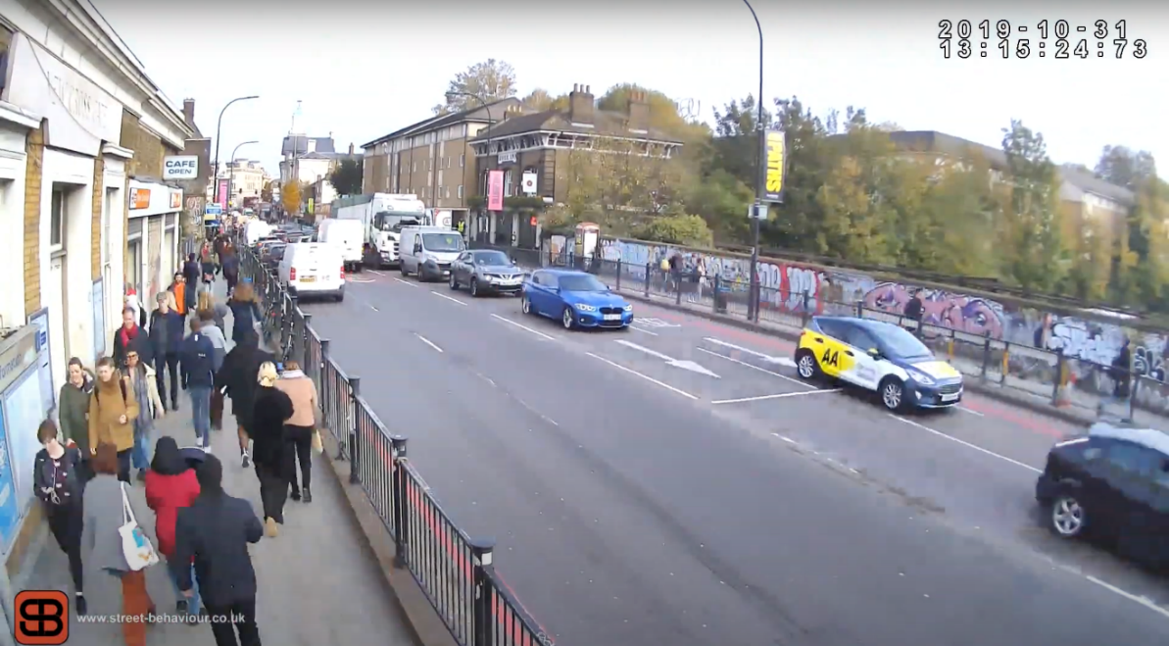
MORE-Cities: Stress Sections
Budapest
Constanta
Lisbon
London
Malmö
Maps created on the basis of © OpenStreetMap Contributors (2021); Picture by © Street Behaviour Ltd (2019): Video-Surveys at Stress Section, 31.Oct.2019

Slide 9
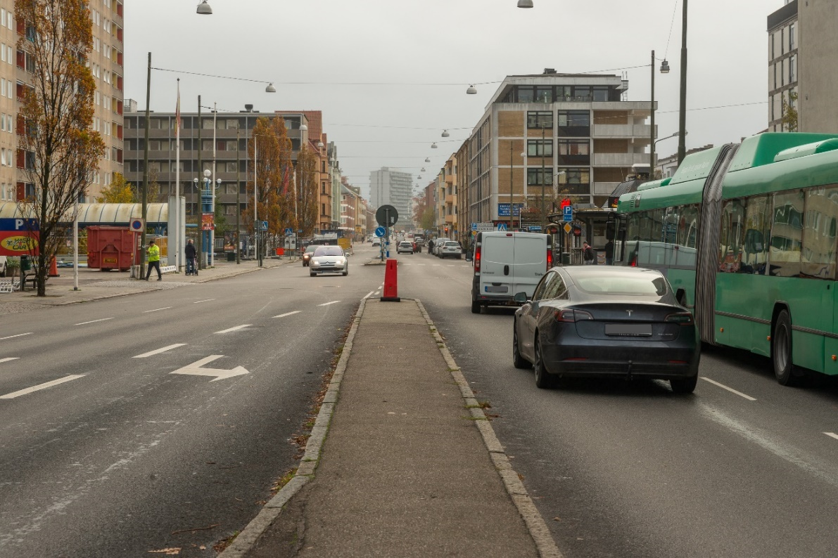
MORE-Cities: Stress Sections
Budapest
Constanta
Lisbon
London
Malmö
Maps created on the basis of © OpenStreetMap Contributors (2021); Picture by City of Malmö

Slide 10
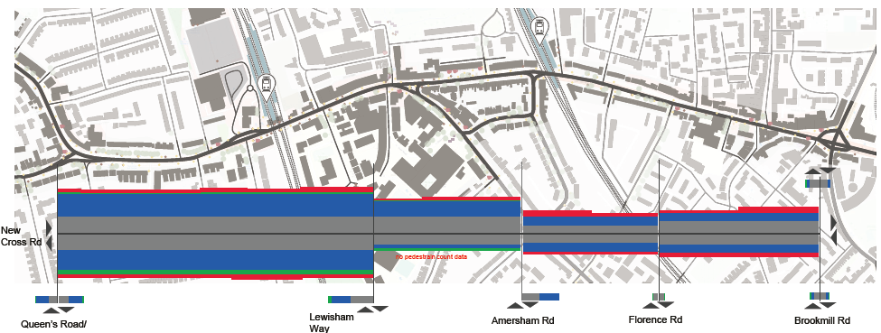
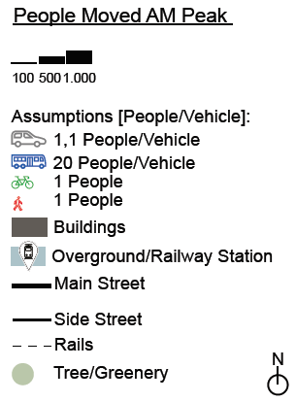
MORE-Cities: Stress Sections – People Moved
London: People Moved AM Peak
Budapest
Constanta
London
Lisbon
Malmö
Maps created on the basis of © OpenStreetMap Contributors (2021); Figure: TU Dresden; Gerike, R.; Koszowski, C.; Schröter, B. (2022): Factsheet on the Current Condition at the Stress Section of London
Notes:
AM Peak

Slide 11
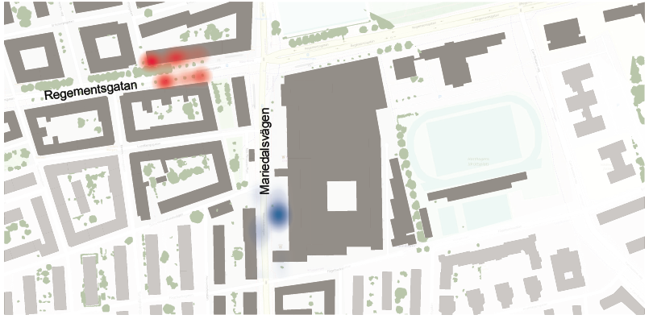
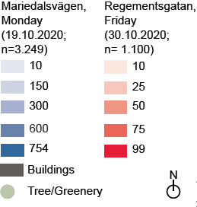
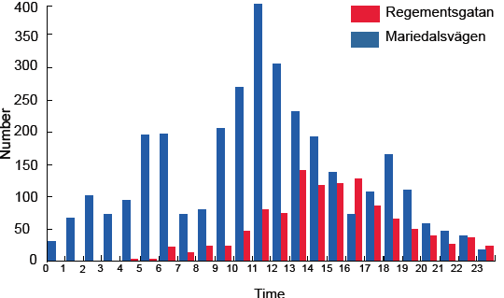
MORE-Cities: Stress Sections – Stationary Activities
Malmö: Heatmap on Stationary Activities from 00:00 am to 23:59 pm
Budapest
London
Malmö: Number of Stationary Activities from 00:00 am to 23:59 pm
Lisbon
Malmö
Maps created on the basis of © OpenStreetMap Contributors (2021); Figure: TU Dresden; Gerike, R.; Koszowski, C.; Schröter, B. (2022): Factsheet on the Current Condition at the Reference Streets of Malmö

Slide 12
Conclusion
There is no
right and wrong
in urban street design!
Thank you for
your attention!
Picture by City of Lisbon

Slide 13
Better streets for better cities MORE Final Event
Brussels, 17 February 2022
Current user groups and patterns of street use
Regine Gerike, Caroline Koszowski, Bettina Schröter, Rico Wittwer TU Dresden
With Valuable Contributions from Partners
This project has received funding from the European Union’s Horizon 2020 research and innovation programme under grant agreement No 769276.
This document reflects only the author's view and that the Agency is not responsible for any use that may be made of the information it contains.

