Slide 1
MORE Final Meeting
Roisin Naughton
London
This project has received funding from the European Union’s Horizon 2020 research and innovation programme under grant agreement No 769276.
This document reflects only the author's view and that the Agency is not responsible for any use that may be made of the information it contains.

Slide 2
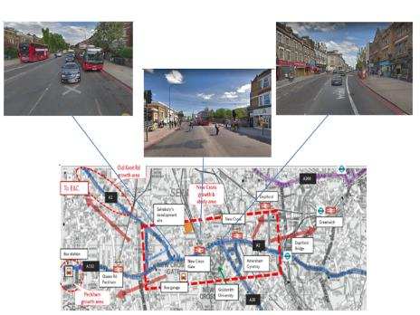
Current section under stress
1
3
Characteristic of section
Section 1 | Section 2 | Section 3
Wide carriageway | Restricted road space | Variable carriageway width
Bus lane in one direction | Higher pedestrian density | Commercial land use
Residential land use | Station exit directly onto street | High street/road environment
Busy location for bus-bus interchange | Transitioning to high street environment | Pedestrian activity
 | Commercial land use with small shops, cafes and restaurants | Bus lane in one direction
2
Notes:
New cross chosen for its high place and movement function, stood out as area with the most competing demands so most challenging area to provide solutions for.
1.6km split into 3 sections with changing characteristics even within this small area of feeder route with variable road widths, dedicated bus lane variation and modal facilities within each section.
Gathering characteristics including parking and loading survey data, collisions, boarding and alighting data for buses, land use, traffic speeds, air quality etc.
Which has identified the Main Challenges and pressures as:
Severely low air quality- concerning given proximity to many local schools and residencies
High bus flows- strategic bus route to wider south east London- but major congestion delays
Low Bus speeds- inconsistent bus lane provision and high boarding figures.
High cycling flows but lack of formal facilities creates footway conflicts
High pedestrian density and footway flows against narrow and inconsistent pedestrian facilities causing pinch points
High levels of illegal parking and loading
Collision hotspots for vulnerable road users

Slide 3
Stakeholder Engagement Pilot
Notes:
Piloted Buchanan stakeholder engagement tool in stress section in summer 2019. A range of approaches used, emails, phone calls and drop by visits with an iPad for residents and workers to tell us the existing issues in the area.
Main uses revealed were centred around congestion, parking and loading and road safety and crossings.
Main outcomes:
Most people don't distinguish between times of day- they think the issues are a problem at all times
Parking and loading non-compliance issues and road safety and crossings came out as most important issues to stakeholders

Slide 4
Objectives
Overarching outcomes have been identified which align to the Mayor’s Transport Strategy, as well as subsequent TfL Strategies and Borough local plans.
Key Priorities
Provide safe and consistent cycle provision | Introduce road danger reduction measures
Improve bus journey time | Improve air quality
Improve walking conditions | Improve access to public transport
Reduce severance for pedestrians | Improve interchange between modes
Reduce speed | Reduce private car trips and consolidate freight
Notes:
Mayoral target of 80% sustainable mode share by 2041 using healthy streets indicators to encourage sustainable transport use.
10 key objectives identified- incorporating the healthy streets approach and aligning with Lewisham Transport Strategy, New Cross Gate Area Framework, Vision Zero Action Plan, Freight and servicing action plan, walking action plan, cycling action plan

Slide 5
Generating Designs using Blocks & LineMap
UCL provided assistance with generating design options which will then be commented on by Stakeholders through Traffweb, amended and taken forward for modelling.
The data led us to prioritise two scenarios for designing:
Public transport/ Bus Priority
Place-based/ Pedestrian Priority
The breakdown of designs to be created for current conditions in New Cross can be found below:
PT/ Bus Priority Designs | Place-Based/ Pedestrian Priority
PT Gyratory (1-way) AM Peak | PT Gyratory (2-way)- AM Peak
PT Gyratory (2-way) AM Peak | PT Gyratory (2-way)- IP Peak
PT Gyratory (1-way) IP Peak | PT Gyratory (2-way)- PM Peak
PT Gyratory (2-way) IP Peak
PT Gyratory (1-way) PM Peak
PT Gyratory (2-way) PM Peak
Notes:
Using the design brief provided for design priorities and road-user requirements, and the characteristics of the corridor this led us to two distinct thematic areas to consider in producing the road space designs of:
Place priority
People moved priority
These two areas are considered to address each of the key priorities, but recognise that there are clear competing elements of the road space that require compromise to the detriment of one or the other mode when prioritised. Therefore, it is deemed necessary to achieve the greatest benefits to allocate priority to each of these modes separately when developing designs.
Place priority refers to giving consideration to the stress section as a place, considering it’s high priority function and land-uses of shops, cafes, restaurants where people would like to spend time and enjoy activities on the street in itself. In terms of design considerations, this not only refers to more space allocated for pedestrian activities on the footway but also crossing facilities in places where pedestrian desire lines dictate as opposed to where the least impact to traffic occurs.
People moved priority aligns to the improved access to public transport, bus journey times and reducing private car trips indicators of the key priorities identified in the design brief (Table 1). Specifically, on the corridor, Buses act as the most efficient mode to transport significant numbers of people at all times of day for which road space should be prioritised.
The A2 in New Cross includes a gyratory that currently operates as a one-way system, but as part of the designs we’ve proposed a 2-way bus access only through a section of the gyratory, hence the depictions between 1-way & 2-way.
The design improvements involved two scenarios for the three times periods during the day (AM peak, and Inter-Peak & PM peak.)
The designs included two scenarios:
1-way gyratory scenario: where the traffic in the central section of the roads circulate in 1-way, which is the existing condition at the road
2-way gyratory scenario: where the traffic circulation on the central section of the road is 2-way
The traffic circulation at east and the west sections of the road were kept the same as in the existing condition.

Slide 6
PT Gyratory (2-Way) IP Peak- West
Notes:
Adding of signalized crossing in front of building 186
The loading bays and the parking bays in front of Fairlawn mansion building were shifted partly to the footway.
The loading bay in front of building 243 was removed and new footway was added in front of building 267.
The side roads around building 263: new station entrance was added, a built out was added to straighten the existing footway, the road is closed from the east side. And a signalized crossing was added to the west side of this section.
New loading bay was added in front of building 267, replacing the bus stop at this location.
In front of building 297: loading bay was added beside the parking bays and they are all moved partly to the footway.

Slide 7
PT Gyratory (2-Way) IP Peak-East
Notes:
The bus stop in front of building 414 was shifted to the west.
The loading bay in front of building 447 was shifted to the footway.
New loading bay was added in front of building 459 on the footway.
Moving the bus stop in front of 487 to the west.
Shifting the loading bay to the west and to partly to the footway.
In front of building 57: a bus gate and pedestrian crossing was added, the existing pedestrian crossing is removed.

Slide 8
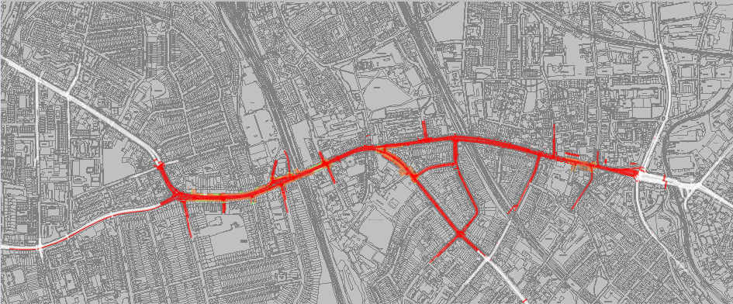
Micro simulation
TfL Network Management commission, audit and develop Vissim models routinely to determine operational impacts of a schemes on London’s road and bus network,
A recent Vissim model had already been developed of the corridor
Solely a highway model (General traffic, bus services, taxis, cyclists),
Pedestrian elements including boarding and alighting of bus services required to be added
COVID-19 pandemic led to an absence of a tailored pedestrian survey, pedestrian count data, Oyster data, Bus boarding/alighting data had been combined to synthesise pedestrian demand scenarios
Notes:
The approach taken was to further develop a highway model that had already been developed by Transport for London previously. The highway model includes bus services, cyclists, taxis, freight and passenger cars. The traffic signals coded in the model uses an emulation of the SCOOT / UTC system that is used on street with UTC-Vissim plug-in.
The baseline modelling was not revalidated (partially due to COVID) once pedestrian elements were added
Design scenarios are not at a developed stage where TfL would ordinarily consider modelling and therefore detailed designs would need to be remodelled in order to consider for delivery on-street. Strategic modelling would often be required for schemes such as these.
Highway Network Extents
White links are those which do not form part of the evaluated highway area
Red links are the evaluated areas

Slide 9
Gyratory Operation Change
Base
PT & PP Scenarios
Notes:
Following feedback on the designs from technical experts, the design options were sifted to those to take forward to modelling. It was decided the 2-way operation of the gyratory within the stress section provided the best opportunity to achieve the design objectives and priorities.
The most challenging aspect of the modelling was the replacement of the gyratory system in the model from the baseline condition to the PTP and PP situations. This crucial change to the modelled network would allow the northern section to be bus and access only (only in green). All signal layouts had to be changed in order to accommodate the change. Traffic to/from the minor road highlighted in 8 was also diverted.
Challenging to develop signal strategy to minimise bus delay and journey times even though new signals have been introduced to provide better pedestrian results,
Although the designs provide high levels of bus priority, there are still areas of the model where high levels of general traffic cause impacts to progression of buses (some short sections where bus lanes are not possible, waiting right-turners, buses struggle to find gaps to overtake buses at bus stops)

Slide 10
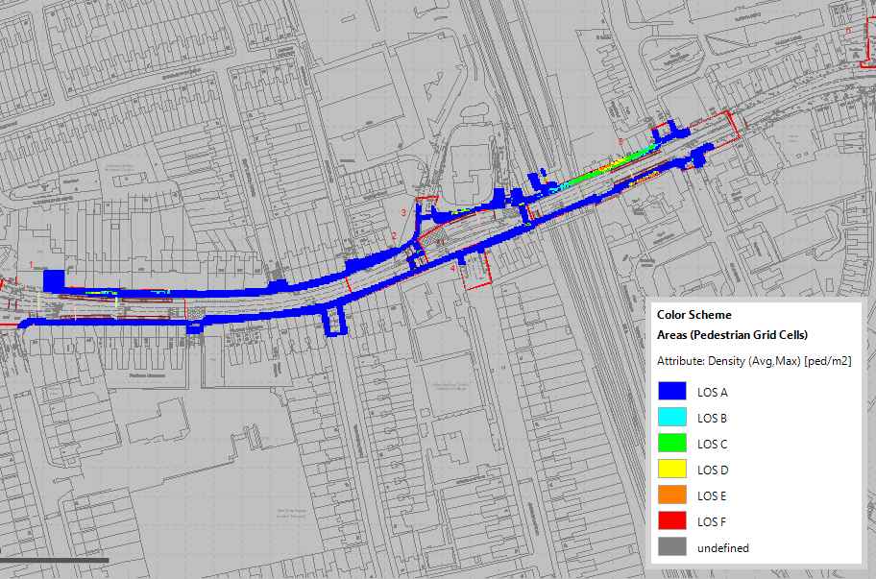
Pedestrian Density
Modelled Area 1, PM Peak (Baseline), Level Of Service (Fruin) – Maximum Density
Modelled Area 1, PM Peak (PT Priority), Level Of Service (Fruin) – Maximum Density
Notes:
The largest difference in density is on the northern pavement of the section on New Cross Road. The high numbers of pedestrians waiting for a bus at that location lead to a very high density of pedestrian on the narrow pavement in that section. As this bus stop has now been consolidated to the bus stop where the red circle is highlighting. In the pedestrian place scenario this area shows LOS A or low density due to the wider pavements allocated.

Slide 11
Journey Time- PM Peak- average speed
 | Average Speed (mph)
 | All | Motorised | Cyclists | Cars (exc Taxi) | Bus
Current
1700-1800 | 6.0 | 5.9 | 9.5 | 5.9 | 6.1
1800-1900 | 7.4 | 7.2 | 10.2 | 7.2 | 7.0
Public Transport Priority
1700-1800 | 6.0 | 5.9 | 9.3 | 5.8 | 6.6
1800-1900 | 6.1 | 5.9 | 9.3 | 5.8 | 6.7
Place Priority
1700-1800 | 6.1 | 6.0 | 8.8 | 5.9 | 6.2
1800-1900 | 5.7 | 5.5 | 8.7 | 5.4 | 6.1
Model results are indicative only and are based on pre-feasibility, non-audited designs of the highway and signal design.
Model results should not be used or relied upon outside of the MORE project.
Notes:
The average speeds in the model shows that the general trend is that the higher speeds are in the Current and Public Transport Priority scenarios, with the exception of motorised vehicles in Place Priority. In contrast to the Current Scenario, the Public Transport Priority and the Place Priority have lower average speeds in all vehicle types in the second hour compared to the first hour. This is due to the build up of queues throughout the modelled time period.
Buses in the Public Transport Priority Scenario have a higher speed in the first hour and a lower speed in the second hour in comparison to the Current Scenario. This shows that the overall lowering of speeds due to queues has an impact on the bus services, however the speed drop is less than the average for cars. The conclusion here, something we see fairly often, is that allocating road space to priority modes alone does not always provide the sought after outcomes desired, as road space priority also needs to be delivered alongside wider policy interventions that reduces the volume of traffic.

Slide 12
5 – Appraisal
Multi Criteria Analysis
 | Option 0 | Option 1 | Option 2 | Option 3 | Option 4
Overall Ranking | 1.0 | 2.0 | 2.0 | 4.0 | 4.0
Overall Score | 69% | 8% | 8% | 5% | 5%
Political and Technical Assessment
Option 0 | Existing layout
Option 1 | PT 2-way PM
Option 2 | PT 2-way IP
Option 3 | PP 2-way PM
Option 4 | PP 2-way IP
 | Number of indicators for which option is best | Number of violations of political priorities | Number of violations of standards
Option 0 | 29 | - | 6
Option 1 | 9 | 3 | 6
Option 2 | 10 | 3 | 6
Option 3 | 10 | 3 | 6
Option 4 | 13 | 3 | 6
Notes:
Each modelled option was inputted into the tool, see below for identifier code of each option. However, the tool required extremely detailed information for the most part which was not available at the scale or detailed level of the stress section for each of the design options. Therefore, the results for each of the appraisal methods should be treated with caution due to the limited data available for input and the subjectiveness of many of the indicators assessed against.
PTA
The Political and technical assessment (PTA) required the same inputs used for the Option generation and road space design tools in terms of political priority considered for each road user/ use and objectives.
Perhaps surprising to see was that the existing road space layout and function performed best against the performance indicators, by a considerable margin, in this appraisal against all of the design options generated. The reason for this is because Option 0 is the best for almost all movement indicators and for all modes. The other design options, particularly the place based options, are best for place indicators, but there are not so many of them with complete data from the VISSIM outputs, hence the aggregate results suggest 0 is best due the quantity of data provided for the movement indicators compared to place.
MCA
Similar to the CBA outputs, this is due to the insufficient data available to input for place based performance indicators and the reduced reporting in comparison to movement performance indicators.
Whilst much of the inputs were automated for the design options performance indicators, the tool required input for maximum and minimum values for each performance indicator per road user group. This was considered to be the most complex aspect of the appraisal tool as the values are subjectively determined by the inputter and impacted by a number of factors. This is further complicated at the spatial level at which the best and worse values should be deemed against comparable to the stress section being analysed.
CBA
The net benefit could not be calculated due to insufficient knowledge of the implementation and maintenance cost of each of the design options modelled. The benefit-cost ratio (BCR) has been calculated based on the change in performance indicators against the Do Nothing option VISSIM outputs.
Whilst the tool was completed to the best of officer abilities, we were not able to produce any results for the BCR due to insufficient data available to make a comprehensive assessment of all options. The Cost benefit appraisal uses only the movement indicators, where a monetary value can be applied. For these indicators, Option 0 is always the best. There is a definitive lack of data on the monetary values of place indicators which is a major limitation. Furthermore, due to limitation as stated above in calculating implementation and maintenance costs for design options, calculating benefit-cost ratios would not be reasonable: there are only costs and no benefits.

Slide 13
Conclusions- Re-designing road space
Reallocating road space to prioritise certain modes doesn’t always result in the anticipated benefits for that mode.
Reallocating road space to meet current and future priorities has to be delivered in conjunction with wider policy interventions
There is a definitive lack of data on the monetary values and benefits of place based indicators which is a major limitation with current appraisal methodologies.

Slide 14
Conclusions- Tools
COVID-19 pandemic severely limited ability to pilot engagement tools with members of the public and online variations of tasks meant they could not be piloted with their intended purposes- conclusions are therefore difficult to draw on effectiveness.
A blank piece of paper for creating road designs is overwhelming- perhaps more so for technical professionals
The appraisal tool requires a level of information that city officers do not have access to which results in making very big assumptions which then compromises results.
Very detailed information required for the concept stage at which the road space designs were at
the VISSIM pedestrian modelling experience gained in the project aligns well with other initiatives being undertaken by TfL

Slide 15
Thank you !
Roisin Naughton
Roisinnaughton@tfl.gov.uk
This project has received funding from the European Union’s Horizon 2020 research and innovation programme under grant agreement No 769276.
This document reflects only the author's view and that the Agency is not responsible for any use that may be made of the information it contains.

