Slide 1
Better streets for better cities MORE final event
17 Februarie 2022 Online
George Lupașcu Constanța Municipality MORE in Constanța
This project has received funding from the European Union’s Horizon 2020 research and innovation programme under grant agreement No 769276.
This document reflects only the author's view and that the Agency is not responsible for any use that may be made of the information it contains.

Slide 2
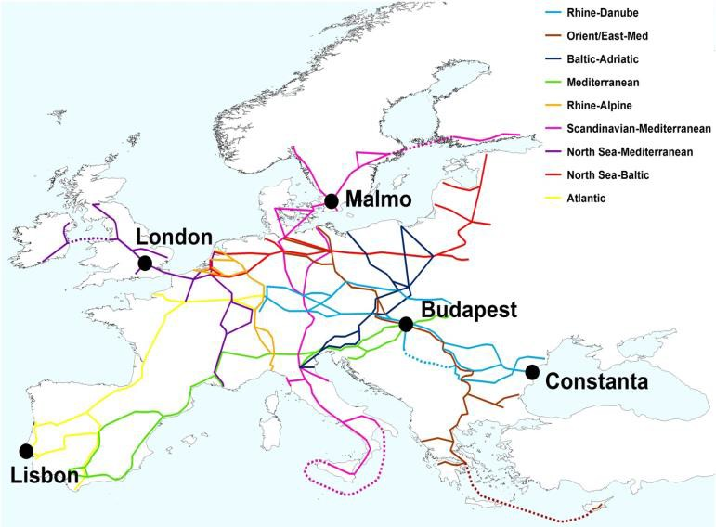
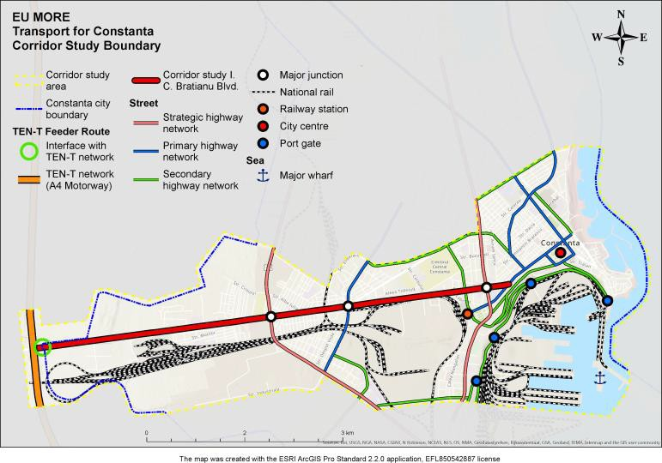
Constanta Feeder Route
DN 3 / Bulevardul I.C. Brătianu (7,5 km) main link to the Rhine – Danube TEN – T network
Section 1: DN3 (1,7 km) – road (90km/h; CNAIR)
Section 2: I.C. Brătianu Boulevard (5,8 km) –
street (50km/h; UAT)

Slide 3
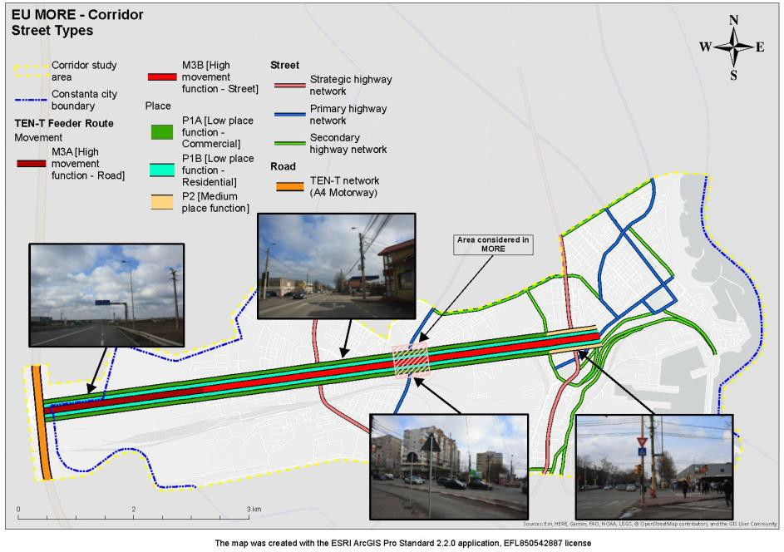
Feeder route assessment
Activities
Stakeholders analyses
Identification of the existing data (traffic, environment etc.)
Analyses of the actual street functions (”Link and Place”)
Identification of the development objectives
General issues
Traffic congestion
Lack of alternative transport mode facilities
Safety and security
Infrastructure not adopted to the needs of people with reduced mobility
Parking (illegal parking)
Air pollution and noise

Slide 4
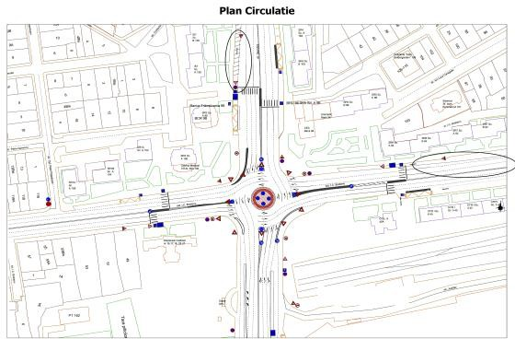
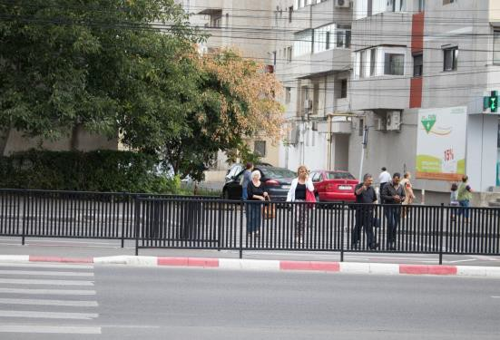
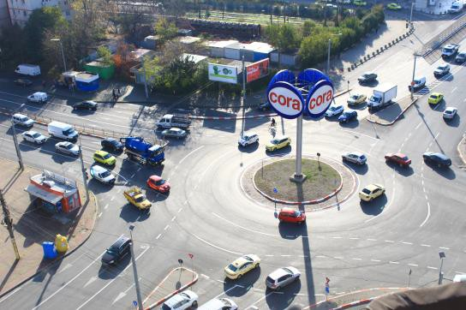
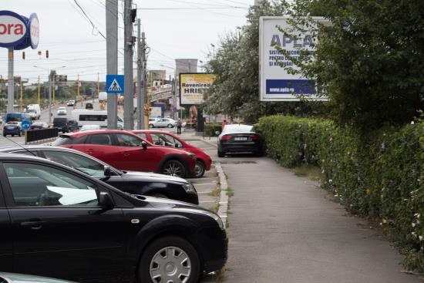
Constanta Stress Section
important connexion point
provides all urban functions (housing, health, education, business, leisure etc.)
4.000 inhabitants
40 businesses
37.295 pedestrians/day
public transport hub (local and
metropolitan)
8.267 PT users/day
61.730 vehicles/day

Slide 5
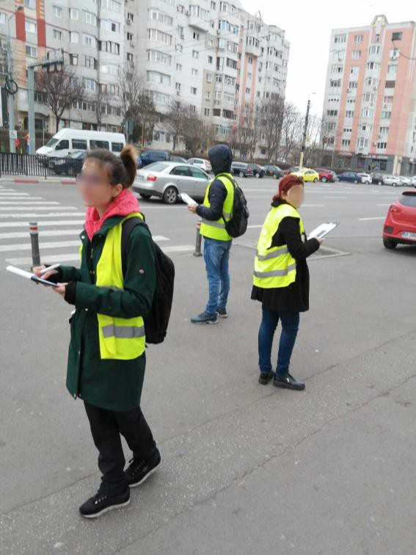
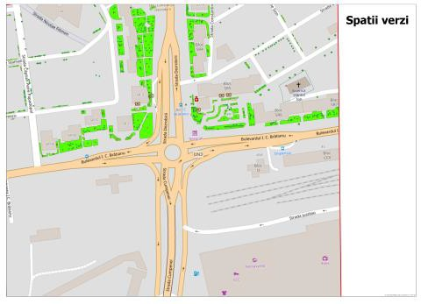
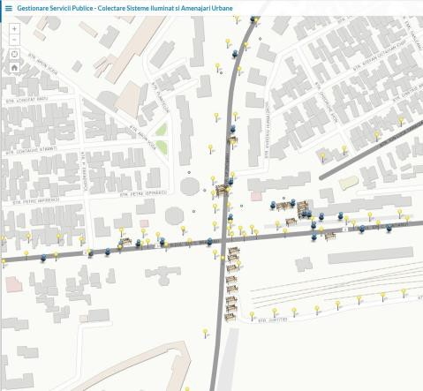
Quantitative data collection
Demand side
Supply side
Street geometry
street markings
parking places
bus stations
crossings
street furniture
green areas
attraction points (schools, parks, shops etc.)
Pedestrian activities,
(volumes,
street
crossings etc.)
Public
service of users
transport and number
Cars (volumes, ques
in junction, travel time
between junctions,
kerb side activities)
Traffic composition
5.11% _{1.47%}
0.26%
0.17%
92.99%
Bicycle
Car
Light freight vehicles Heavy freight vehicles Bus

Slide 6
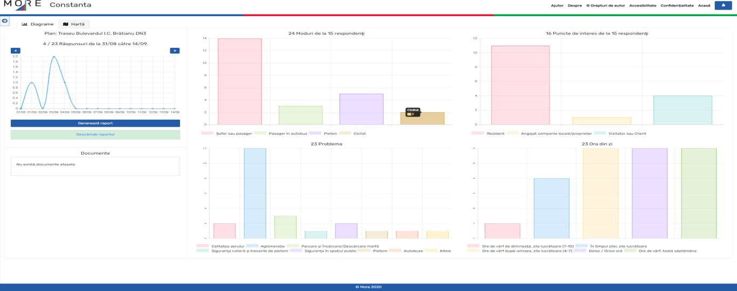
Qualitative data collection using the Traffweb tool

Slide 7
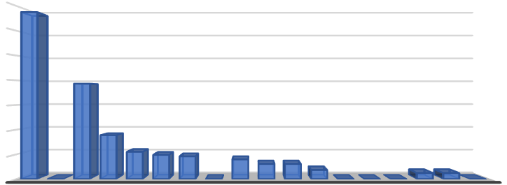
Qualitative data collection through street interviews
Street users perception regarding the Stress Area
1 day (during a working day in summer)
The means of transport used to travel in the review area
40%
20%
40%
20%
0%
163 respondents (97 locals, 61 visitors and 5 economical agents)
Questionnaire - 13 questions + 7 thematic
appreciation
10% 10% ^{18%}
0% 1% 1%
Stress area – positive aspects
67%
Stress area – negative issues
70%
60%
50%
40%
30%
20%
10%
0%
No garbage bins
No parking spaces
No urban 5% furniture
6%
Noisy
7%
4%
39%
Congested traffic 23%
18%
^{11%}10%9%
0% 0%
^{8%} 6% 6%
^{4%} 0% 0% 0% ^{2% 2%} 0%
No traffic lights 7%
Insufficient sanitation service 15%
Dirty 10%
No green areas Messy 10% 13%

Slide 8
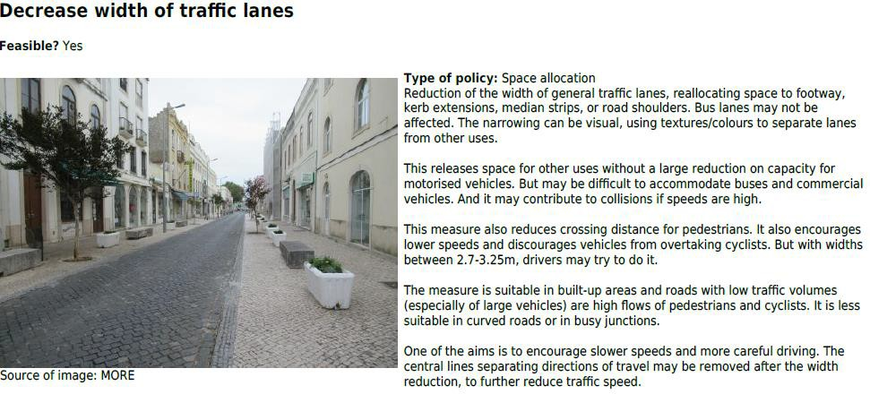
Generating ideas for design options
Public stakeholders engagement
4 online meetings
Municipality departments/ local public companies/ CNAIR / Traffic police/ ZMC / EIP
Policy intervention tool
Road design tool

Slide 9
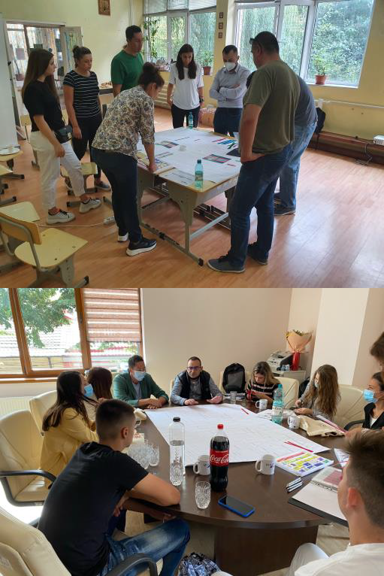
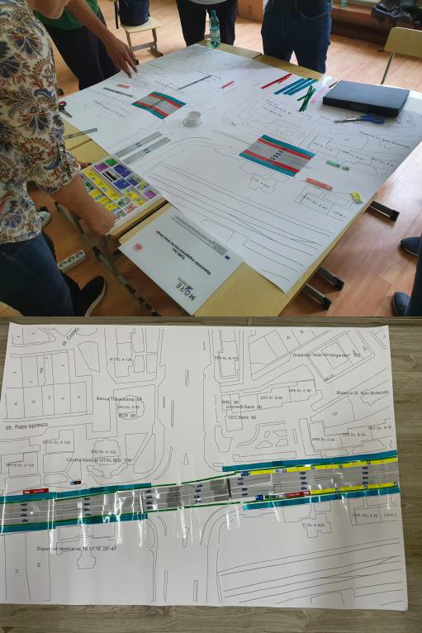
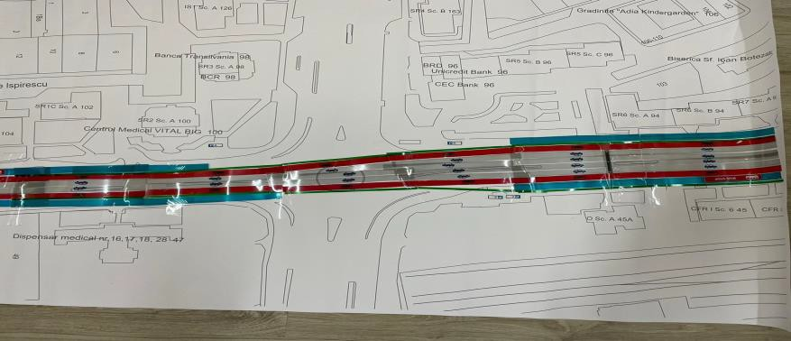
Design days with citizens
Blocks and acetates
2 meetings
2 maps
Very challenging !!!

Slide 10
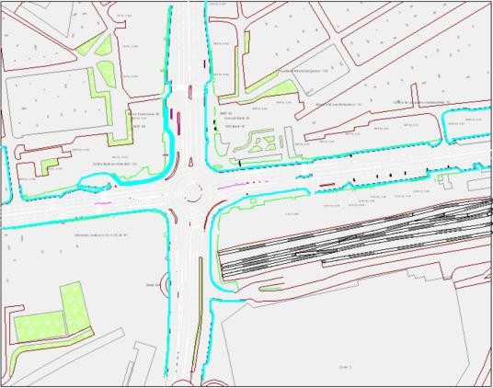
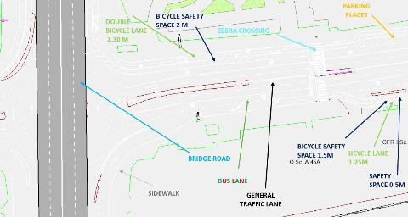
Establishing the scenarios for modelling
2 in-house meeting (Municipality departments + external
modelling expert)
Introduction of dedicate bus lanes along the hole Feeder route and the elimination of all parking spaces.
Increasing the frequency of the PT service with 100%, keeping the same street geometry as in previous scenarios (introducing bus lanes).
Introduction of dedicated bike lanes and eliminating one vehicle lane.
Increasing the sidewalks surface + speed reduction for cars (30 km/h).
Traffic light signalized junction
Over ground passage for vehicles is built above the Feeder Route
Over ground passages for pedestrians
Combined scenario no. 1 (design day 1 map – bus and cycle lanes)
Combined scenario no. 2 (design day 2 map – traffic light junction, cycle lanes, parking places for cars/bikes)
Combined scenario no. 3 (over ground passage for vehicles, bus and cycle lanes)

Slide 11
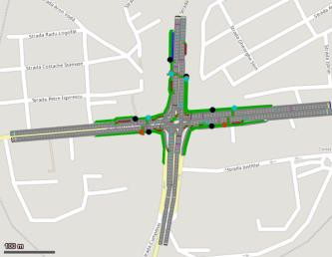
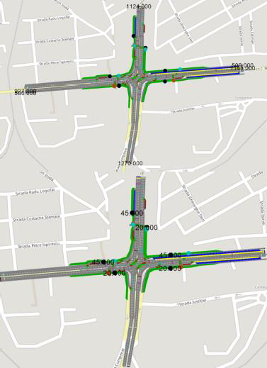
Building and applying the PTV simulation model
external company
AM/PM scenarios
Building the model
Building the base line model
Input data (street geometry, speed, traffic volumes)
Output data (average travel
Code | Description | Data
OM_in1 | Unique Identifier for option | CON_S9_1010_2021_M_0_ABFGJKLM
OM_in2 | Screenshot of the modelled network (including all network objects and scale bar)
OM_in3 | Desired speed distribution (name of standard distribution or values of individual distributions) | 50 km/h
OM_in4 | Entering vehicle input volumes
OM_in5 | Pedestrian input volumes
OM_in6 | Pedestrian distancing values (modelling parameters e.g. due to COVID-19 social distancing) | Not used
Code | Description | Data
OM_out1 | Unique Identifier for option | CON_S9_1010_2021_M_0_ABFGJKLM
OM_out9 | Average travel time [s/veh] = Total of travel times / number of vehicles - at network level - for motorised vehicles and bicycles - average across simulation runs | 142.07
OM_out10 | Variance and 95% percentile of average travel times across simulation runs - at network level - for motorised vehicles and bicycles
OM_out11 | Average travel time [s/veh] = Total of travel times / number of vehicles [for the stress section] - for motorised vehicles and bicycles - average across simulation runs | Not applicable
OM_out12 | Variance and 95% percentile of average travel times across simulation runs [for the stress section] - for motorised vehicles and bicycles | Not applicable
OM_out13 | Average delay [s/veh] = Total of delay / number of vehicles - at network level - for motorised vehicles and bicycles - average across simulation runs | 142.07
OM_out14 | Variance and 95% percentile of average delay across simulation runs - at network level - for motorised vehicles and bicycles
OM_out15 | Average delay [s/veh] = Total of delay / number of vehicles [for the stress section] - for motorised vehicles and bicycles - average across simulation runs | Not applicable
OM_out16 | Variance and 95% percentile of average delay across simulation runs [for the stress section] - for motorised vehicles and bicycles | Not applicable
OM_out17 | Average delay stopped [s] - at network level - for motorised vehicles and bicycles - average across simulation runs | 113.83
OM_out18 | Variance and 95% percentile of delay stopped across simulation runs - at network level - for motorised vehicles and bicycles
OM_out19 | Average delay stopped [s] [for the stress section] - for motorised vehicles and bicycles - average across simulation runs | Not applicable
OM_out20 | Variance and 95% percentile of delay stopped across simulation runs [for the stress section] - for motorised vehicles and bicycles | Not applicable
OM_out21 | Average speed [km/h] or [mph] = total distance / total travel time - at network level - for motorised vehicles and bicycles - average across simulation runs | 6.02
OM_out22 | Variance and 85% percentile of average travel speeds across simulation runs - at network level - for motorised vehicles and bicycles
OM_out23 | Average speed [km/h] or [mph] = total distance / total travel time [for the stress section] - for motorised vehicles and bicycles - average across simulation runs | Not applicable
OM_out24 | Variance and 85% percentile of average travel speeds across simulation runs [for the stress section] - for motorised vehicles and bicycles | Not applicable
OM_out36 | Environmental impact (CO, NOx; VOC, Fuel Consumption by node evaluation) - on network level - average across simulation runs | N/A
time, average
delays, stopping,
average delays speed)

Slide 12
Appraisal of designs
Appraisal methods
Roaduser
Use
Priority
Objective
Priority
Pedestrians
Walk
Cross the road Stroll
Sit (street furniture) Sit (outdoor café)
2
Movement | Increase number of trips Reduce travel time Increase travel time reliability Reduce congestion Improve trip quality Achieve a more sustainable modal split
Place | Facilitate place activities (e.g. people sitting) loading) Improve access to local buildings
Road operation | Improve resilience (to weather conditions) Increase flexibility (to different road uses)
Wider objectives: economic | Reduce costs of transport Promote local economy
Wider objectives: social | Improve traffic safety Reduce community severance Increase personal security Promote physical activity/health Promote social interaction Promote social inclusion Increase wellbeing
Wider objectives: environment | Increase green space Improve air quality Reduce noise Protect soil/water and reduce flood risk Improve local climate Reduce energy consumption Improve regional/global environment
Cost/benefit analysis
Multi-criterial analysis
Technical/ political assessment
2
1
2
Pedestrians (restricted mobility)
Walk
Cross the road
2
2
Cyclists
Move Park
Rent (dock) Rent (dockless)
2
Assessed scenarios
Combined scenario no. 1 (design day 1 map – bus
and cycle lanes)
Combined scenario no. 2 (design day 2 map – traffic light junction, cycle lanes, parking places)
Input data
2
2
1
Micromobility (scooters, skates,etc.)
Move
1
Bus drivers
Move Stop
2
1
Bus passengers
Move Wait
1
2
Rail/metro/bus passengers
Interchange
2
Car drivers
Move Park Stop
1
1
0
Car share users
Park
0
Motorcyclists
Move
0
Taxi drivers (inc. ride-hailing)
Wait
1
Taxi passengers (inc. ride-hailing)
Wait
1
Street geometry
Movement function (volumes, speed, delays)
Place function (users activities)
Wider impacts (economic, social, environment)
Goods vehicles
Move Stop
1
1
Emergency vehicles
Move Stop
1
1
Service vehicles
Stop
1
1
 | Number of indicators for which option is best | Number of violations of political priorities | Number of violations of standards
Option 0 (Do nothing) Base line | 20 | - | 4
Option1 Combined scenario no. 1 | 6 | 15 | 2
Option2 Combined scenario no. 2 | 10 | 12 | 3

Slide 13
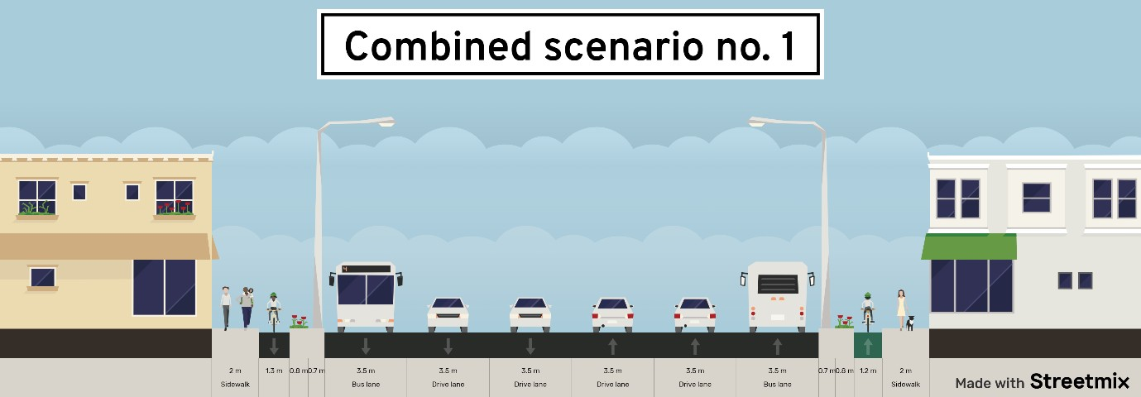
Winning street design option
Inclusive design, considers all users needs
Good results both in simulation and appraisal
Aligned with City development objectives
Similar with the designs off the major Boulevards that are refurbished

Slide 14
Thank you!
George Lupascu
george.lupascu@primaria-constanta.ro
This project has received funding from the European Union’s Horizon 2020 research and innovation programme under grant agreement No 769276.
This document reflects only the author's view and that the Agency is not responsible for any use that may be made of the information it contains.

