Slide 1
MORE Workshop Advances in technologies and future scenarios
Rebecca Sterynowicz, Transport for London
This project has received funding from the European Union’s Horizon 2020 research and innovation programme under grant agreement No 769276.
This document reflects only the author's view and that the Agency is not responsible for any use that may be made of the information it contains.

Slide 2
What is scenario planning and why is it useful
Change and uncertainty are always with us, but the last few years have felt even more uncertain than ever
Even before COVID 19 we were seeing changes to long term travel trends – fewer leisure and discretionary trips, changing demographics, falling bus use.
Scenario Planning involves developing multiple scenarios to describe an end-state of a plausible futures made up of inter-related factors.
This enables us to consider a range of futures, and how our long term policies and transport schemes fit in with them, rather than a single central forecast.

Slide 3
In 2020 we developed five scenarios to explore the implications of COVID 19 on travel in London
The scenarios are:
Fixed end points for 2031
Based on qualitative insights
Narratives to help us explore policies or schemes

Slide 4
These 5 COVID 19 scenarios help us assess our schemes and policies by looking at a range of key indicators

Slide 5
We've built on these scenarios by developing a fully modelled Hybrid Forecast
The Hybrid Forecast is the based on emerging data from the scenario key indicators
As the pandemic continues new data has been released about its impacts and different travel trends (more local travel for example)
The Hybrid Forecast takes this new data and creates a flexible dynamic forecast about where we are now.
It is fully modelled to provide quantitative outputs to assess transport schemes
It is designed to be used alongside the Reference Case

Slide 6
The Reference Case and hybrid forecasts provide two points within a range of uncertainty to inform assessments
Inputs | Reference case |  | Hybrid Forecast
Population 2030 | 10 million in line with London Plan projections |  | Even slower growth to 9.5 million between GLA’s Low and Central Lower trend
Employment |  | London’s economic growth continues throughout the 2020s | London’s economy follows a more central trend with recovery towards the end of the 2020s. However there are higher levels of unemployment in the short term and economic scaring in some sectors
Working from home |  | No change in the levels of home working | Even more working from home in office jobs, for those on higher incomes and for offices located in Central London than Hybrid v1 leaving overall commuting trip rates at 75-80% of 2018 levels
6

Slide 7
Inputs | Reference case |  | Hybrid Forecast
Propensity to use sustainable modes |  | Attitudes towards public transport modes are unaffected. There is a small increase in willingness to cycle | In the main people return to public transport quite quickly but a small minority remain uncomfortable. Some who enjoyed cycling during lockdown make a permanent change in early 2020s but by the 2030s this is indistinguishable from a general increase in the propensity to cycle
Car ownership |  | Car ownership falls as population growth encourages use of sustainable modes, together with London Plan policy of reduced parking supply and increased parking charges | Car ownership falls as population growth encourages use of sustainable modes, together with London Plan policy of reduced parking supply and increased parking charges. The rate is lower than the reference case as housebuilding is not at the same rate. Some of those put off public transport buy a car
Shopping |  | Large shopping centres remain attractive, and the proportion of retail floorspace grows. All shopping trips increase | A shift towards online shopping means that shopping trip rates decline. People are not so inclined to travel long distance to shop and large shopping centres do less well. The CAZ retains some of its attractiveness due to specialist shops
Leisure |  | Leisure trips increase with population growth, and spatial distribution of leisure remains consistent with pre-Covid | Greater flexibility during the working day means that home based discretionary trip rates hold despite some activities possible online. However, there is a decrease in these trips that do not start from home.
7

Slide 8
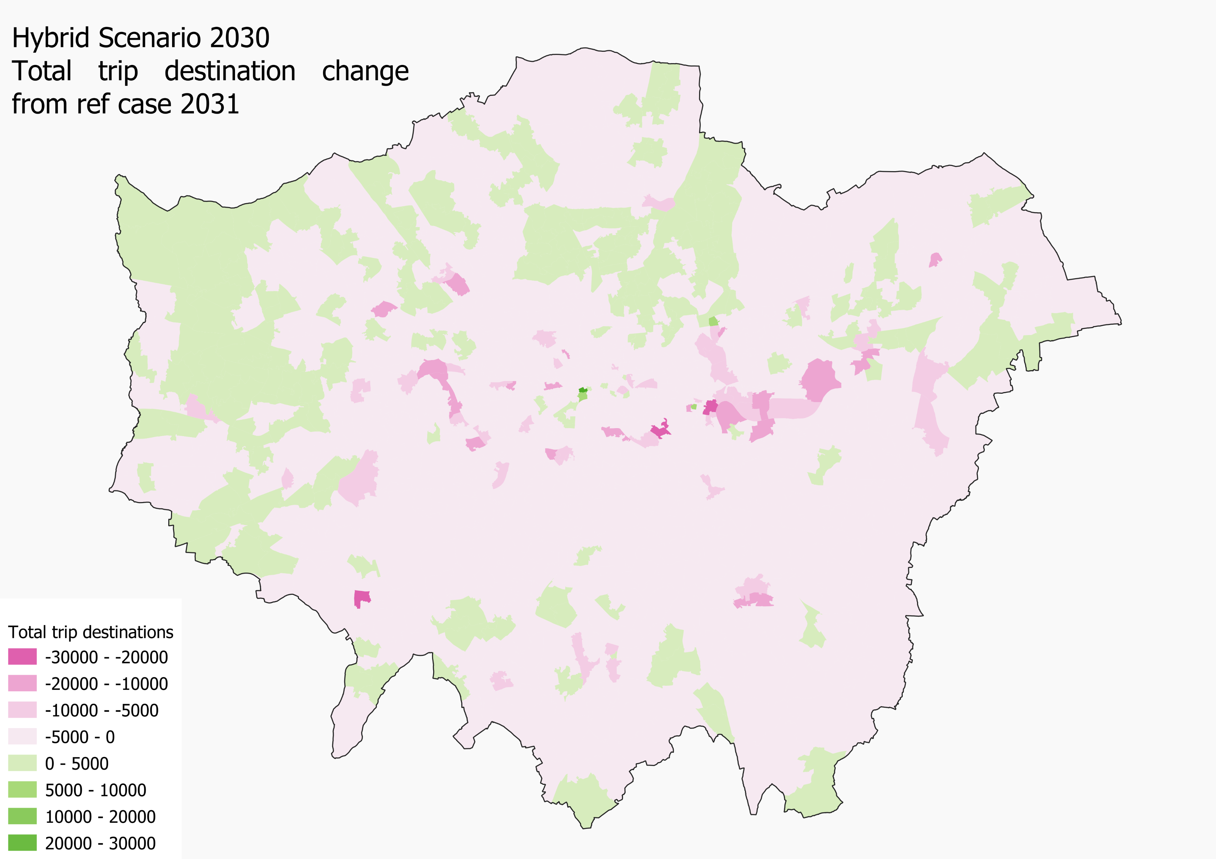
As a result, the Hybrid Forecast has less overall travel demand than the Reference Case
The hybrid forecast and reference case both see an overall increase in trips, however the magnitude of the change and the distribution of these trips differs in the two scenarios
The reference case has higher growth in most Central and Inner London destinations as in the hybrid forecast, home working reduces the need to travel
The hybrid forecast sees some increases in trips in Outer London compared to the Reference Case as home based trips make up a larger proportion of travel
Decline in commuting rates leads to decline in bus and rail compared to 2030 ref case
The hybrid forecast sees increases in car use and cycling, focused away from central London
Change in total trip destinations between hybrid forecast and reference case 2030
Green areas are where the hybrid forecast has more trips than the reference case, pink areas where there are fewer trips than the reference case

Slide 9
Over the last few months, we've used the scenarios and Hybrid Forecast to inform our decisions
Policies such as the recent changes to the congestion charge have been assessed using both forecasts
Infrastructure projects have been limited, but externally sponsored work such as Abbey Wood to Ebbsfleet considered both the Hybrid and Reference Case forecast
The Hybrid and Reference case informed the 2020 financial sustainability plan

Slide 10
Next steps for scenario planning
We are currently reviewing our scenarios to continue exploring uncertainty
Reviewing the whole process to move away from being COVID 19 scenarios. For example to include climate change
Future remains uncertain and scenarios have the ability to help us better reflect this in our planning
For more information on this topic, please see Travel in London 14, chapter 12

Slide 11
Thank you
This project has received funding from the European Union’s Horizon 2020 research and innovation programme under grant agreement No 769276.
This document reflects only the author's view and that the Agency is not responsible for any use that may be made of the information it contains.

