Slide 1
TEN-T FOR SUSTAINABLE MOBILITY
Emmanuel Dommergues
UITP
Organising Authorities Committee Senior Manager
Head of the Governance Unit
This project has received funding from the European Union’s Horizon 2020 research and innovation programme under grant agreement No 769276.
This document reflects only the author's view and that the Agency is not responsible for any use that may be made of the information it contains.

Slide 2
Who we are? We are the only worldwide network to bring together all public transport stakeholders and all sustainable transport modes.

Slide 3
TEN-T and sustainable mobility

Slide 4
COVID19 restrictions on our day life and mobility were associated with:
Less car traffic: more space for walking, cycling, PT and for place-related activities
Free public space & enjoyable urban perspectives & landscape
Less air pollution & blue skies
Less noise & birds singing

Slide 5
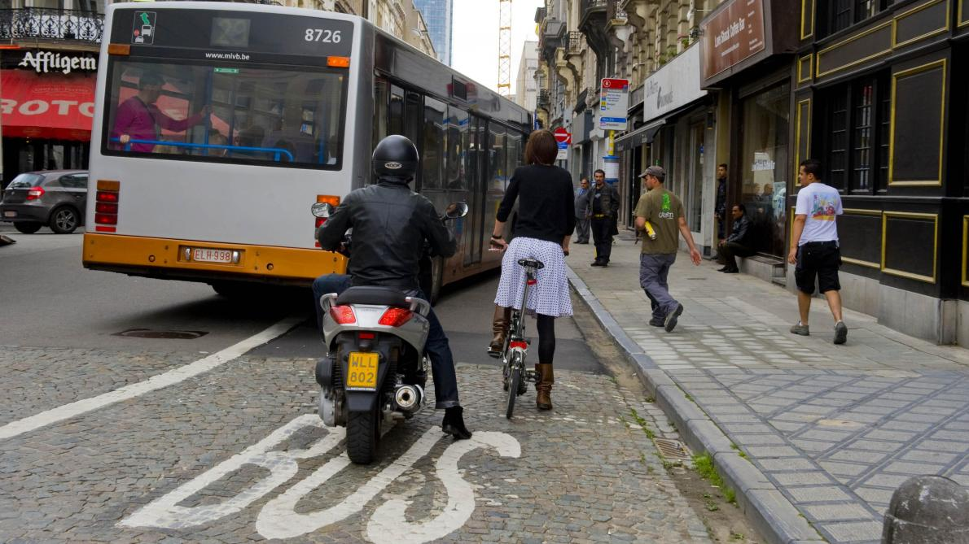
Access, Access, Access
Aims of mobility strategies & policies
Improve access to… activities, jobs, friends, culture, nature…
Facing high level challenges:
Climate change mitigation, reduction in pollution
Equity and social justice
A dynamic city

Slide 6
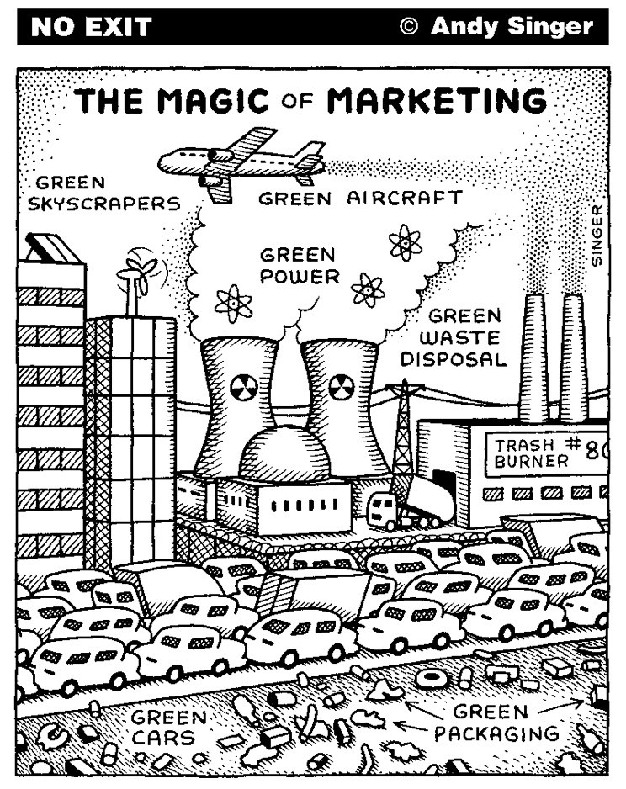
Our vision
1. Public transport as the backbone of our mobility systems
Regaining trust
Adaping to new lifestyles & rythms
Looking at new geography
Providing integrated and door-to-door solutions
2. Integration, combinaision, and intermodality
Offer a bundle of services
Provide door-to-door services
Provide real and virtual services
3. Decarbonisation: let’s focus on the right mode!
E-cars divert the attention from modes that are clean and adapted to the city
E-cars consume as much space
Traffic jams do not disappear with e-cars
E-cars represents a strain on public finance, on investment priorities, on energy provision
BUT shared e-cars provide much more!

Slide 7
What UITP has looked at
Governance
Models to regulate new mobility services
Street space design to promote sustainable mobility
Demand Management Strategies
Mobility Hubs
Data sharing Stratégies for Authorities
Managing conflicts between bicycles and buses

Slide 8
Demand Management
Traditional focus:
Develop the supply and demand will follow
Does not manage structural supply/demand inbalance
Shift in focus of transport and mobility policies:
Understand the demand for transport: what will be the new normal in post-COVD times?
Influence the demand for mobility:
Modal shift
Change in destination, change in time
Demobility
A major tool for Transport & Mobility strategies

Slide 9
Mobility Hubs
Traditional focus:
Develop efficient interchange between transport modes
Does not consider access to…
Shift in focus of transport and mobility policies:
Transform a transport interchange into a mobility interchange
A variety of transport solutions
Real and virtual mobility
Activities and life
A practical project to transform mobility practices locally

Slide 10
Lessons for TEN-T (1/2): goal
TEN-Ts play a key role in the daily mobility of Europeans and is at the core of the attention of European, National, and local strategies and investment plans.
For TEN-T to contribute to a sustainable way of moving around, attention should focus on:
Different functions: movement & place
For movement:
to ensure Public Transport is the backbone
to promote multimodality
For place:
PT and sustainable modes free up space that can be dedicated to other functions
A design and management to improve: #Access, #PublicTransportPriority, #Multimodality

Slide 11
Lessons for TEN-T (2/2): challenge
Looking at a specific functions of TEN-T:
Connecting several cities and linking them to the rest of the Union?
Serving different zones of a city with different urban fabric, with different needs: surburban, industrial zones, densed and lively areas
Looking at the TEN-T from a City perspective:
Outline the different functions of TEN-T networks
Define its roles and functions in the whole transport network and urban area, looking at different scales
SUMPs
Public engagement and political decision:
Integrate different scales of public interests in outlining main design options
Dealing with contradictory goals

Slide 12
UITP messages

Slide 13
Joint Stakeholder statement on the EU’s Urban Mobility Framework
Clean collective mobility must be a priority for towns and cities if Europe is to achieve its climate targets and improve quality of urban life.
Affordable and attractive public transport and active mobility (walking and cycling) should be central to the future Urban Mobility Framework and have a key role to play in decarbonising urban transport, improving air quality, facilitating social cohesion and accessibility for all, including for persons with disabilities, and connecting rural areas to cities.
Multimodal integration must happen first and foremost on the ground: through a sufficient offer of (accessible) collective and shared services, high quality infrastructure for walking, cycling and public transport, and more stations becoming multimodal.
EU should ensure that all cities that are urban nodes on the TEN-T network and as many other cities as possible produce a high quality SUMP or have a similar strategy document in place by 2025.
SUMPS should prioritise public transport and multimodality when it comes to building new infrastructure or attributing road space to transport modes.
The adoption of a SUMP could become a precondition for access to additional European funding instruments, provided that cities have the capacity and resources to set up SUMPs.

Slide 14
Emmanuel Dommergues
This project has received funding from the European Union’s Horizon 2020 research and innovation programme under grant agreement No 769276.
This document reflects only the author's view and that the Agency is not responsible for any use that may be made of the information it contains.

